Slide 1
2023 PROJECTS UPDATE

Slide 2
2023 was an exciting year that saw the arrival of many long-awaited large projects that have been planned for many years. Some of these include:
The Franke Park Phase I Renaissance Project
Phase IIa Riverfront Project
The Mechanic Street Bridge Improvement Project

Slide 3
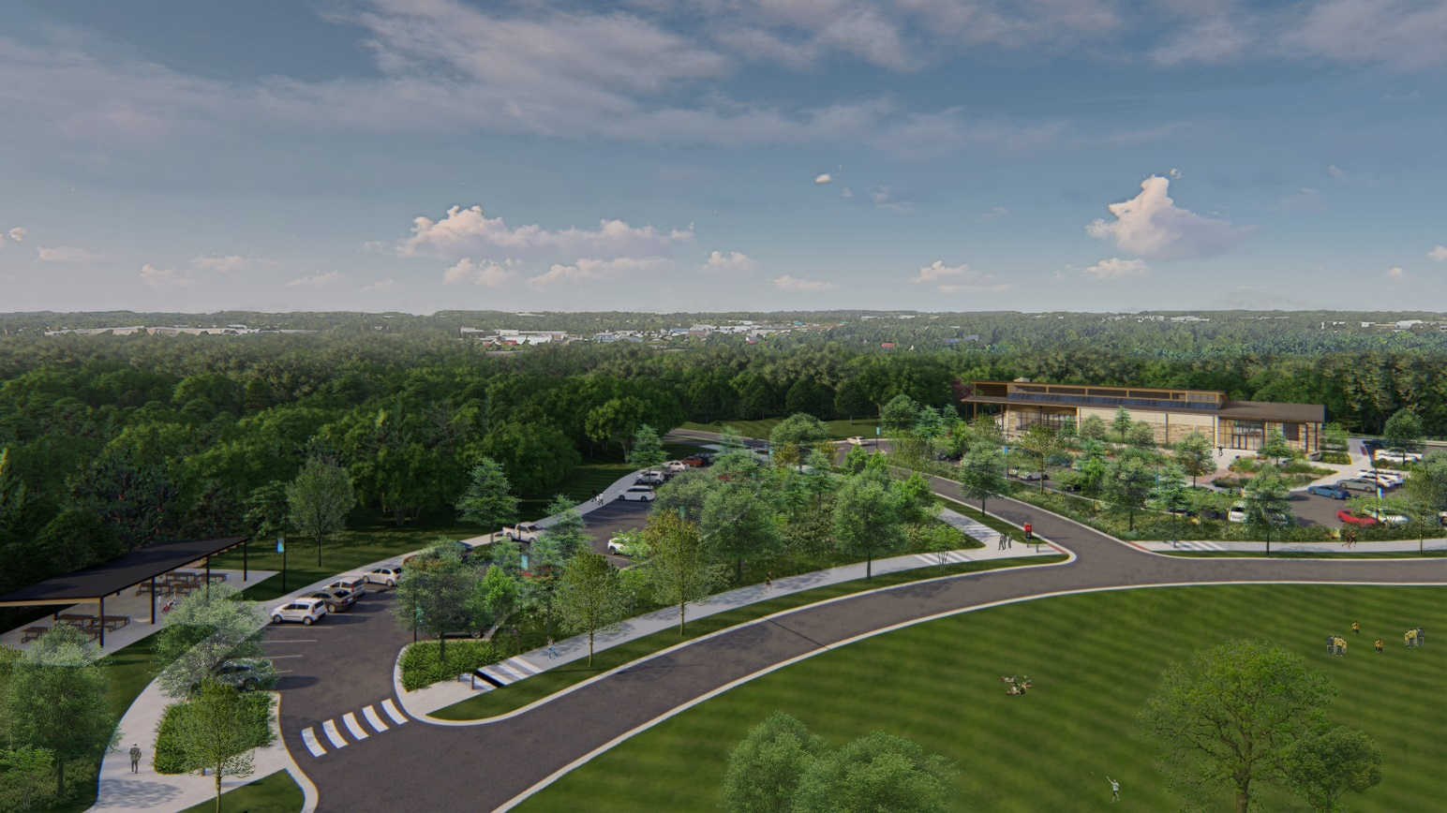
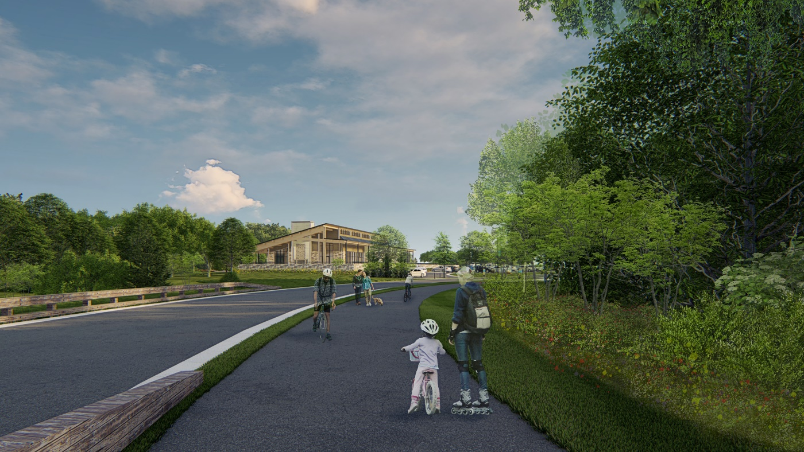
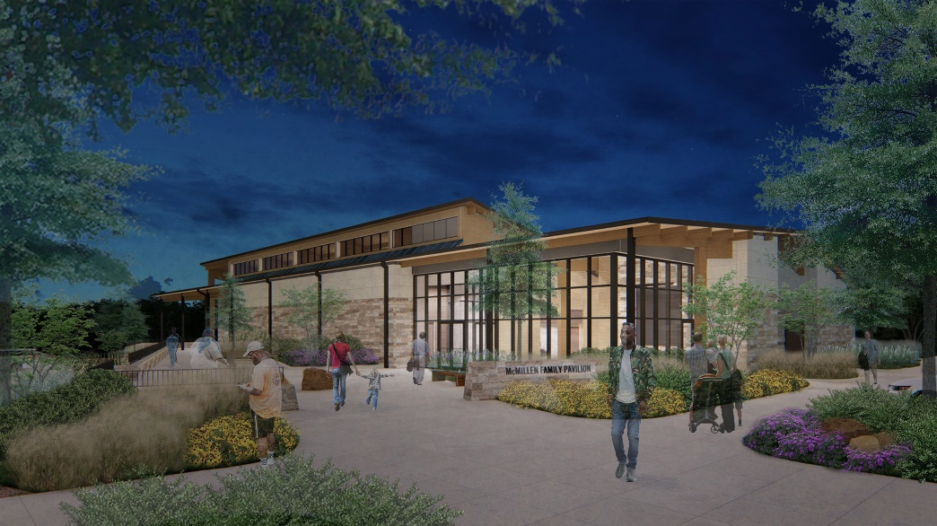
Franke Renaissance
Includes new entrance off Goshen Road, new bridge over Spy Run Creek, new 400 capacity year-round rental pavilion, and lots of new trails and parking

Slide 4
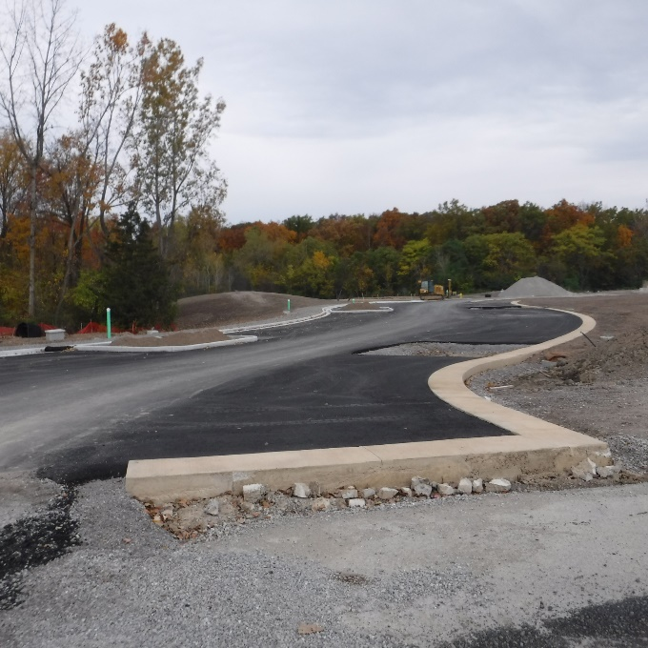
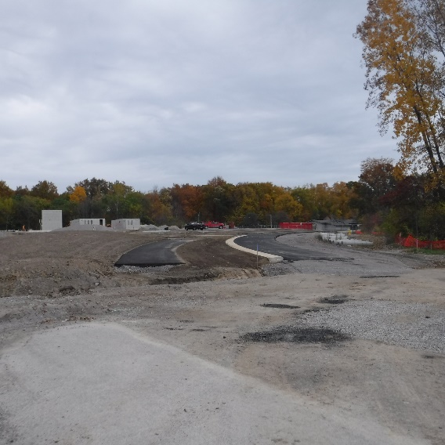
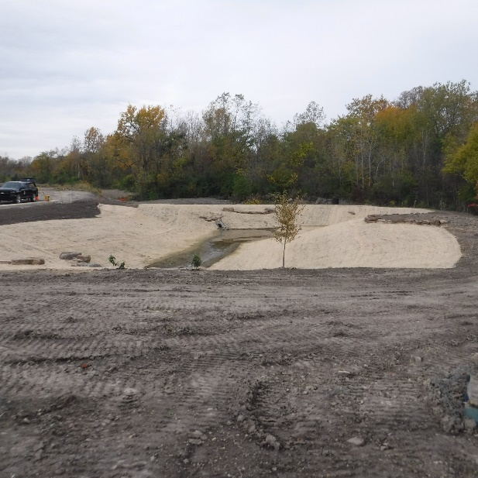
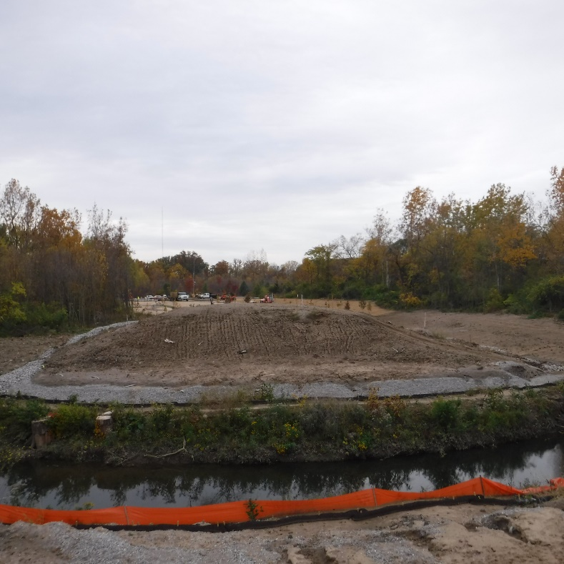
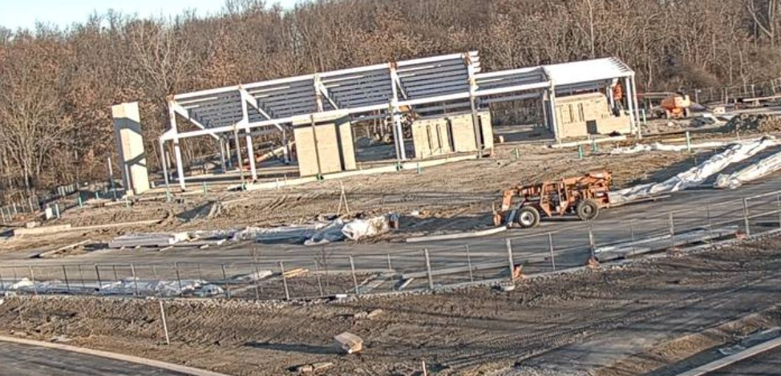
Franke Renaissance – Work in Progress

Slide 5
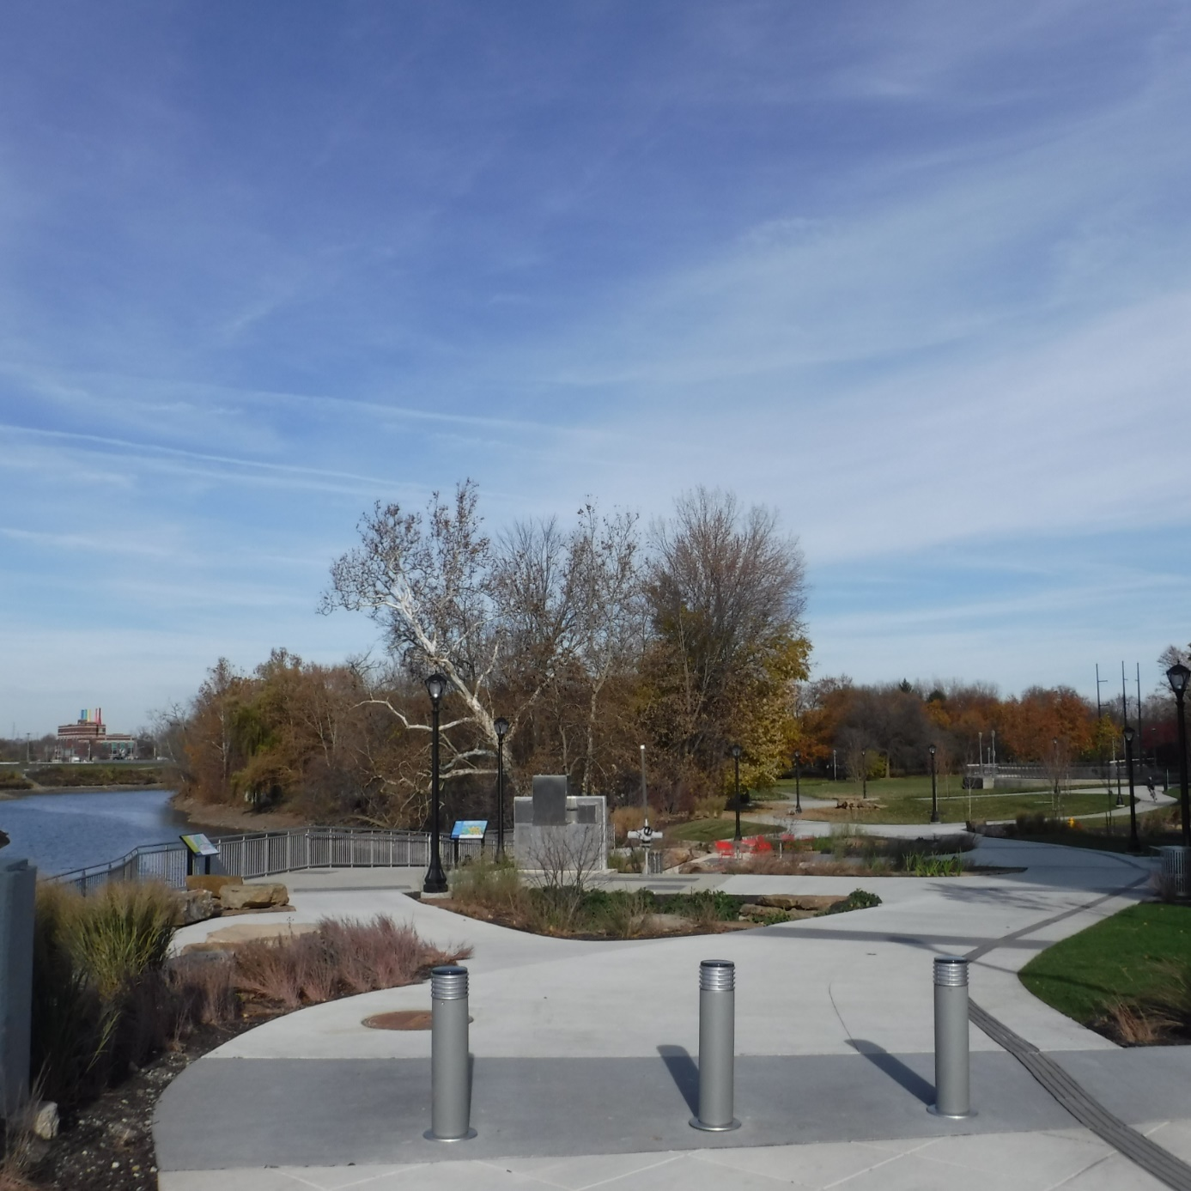
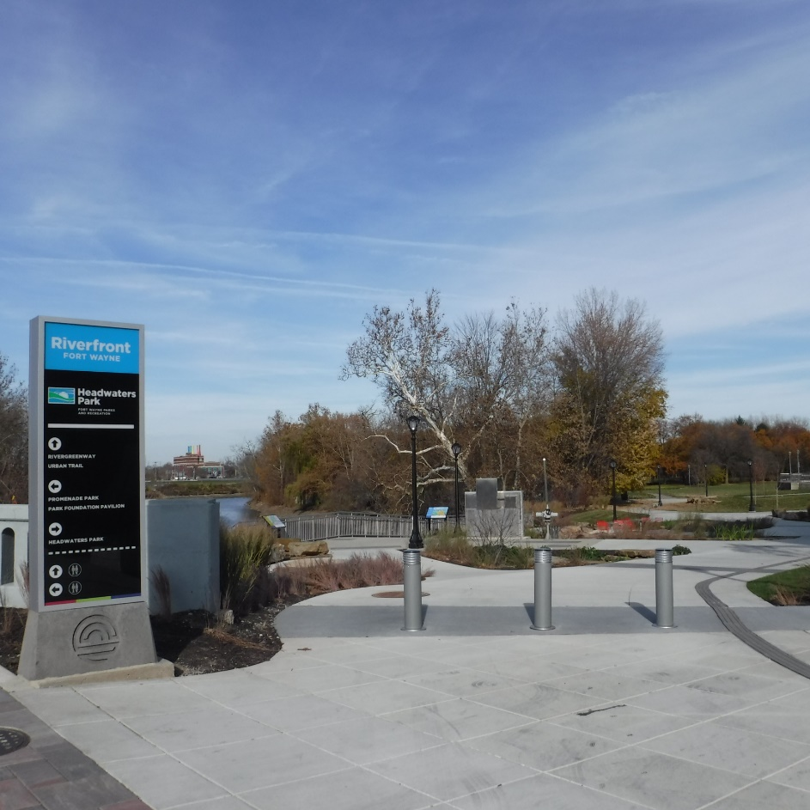
Riverfront Phase IIa
Consists of new river overlook area, landscaping, and walking paths that connect Headwaters Park with Promenade Park

Slide 6
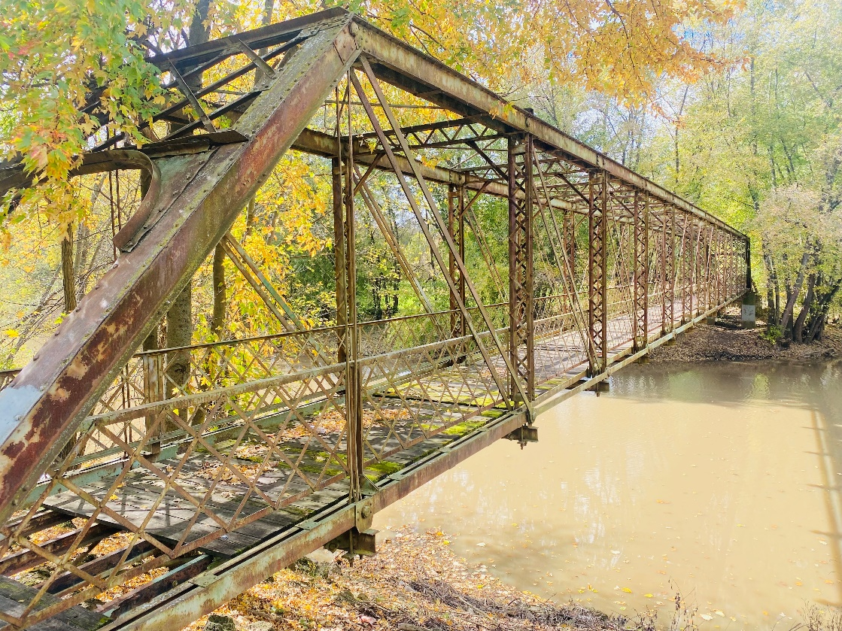
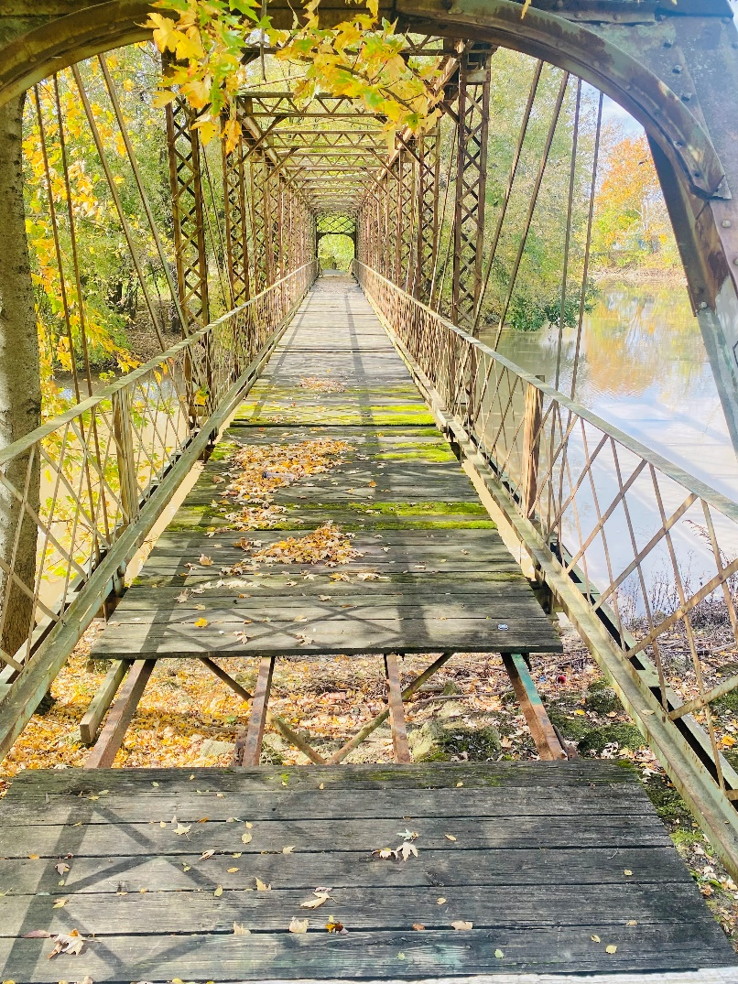
Mechanic Street Bridge

Slide 7
This year also began planning for multiple parks master plans. These include:
Brewer Park Master Plan
Foster Park Golf Master Plan
Hanna Homestead Master Plan
Moody Park Master Plan

Slide 8
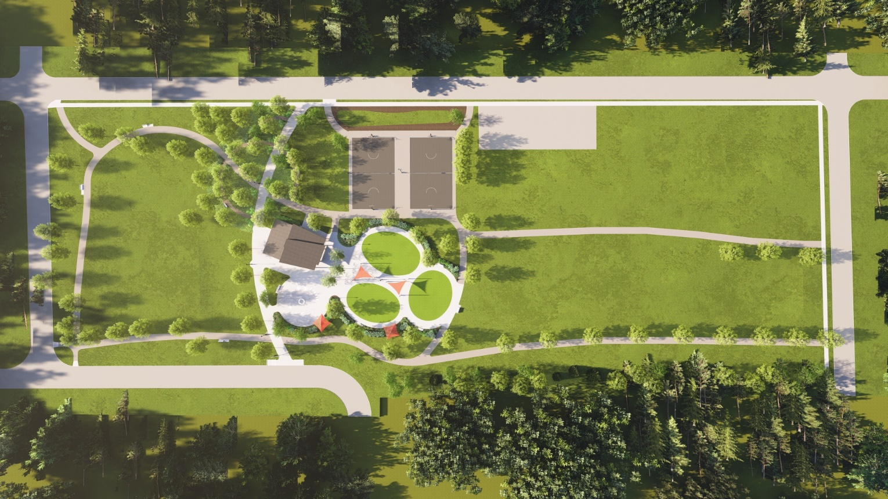
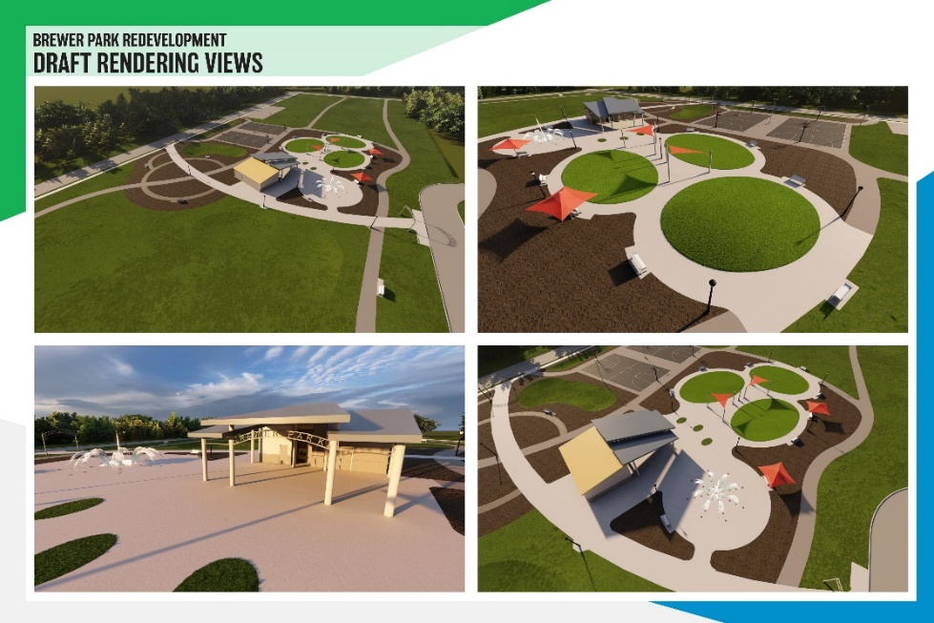
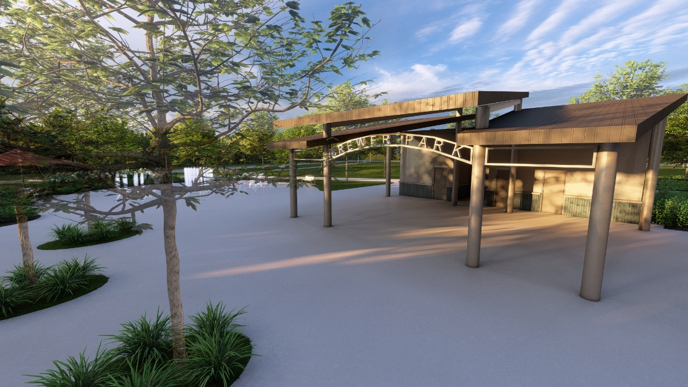
Brewer Park Master Plan
Project includes a new restroom building with shelter, a picnic area,a new playground, a splashpad, two new basketball courts, and new walking paths.

Slide 9
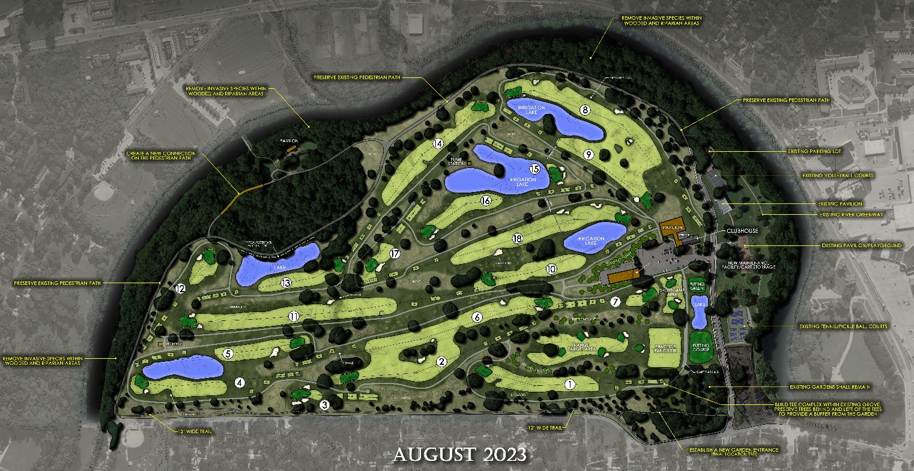
Foster Golf Master Plan

Slide 10
Hanna Homestead Master Plan

Slide 11
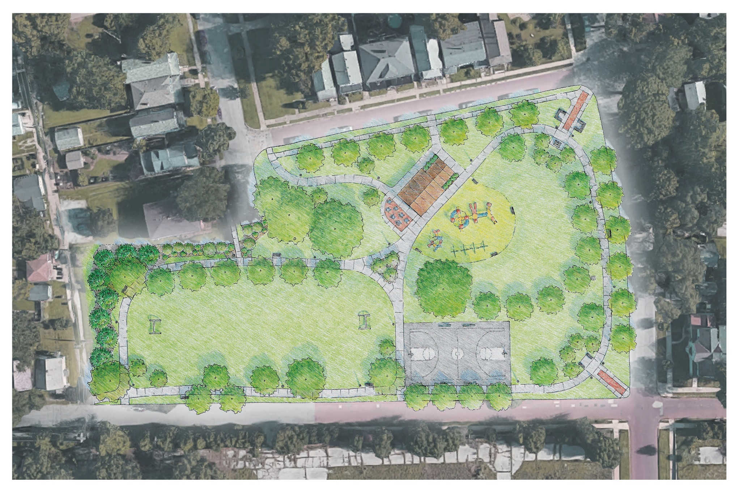
Moody Park Master Plan

Slide 12
Finally, some exciting news… 2023 brought the expansion of the Parks Department by three parks this year with the addition of
McKinnie Commons Park
Powell Park
Sheldon Park
Thus bringing the total number of parks to 89.

Slide 13
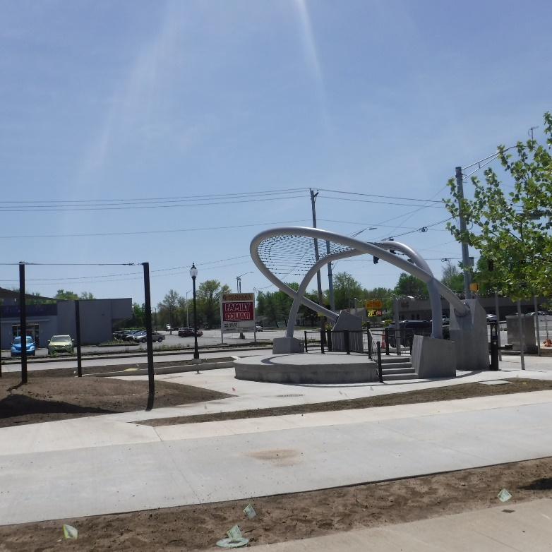
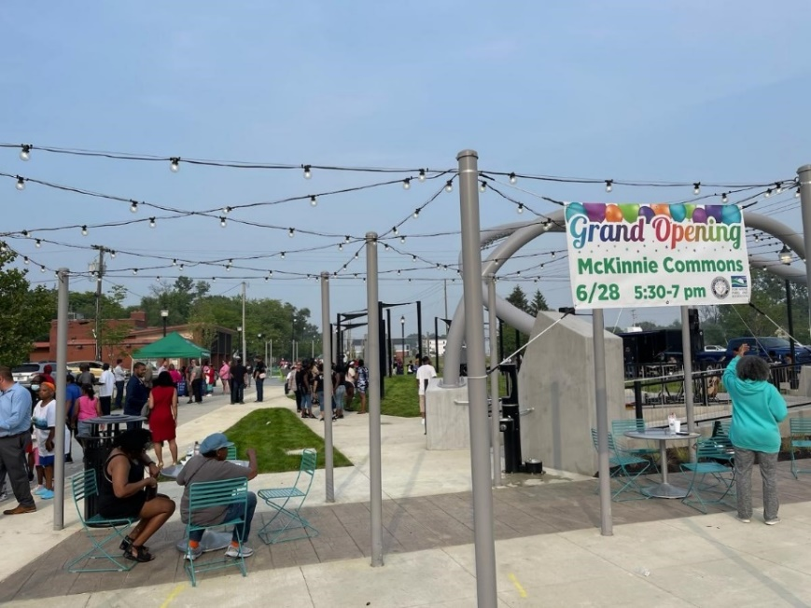
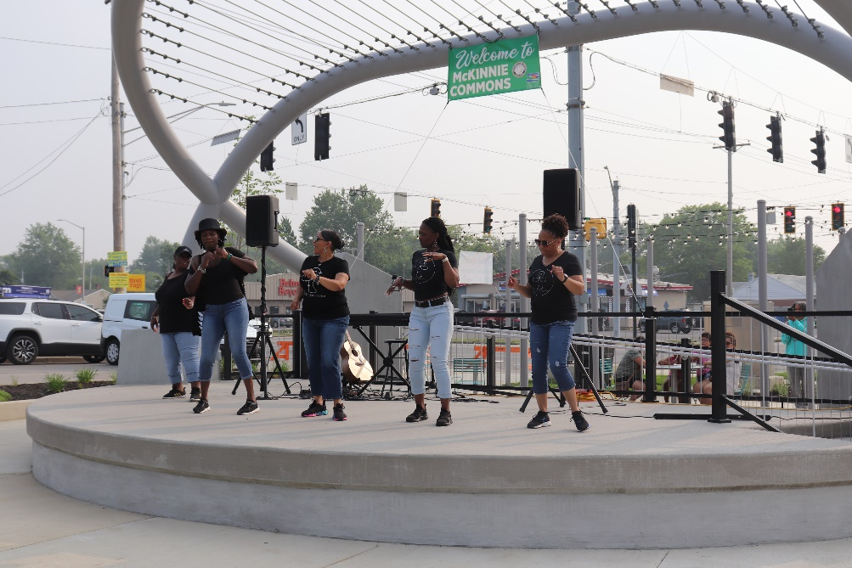
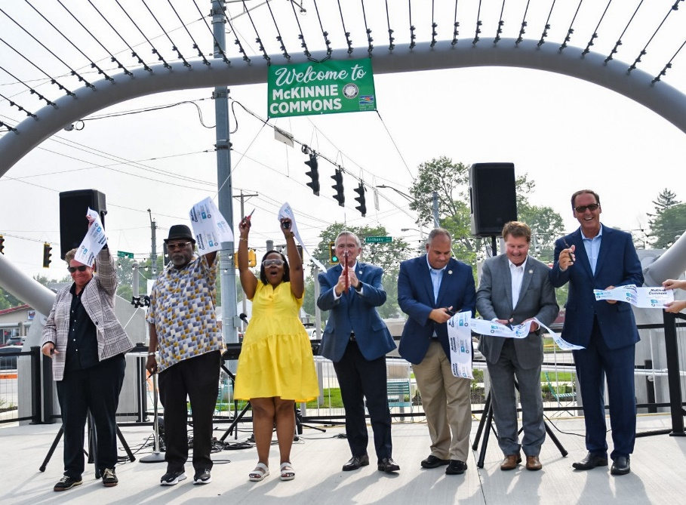
McKinnie Commons Park – McKinnie Ave & Anthony Blvd.
Includes a new outdoor performance stage, seating areas, and walking paths

Slide 14
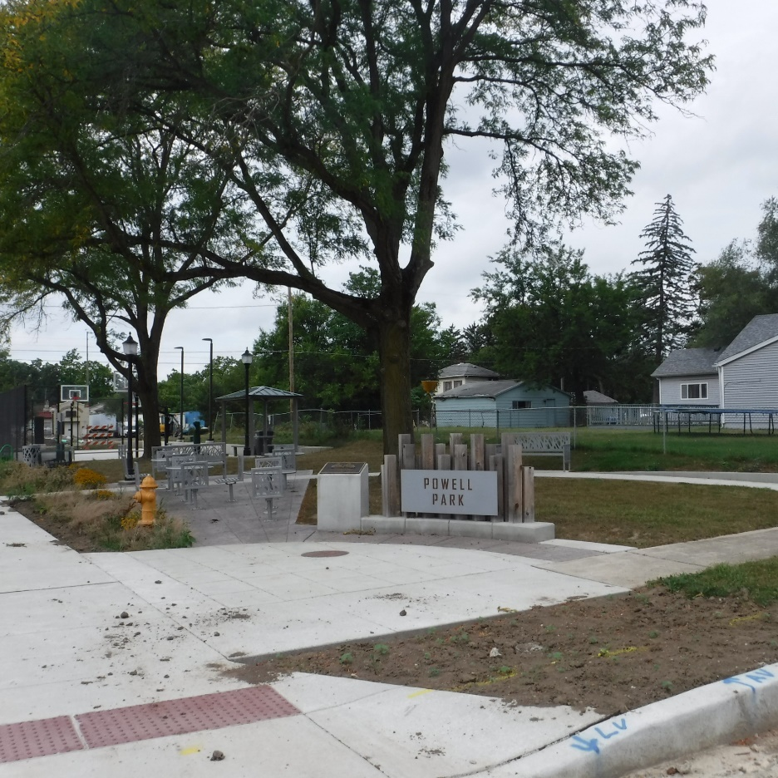
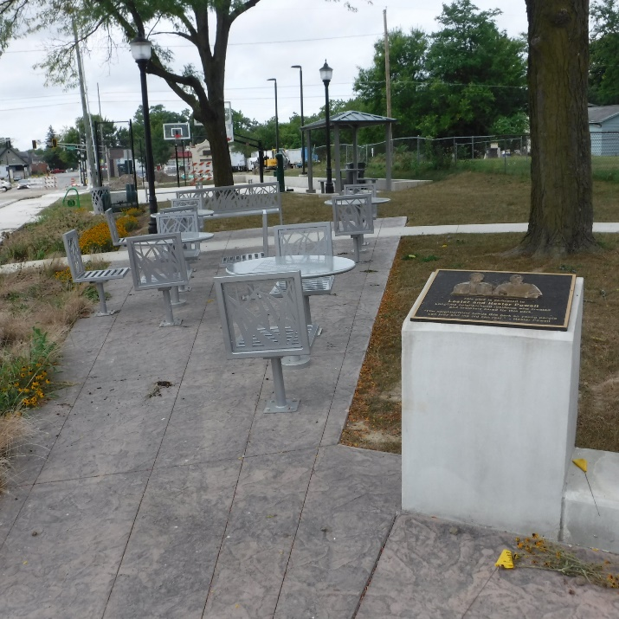
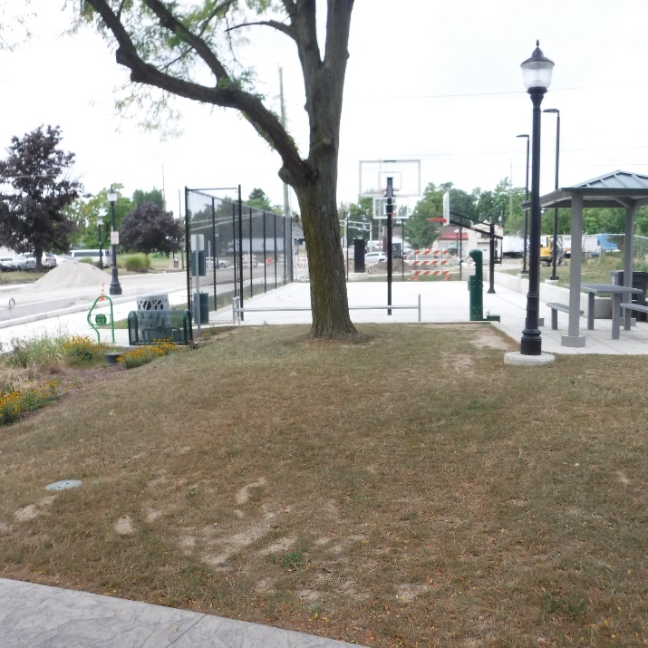
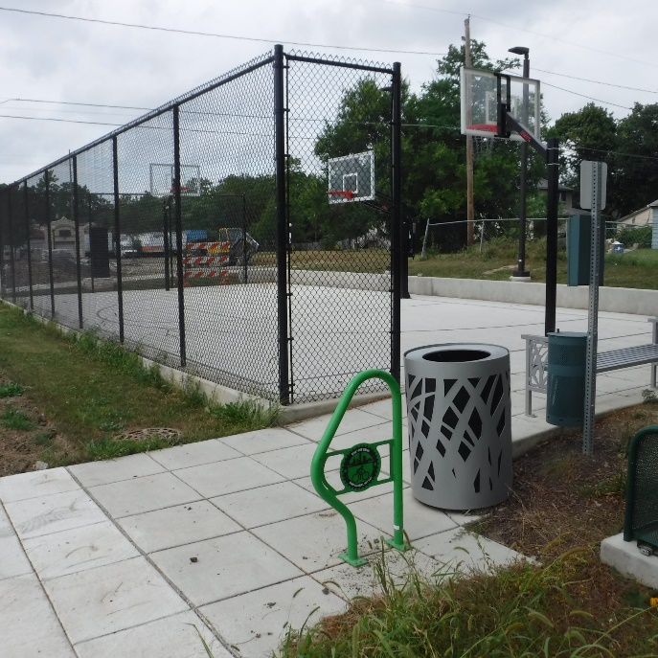
Powell Park Park – Pontiac Ave & Weisser Park Ave.
Picnic areas
New basketball court

Slide 15
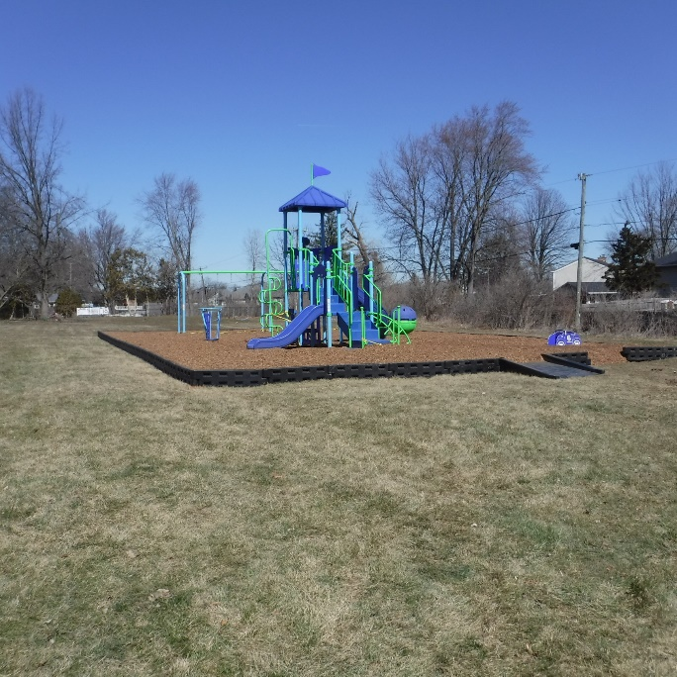
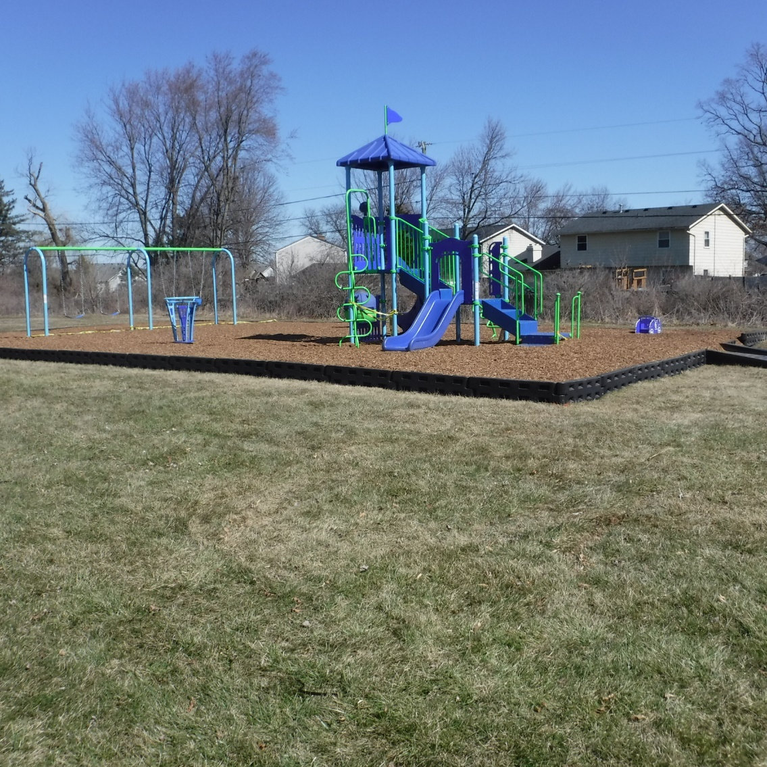
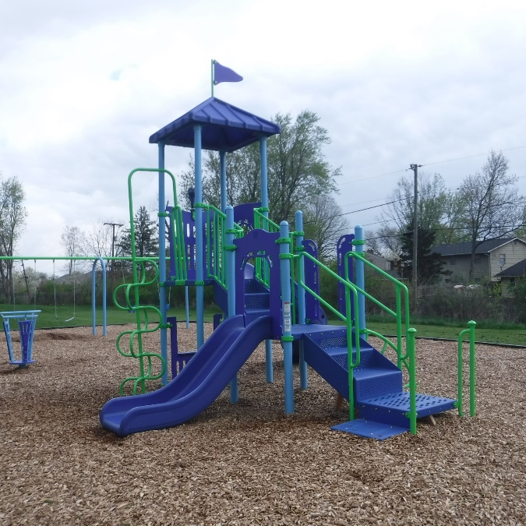
Sheldon Park - 7011 Sheldon Drive, in Maplewood Park Subdivision

Slide 16
In 2023 our Project Administration department was busy managing more than forty projects throughout the year. These ranged in size and scope.
The following photos show some highlights from some of those projects.

Slide 17
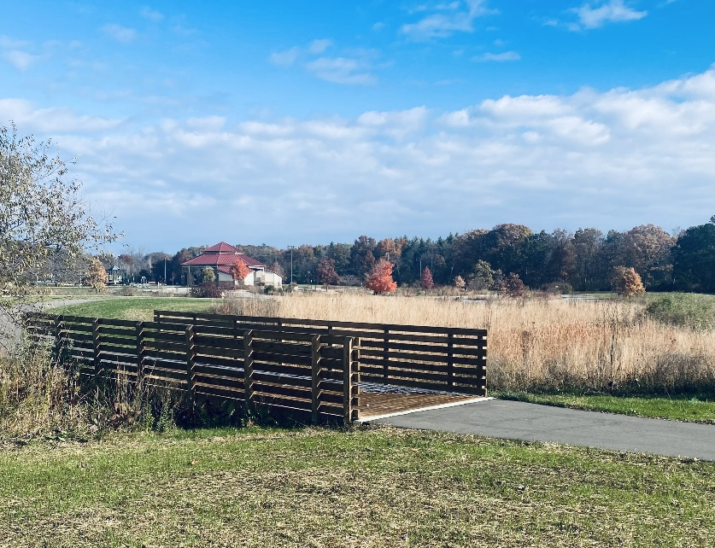
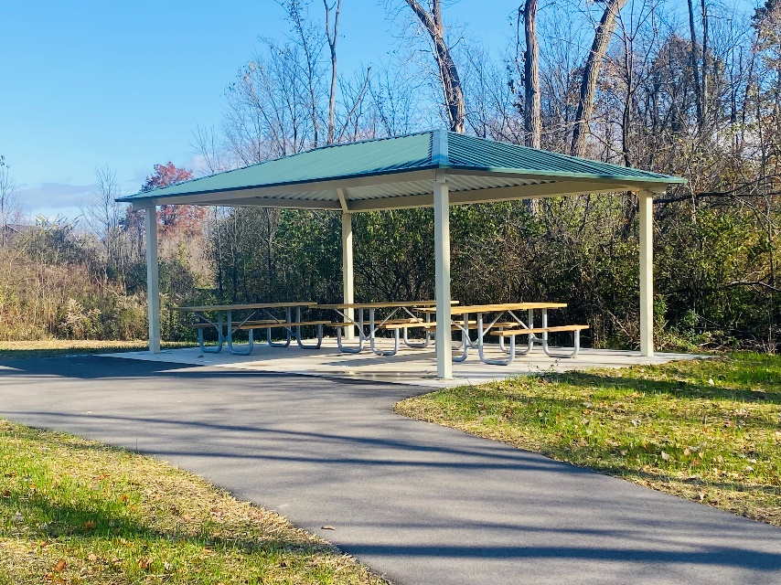
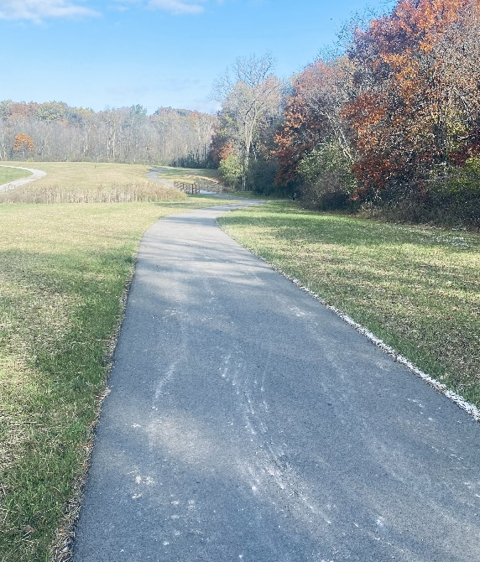
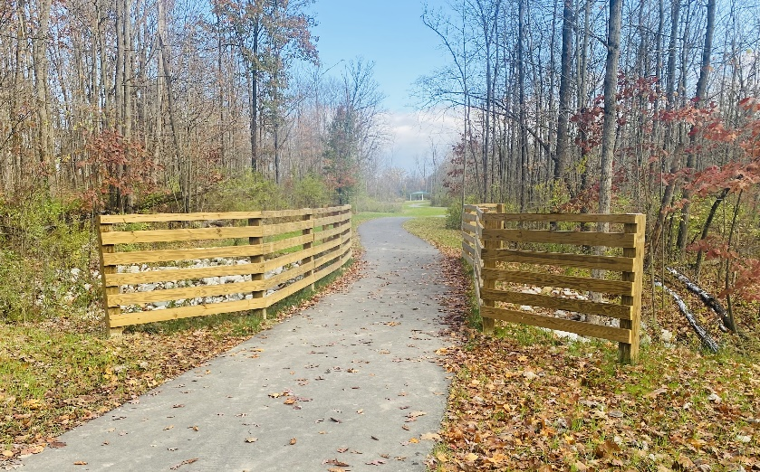
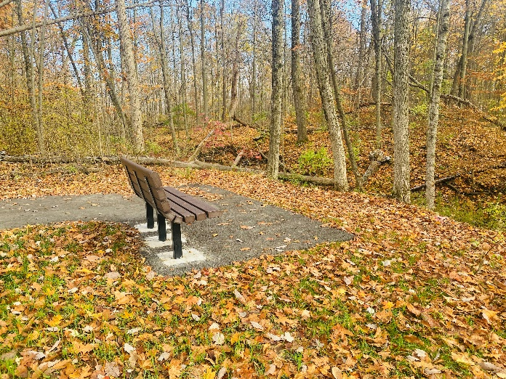
Buckner Park Trail
Project includes ¾ mile asphalt trail, a new shelter, picnic tables, and benches

Slide 18
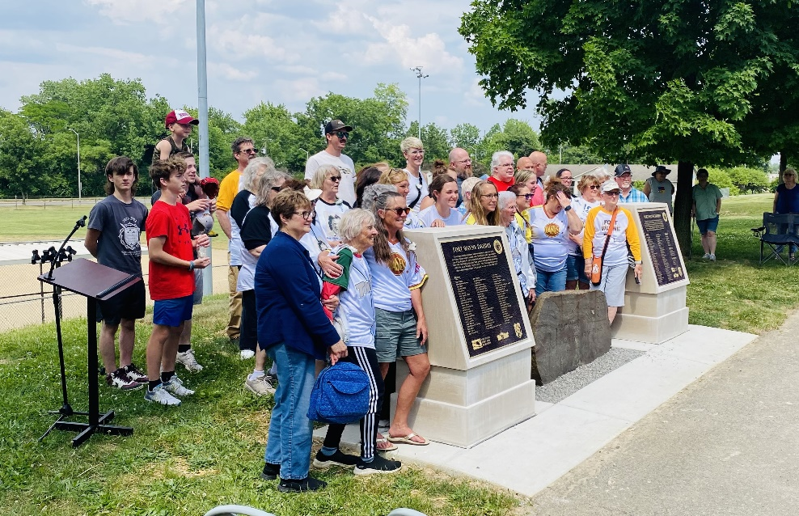
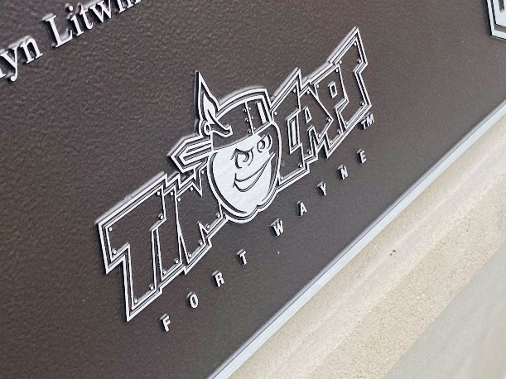
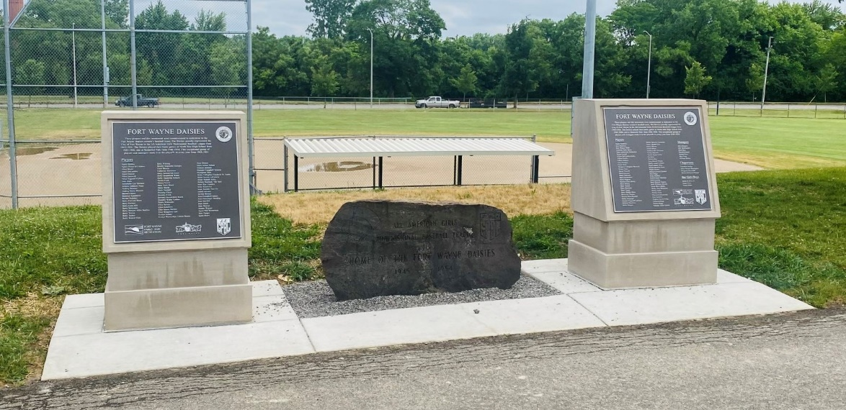
Fort Wayne Daisies Plaza at Memorial Park

Slide 19
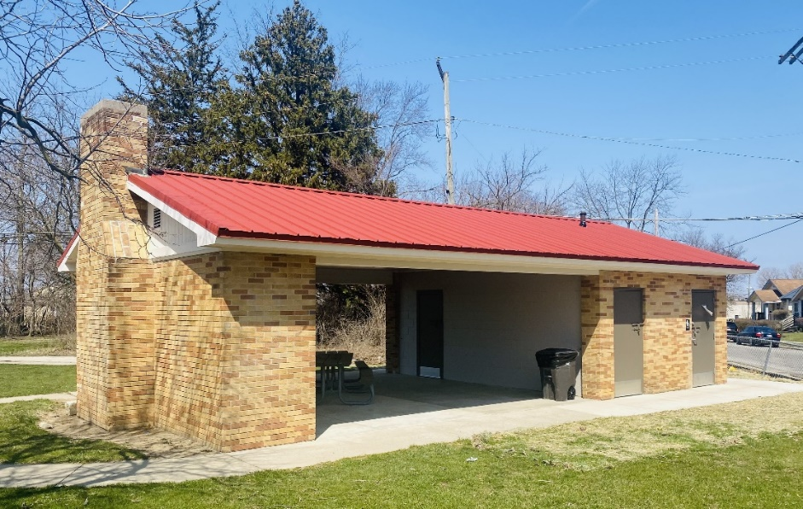
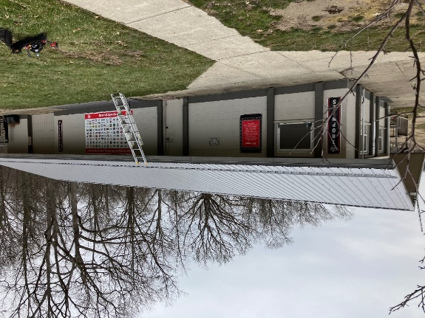
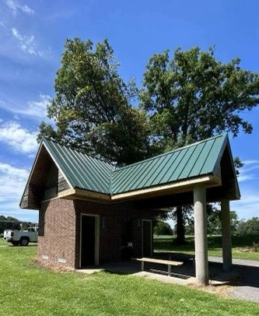
Pavilion Improvements
Franke BMX
Bowser Park Pavilion
Foster Golf Course
McMillen Pool House

Slide 20
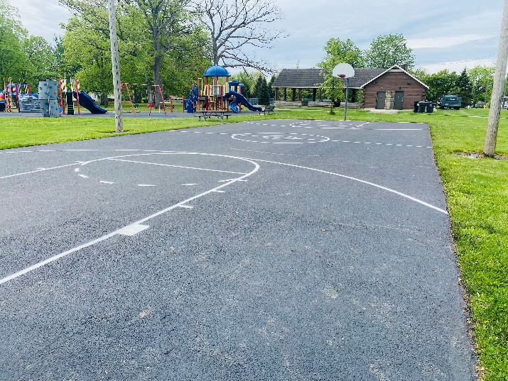
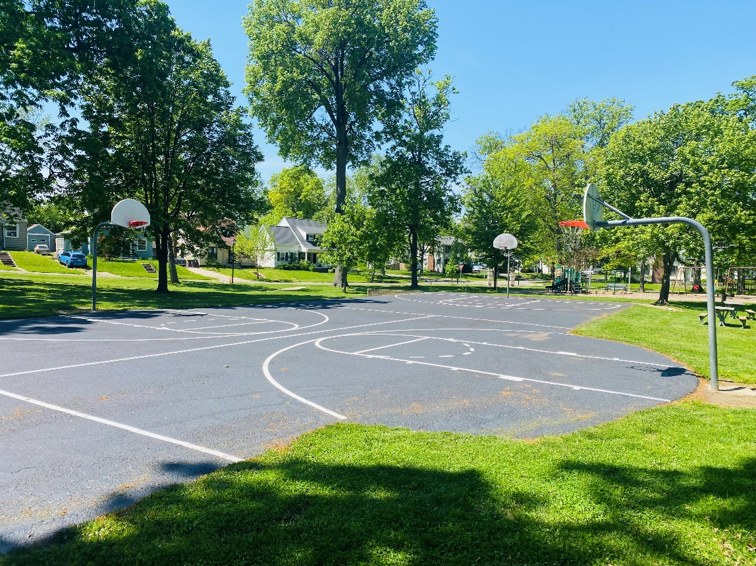
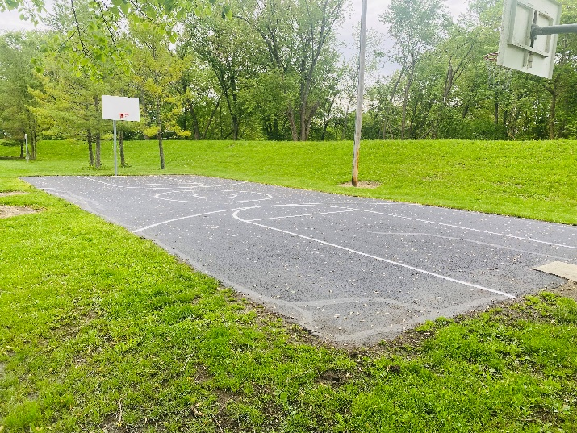
Basketball Courts
New seal-coating and striping
Kettler Park
Klug Park
Camp Allen Park

Slide 21
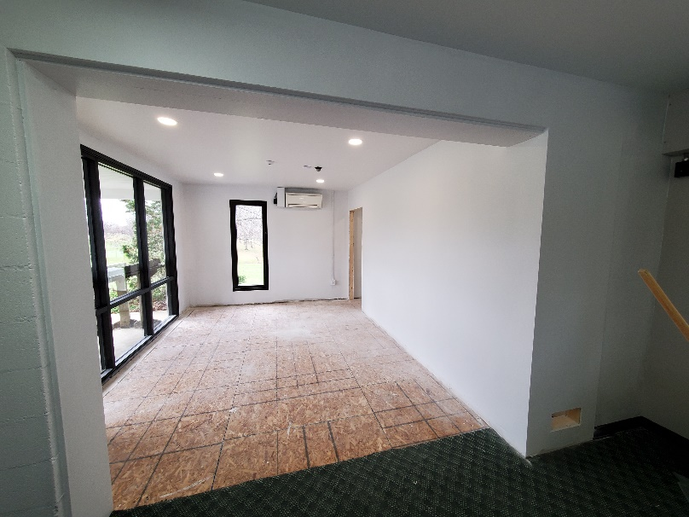
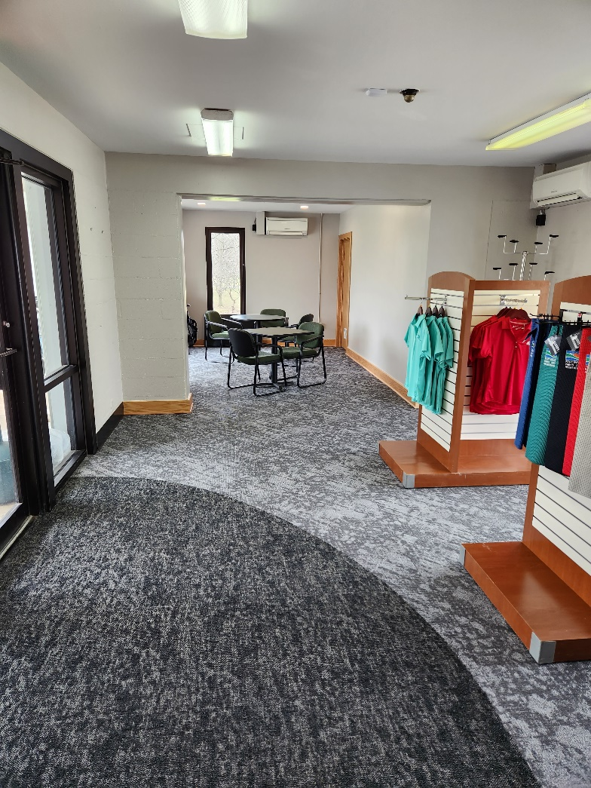
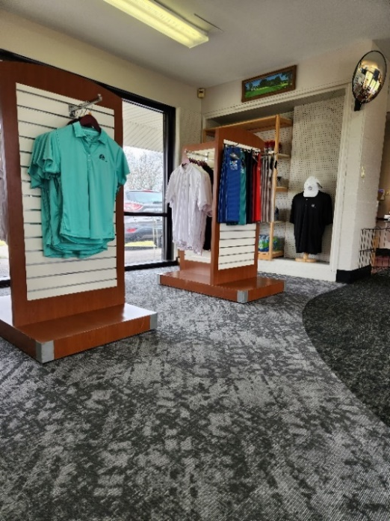
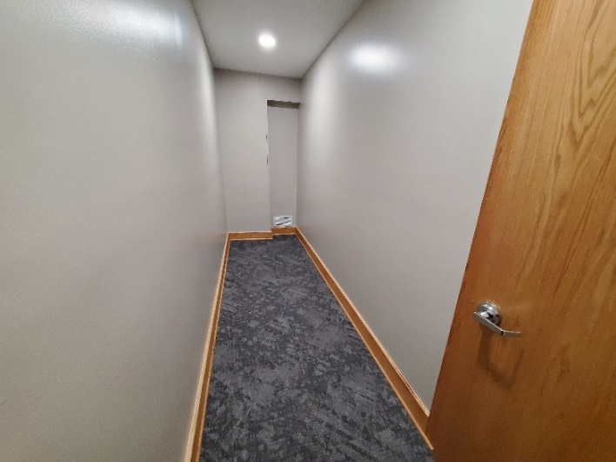
Shoaff Golf Pro Shop – Interior improvements
Floor Leveling and New Carpet
New Storage Area

Slide 22
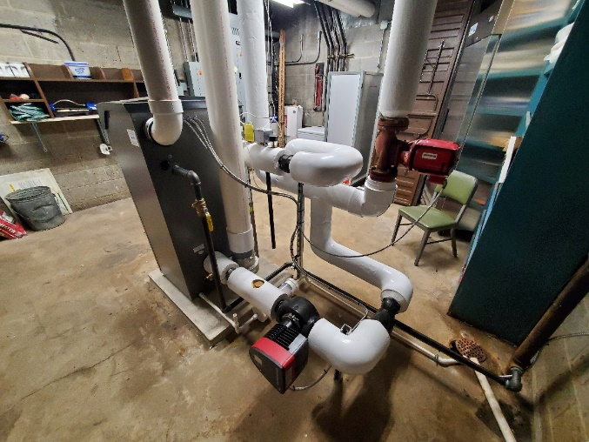
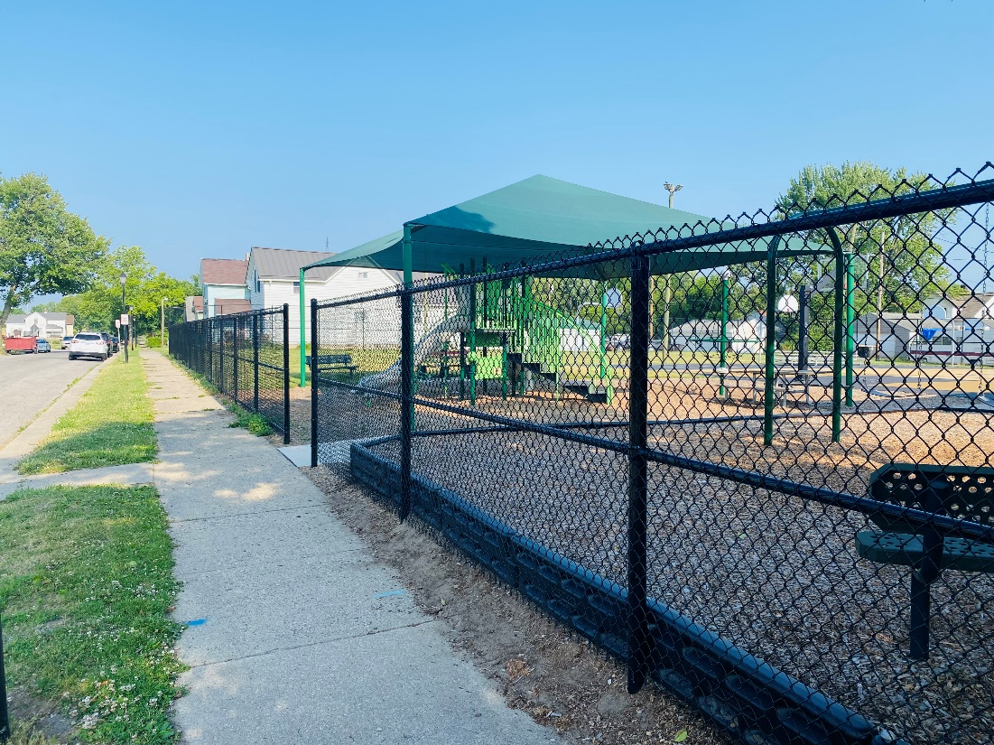
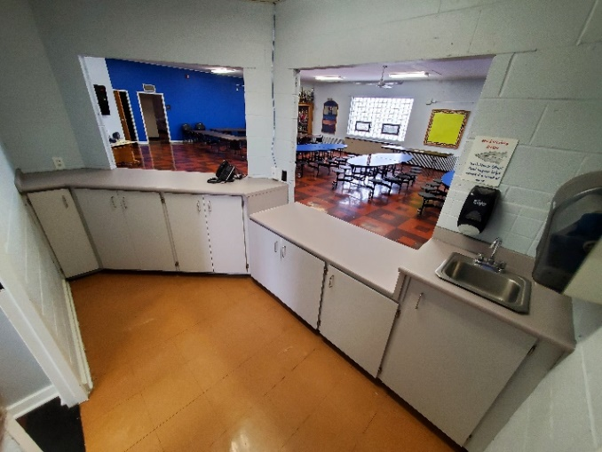
Jennings Center Improvements
Boiler Replacement
New Playground Fence
Kitchen Upgrades

Slide 23
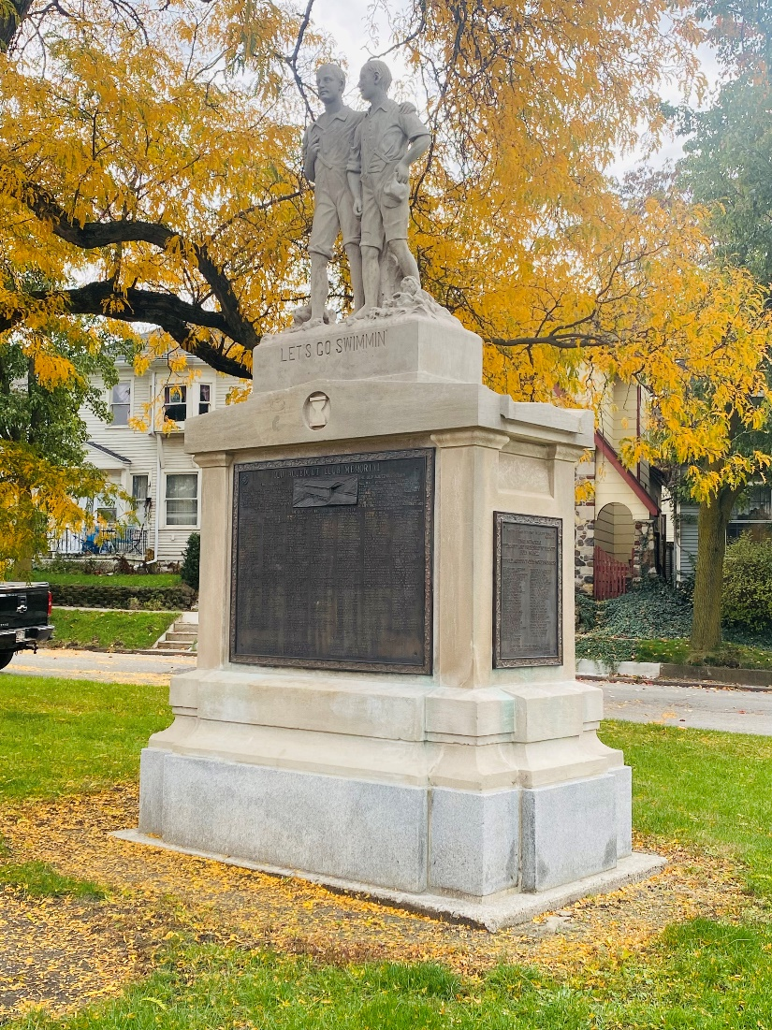
Monuments Restoration
Memorial Park World War Veterans Memorial
Orff Park – Let’s Go Swimmin’

Slide 24
Franklin Park Splashpad Shade Canopies

Slide 25
McMillen Community Center
Front Entrance Guest Services Area Upgrades

Slide 26
Community Center Flooring
New carpeting throughout the building

Slide 27
Salomon Farm Homestead
Front Porch Restoration

Slide 28
Salomon Farm
Restroom Renovation
Flower Field Irrigation System
Chicken Coup Enclosure

Slide 29
Johnny Appleseed Campground – In progress
Project includes 6 new asphalt RV camp sites with electrical, water, and lighting upgrades

Slide 30
Park Sidewalks Improvements
Botanical Conservatory
Headwaters Park
Sheldon Park

Slide 31
Pavement Restoration
McMillen Golf Course
Franke Playground Parking Lot
Jennings Center Parking Lot
Kreager Parking Lot

Slide 32
Parks Paving
Salomon Farm
Foster Trail
Weisser Playground
Conservatory Parking Lots
Franke Trail

Slide 33
Kreager Park Houses Demolition
Completed Demolition

Slide 34
McMillen Park Tennis Center
Tennis court resurfacing

Slide 35
Botanical Conservatory
New ceiling glass panels
Roof improvements to house connection corridors
New concrete patio at front entrance

Slide 36
St. Marys Streambank
Erosion control improvements

Slide 37
Playground Improvements
Casselwood Park
Sheldon Park

Slide 38
Future Playgrounds - $2 million – 10 parks
Lawton Park Playground
McMillen Park Playground
Foster Park Playground
Kettler Park Playground

Slide 39
Future Playgrounds
Kreager Park Playground
Gren Park Playground
Northside Park Playground
Tillman Park Playground

Slide 40
Future Playgrounds
Boone Park Playground
Turpie Park Playground

Slide 41
Headwaters Park Fountain Improvement Project

Slide 42
More to come in 2024

Slide 43
Thank You

