Slide 1
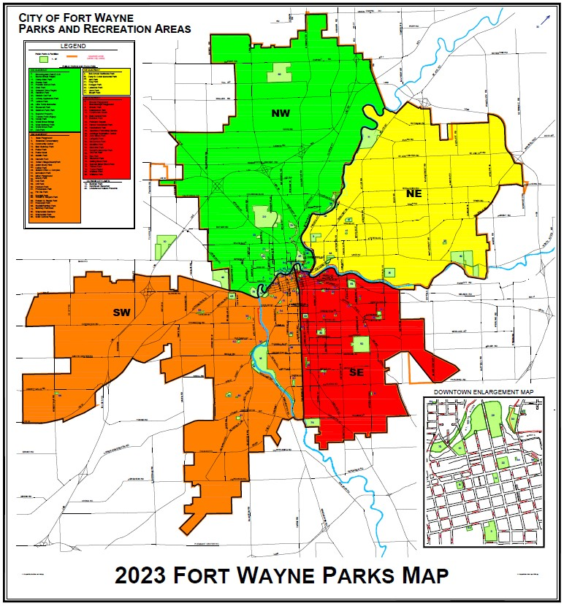
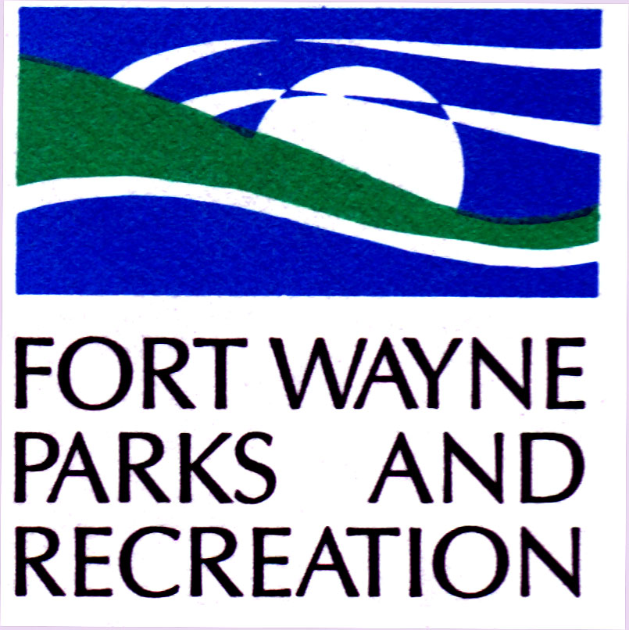
Fort Wayne Board Of Park Commissioners
Parks History and Highlights:
Brookview Parkway
Casselwood Park
Foster Park

Slide 2
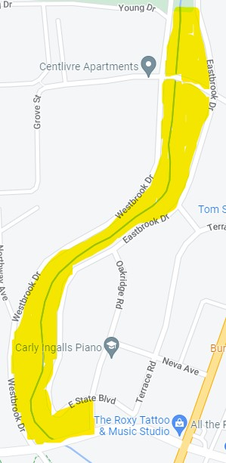
Brookview parkWAY
A linear park located in between Eastbrook and Westbrook Avenues running along Spy Run Creek from Vesey Park to State Blvd.

Slide 3
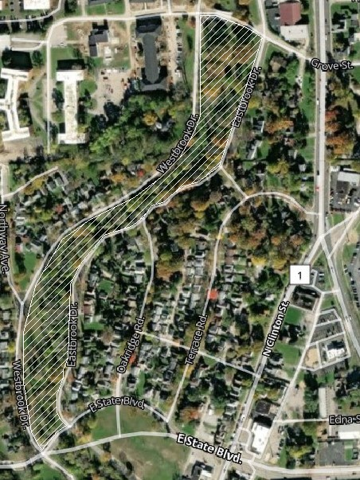
Brookview park
Since 1917
Size in Acres: 16.8

Slide 4
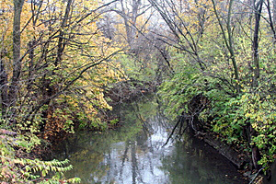
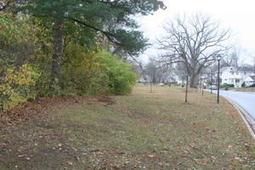
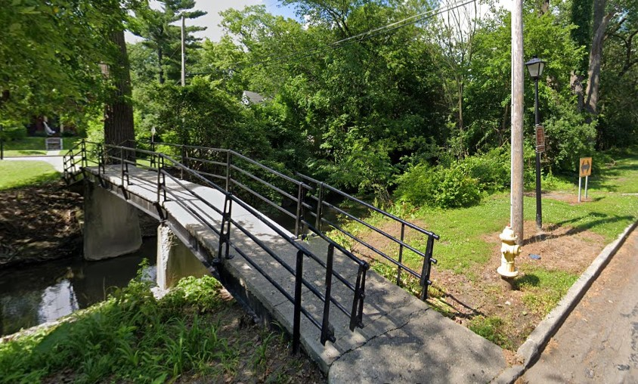
Brookview parkWAY
History: Brookview Parkway is owned by Public Works but has been maintained by the Fort Wayne Parks & Recreation Department since 1917. This Parkway and Brookview Neighborhood was designed by landscape architect Arthur Shurcliff, who also designed the Wildwood Park Neighborhood. The parkway was included in the design of the Brookview neighborhood and land was given to the city for park purposes.

Slide 5
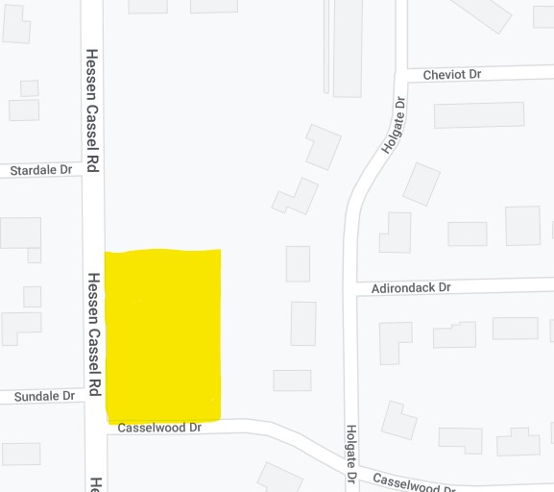
Casselwood Park
Corner of Casselwood Drive and
Hessen Cassel Road

Slide 6
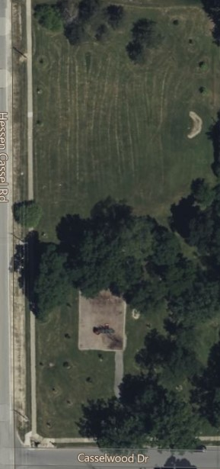
Casselwood Park
Since 1975
Size in Acres: 1.5
History: In 1975 Three private lots in the Casselwood Park neighborhood were purchased by the city and combined into one lot. That same year, a Bishop Luers High School student seeking to become an Eagle Scout canvassed the Casselwood Park neighborhood with a questionnaire associated with the property. The questionnaire pinpointed the neighborhood's wishes for park improvements.
When the lots were purchased there was a baseball diamond and a basketball court existing on the site that were aging and in need of improvements. Due to the neighborhood's priorities these were then repaired and improved. Further improvements came including adding a fence and backstop for the ball diamond; a drinking fountain, picnic tables, and a BBQ pit.
The park was formally dedicated on November 15, 1975.

Slide 7
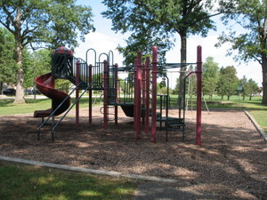
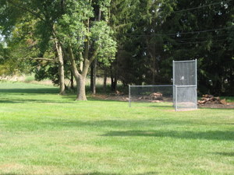
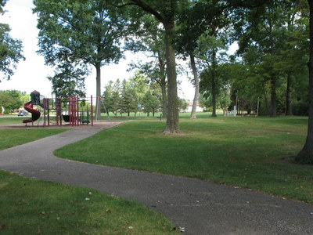
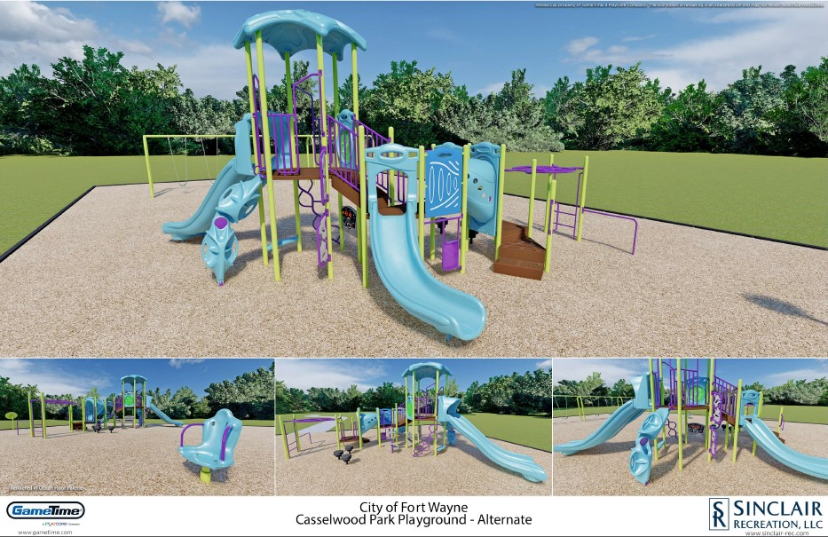
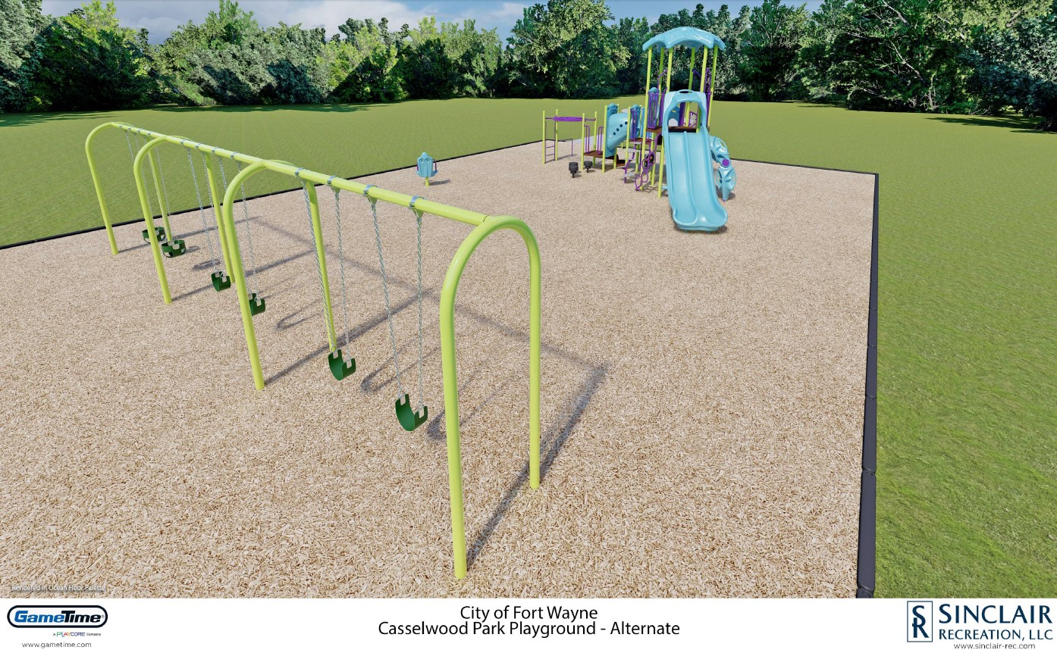
Today this park features open space, a playground with slides, and a swing set, as well as a baseball field. Large trees provide shade for park visitors in the warm summer months. In 2023 this park is scheduled to have new playground equipment installed.

Slide 8
Foster park
3900 Old Mill Road

Slide 9
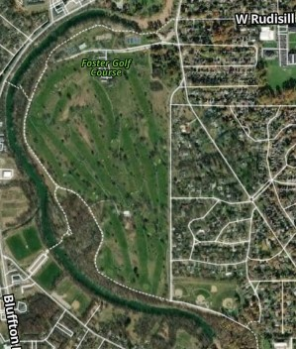
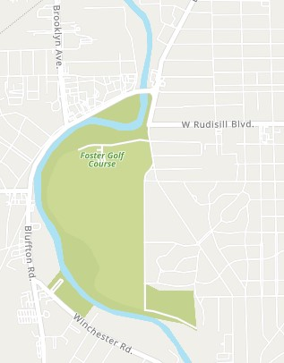
Foster park
Since 1912
Size in Acres: 255.0

Slide 10
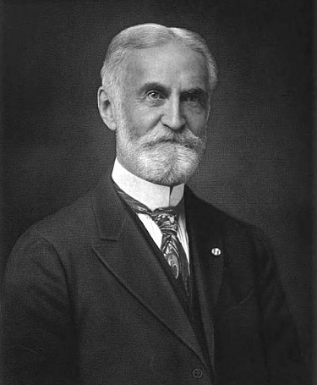
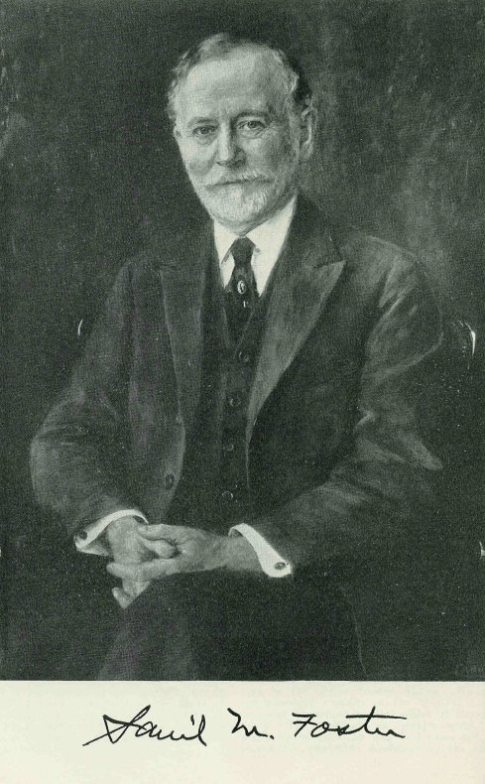
FOSTER PARK HISTORY
Foster Park is named after brothers Samuel and David Foster. Colonel David Foster, often referred to as the “Father of Fort Wayne Parks” served as the first president of the first Park Board. In 1912 the brothers and their families donated 67 acres of land for Foster Park to Fort Wayne. This included wooded areas extending along the St. Marys River for some two miles. Shortly after the addition of that land, the Fosters donated another 40 acres. Then in the early 1920's the Park Board purchased 111 additional acres of land making the park an area of 218 acres, and bringing the park to four miles of river bank. In subsequent years, additional land was added, making a total of 255 acres today.

Slide 11
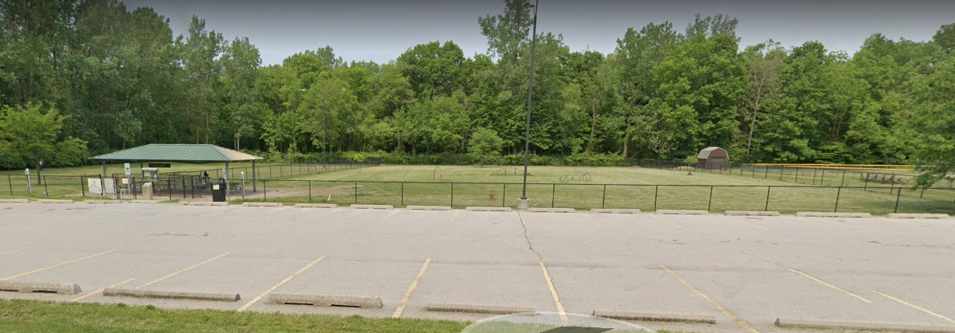
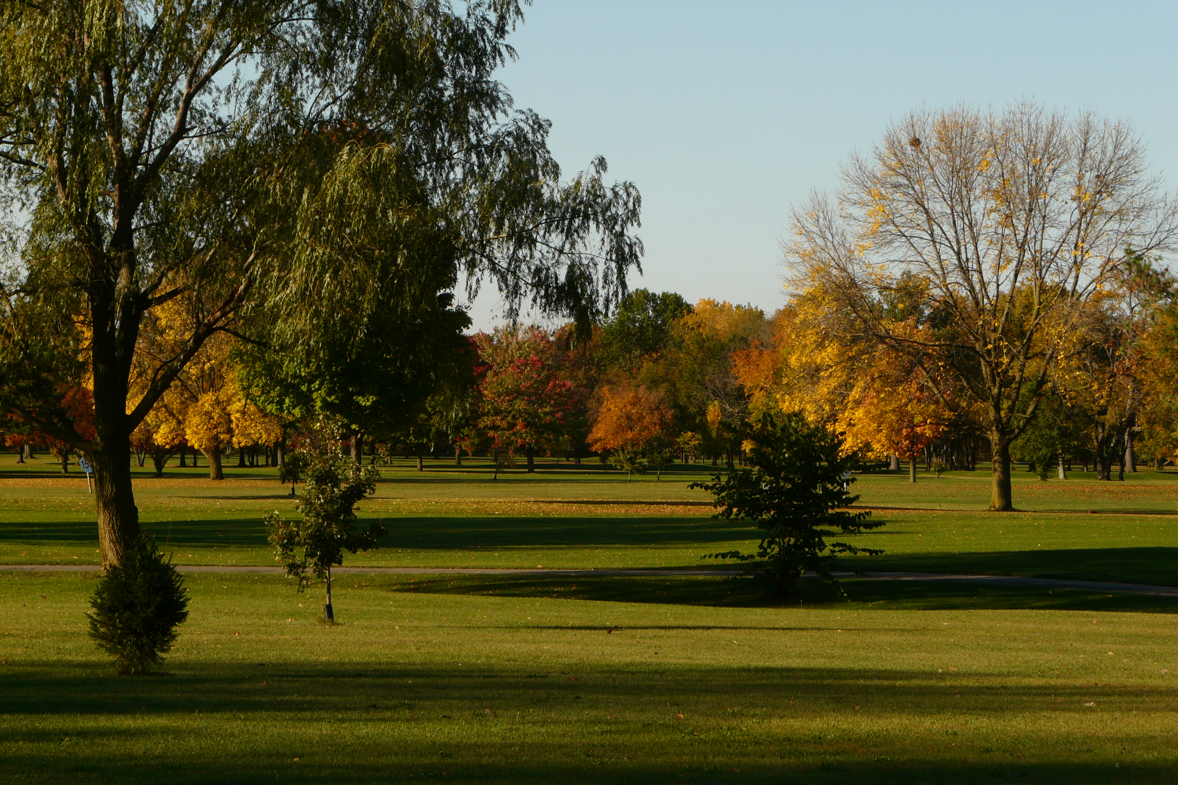
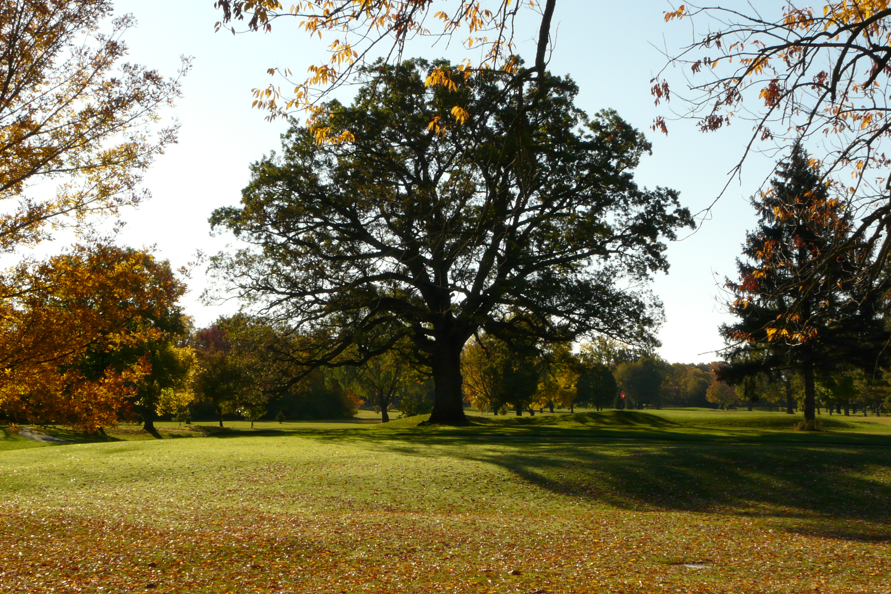
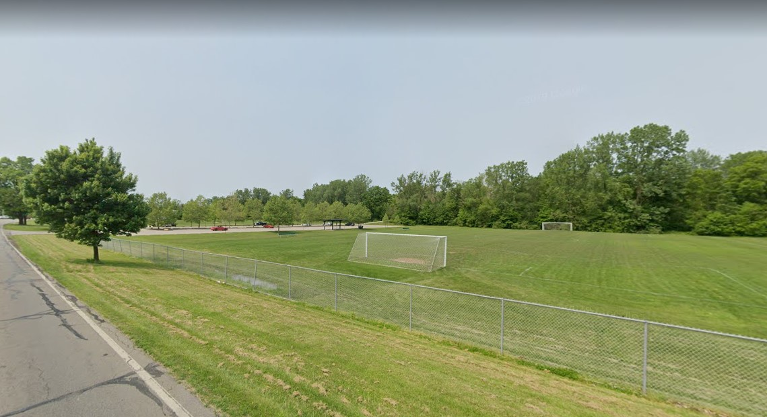
FOSTER PARK TODAY
The park is divided into two parts, separated by the St. Marys River. The majority of land is on the east side where the Foster Park Golf Course exists. To the west is the Foster Park soccer fields and the Pawster Park Dog Park.
Pawster Park
Golf Course
Soccer

Slide 12
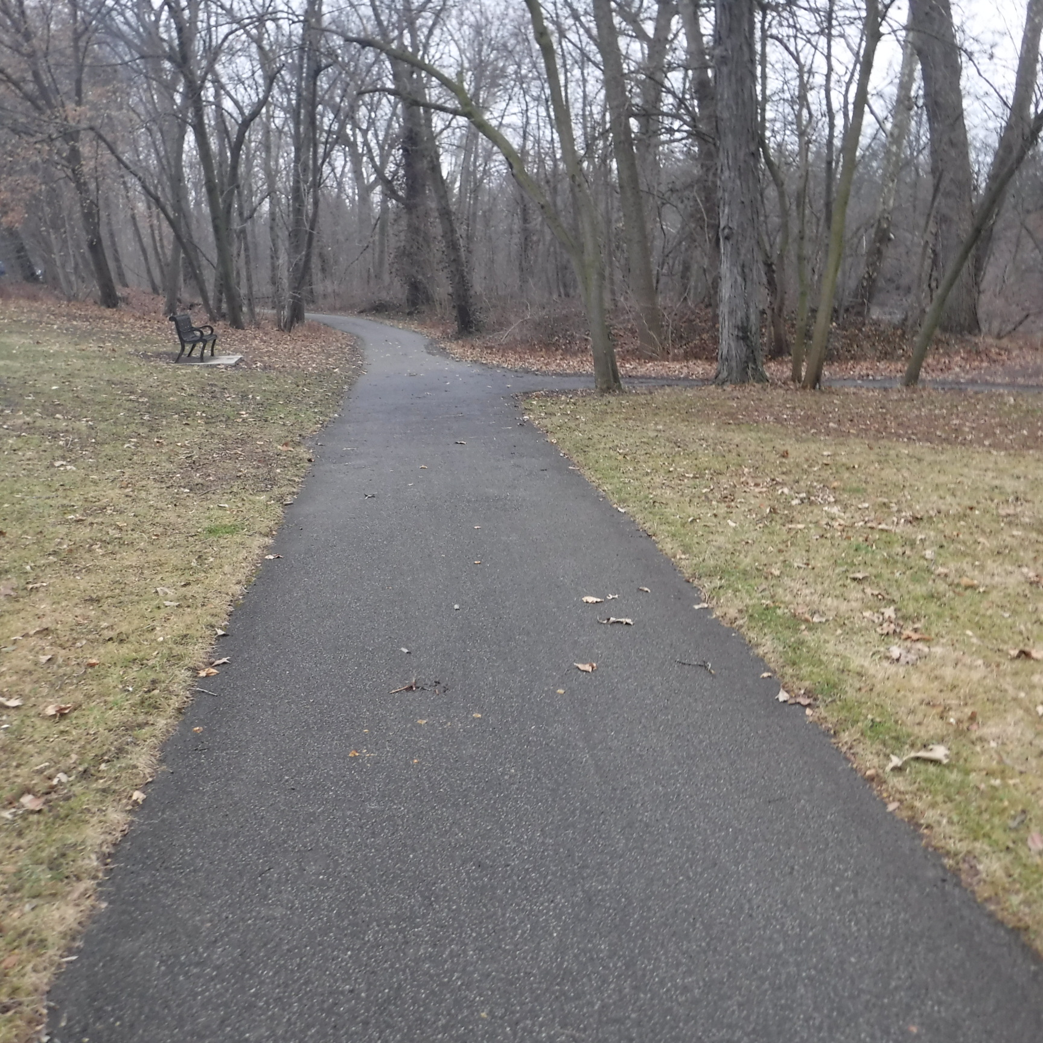
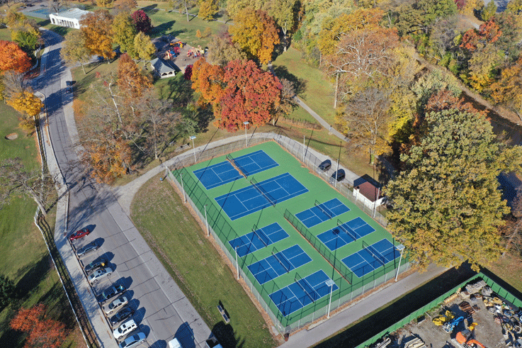
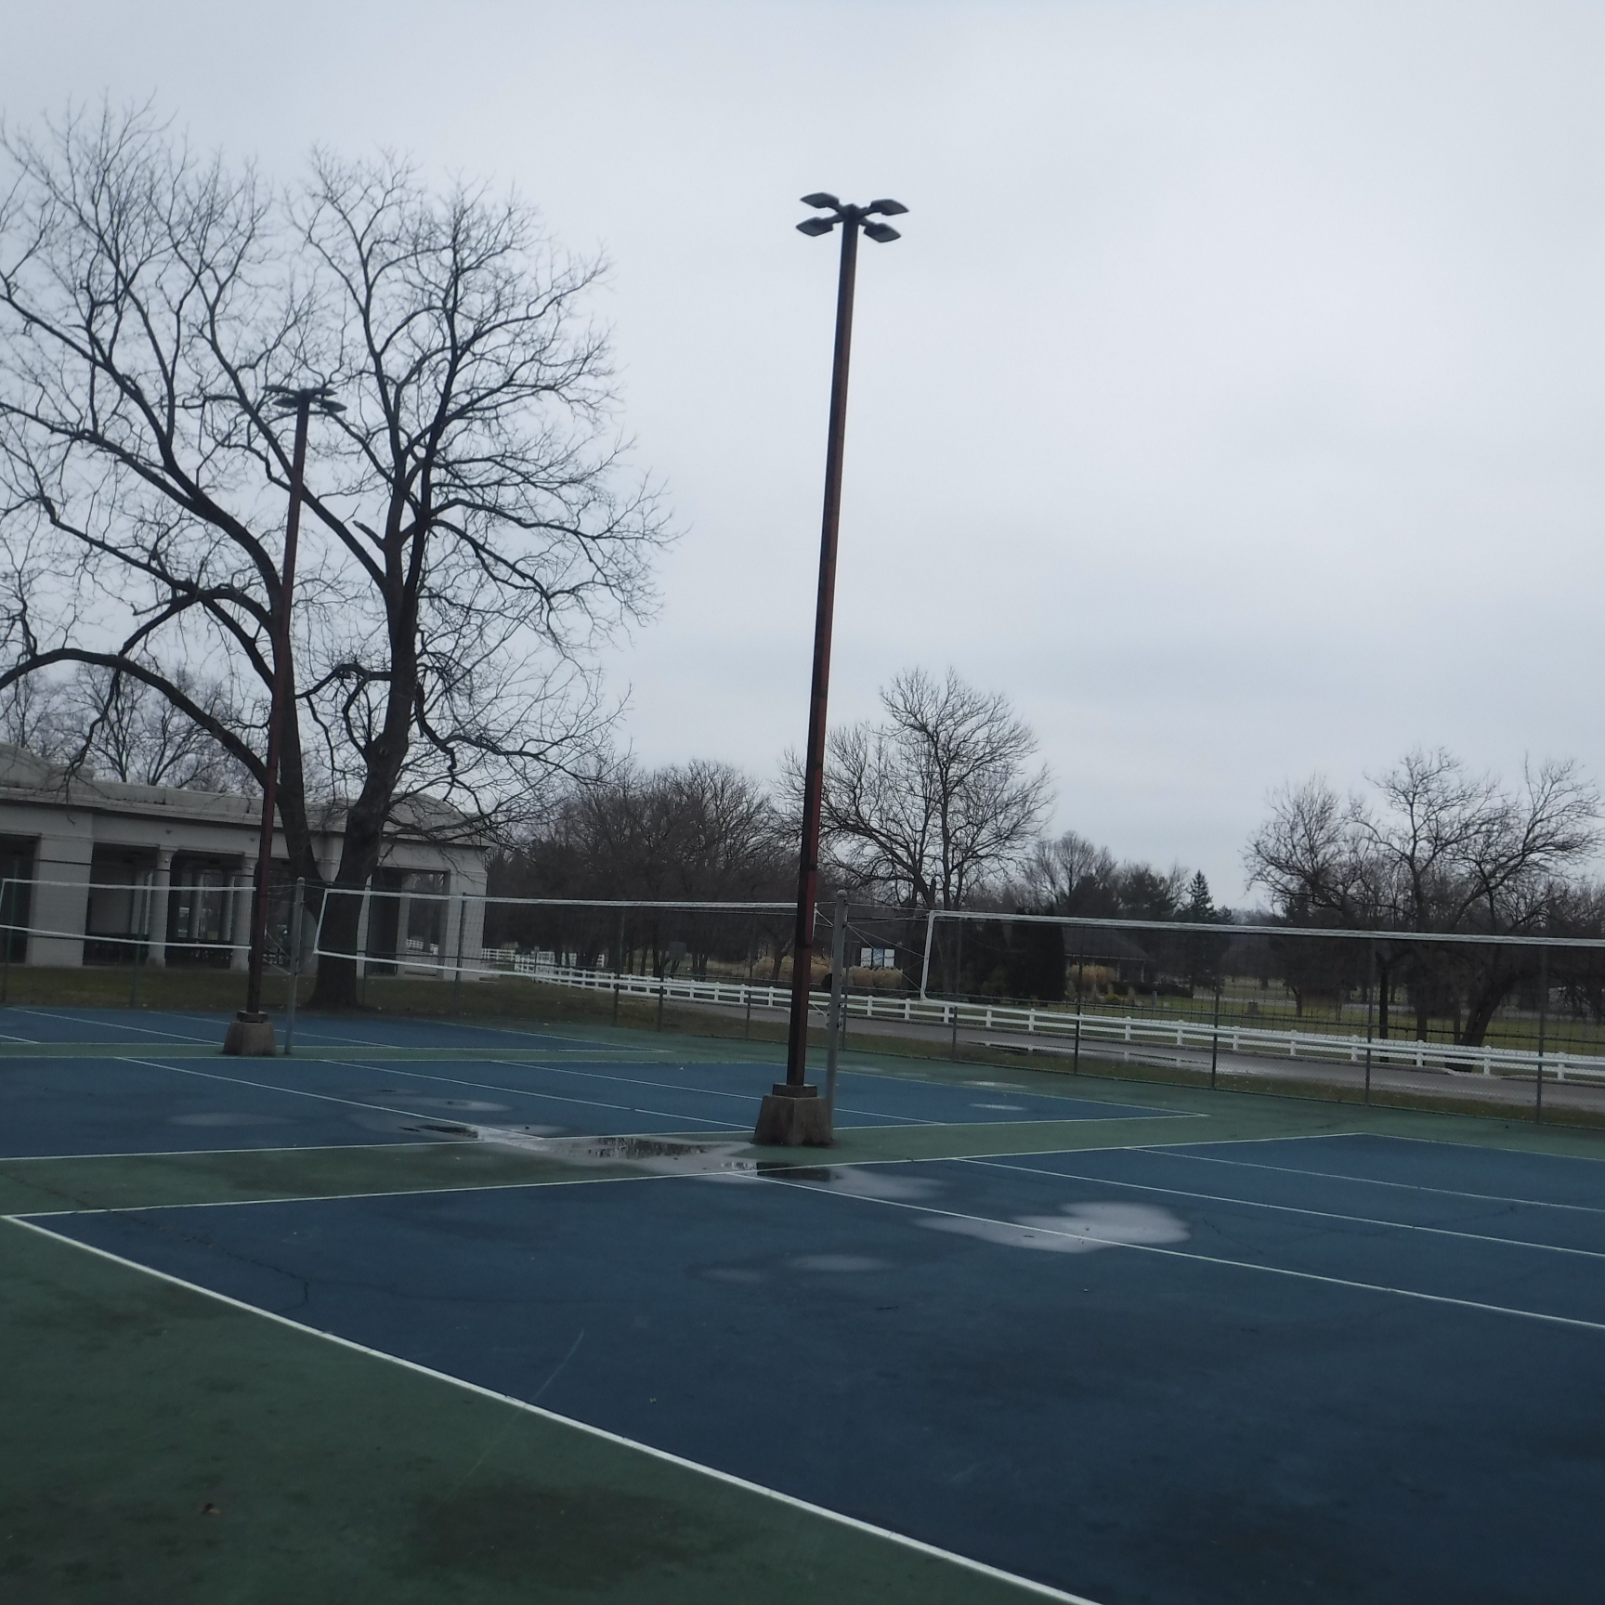
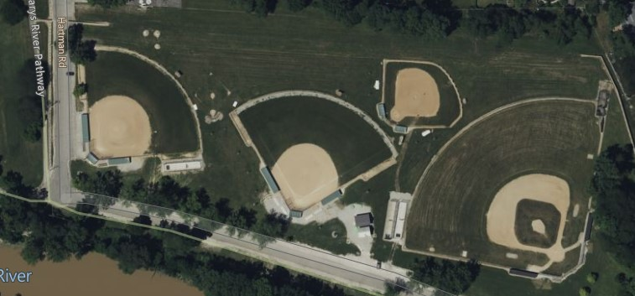
FOSTER PARK TODAY
Foster Park is often referred to as Fort Wayne’s most premier park, providing a diverse list of activities including tennis, pickleball, volleyball, baseball, and many walking trails.
Trails
Tennis/Pickleball
Volleyball
Baseball

Slide 13
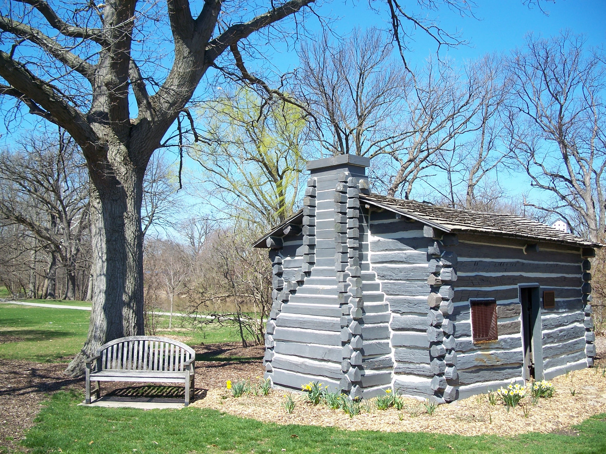
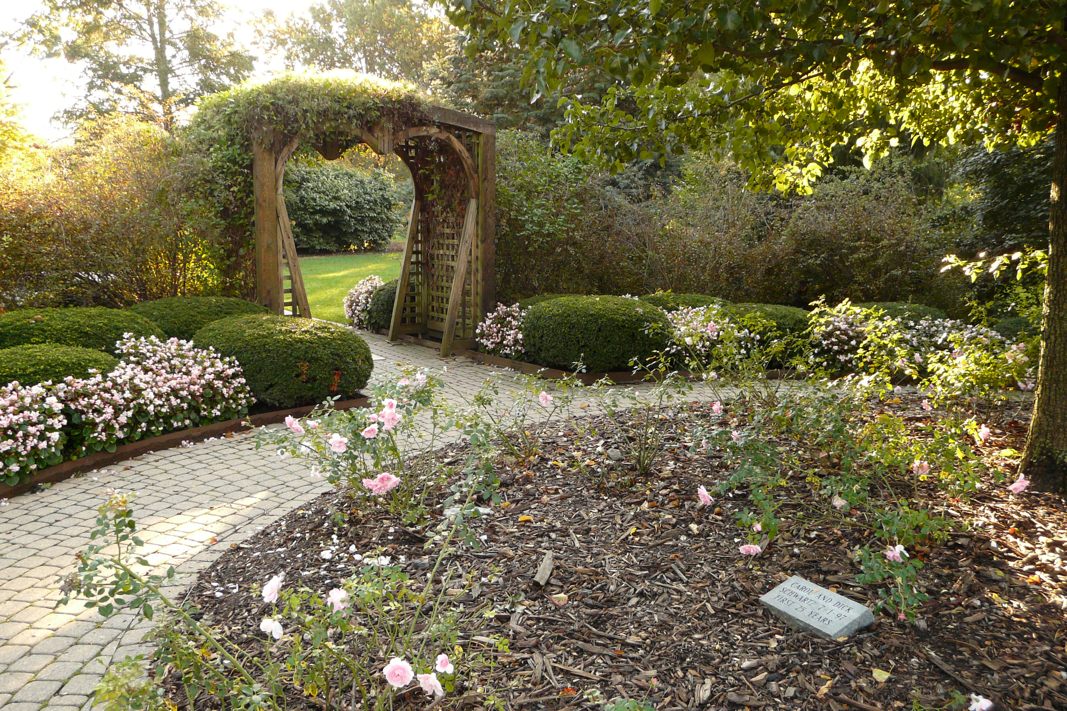
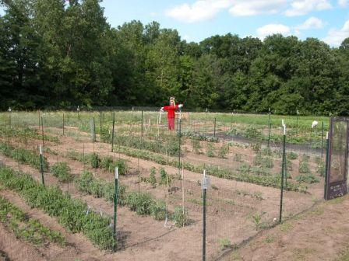
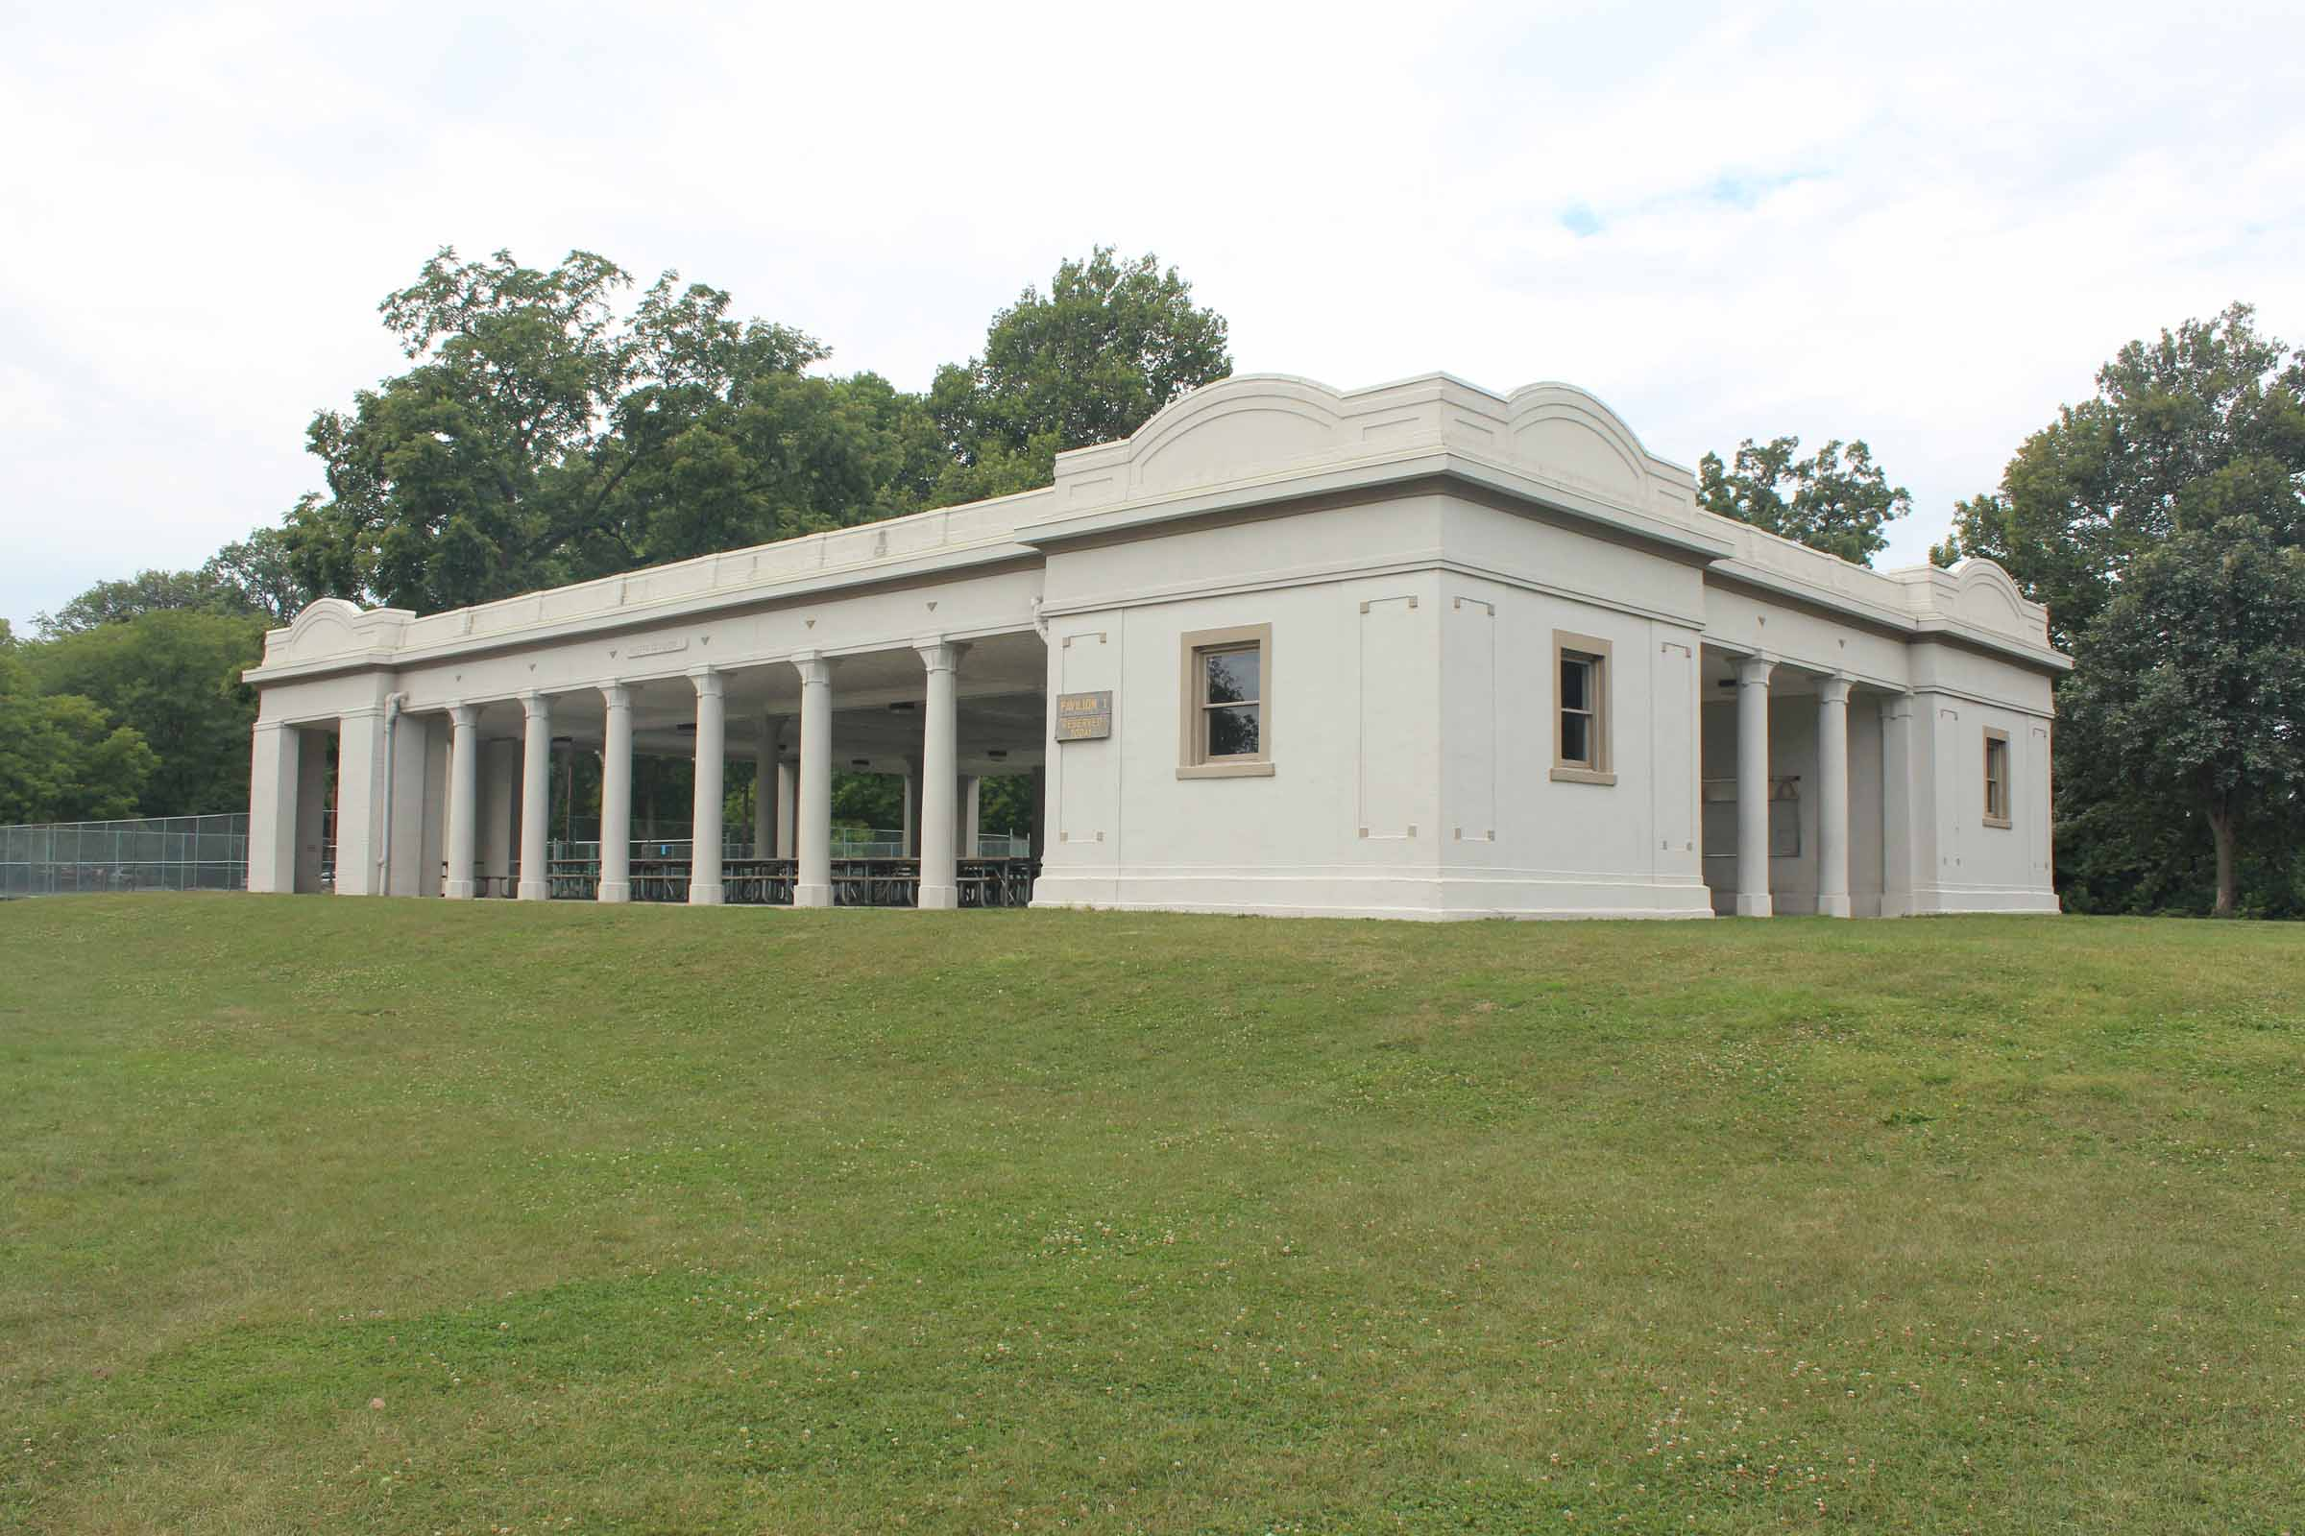
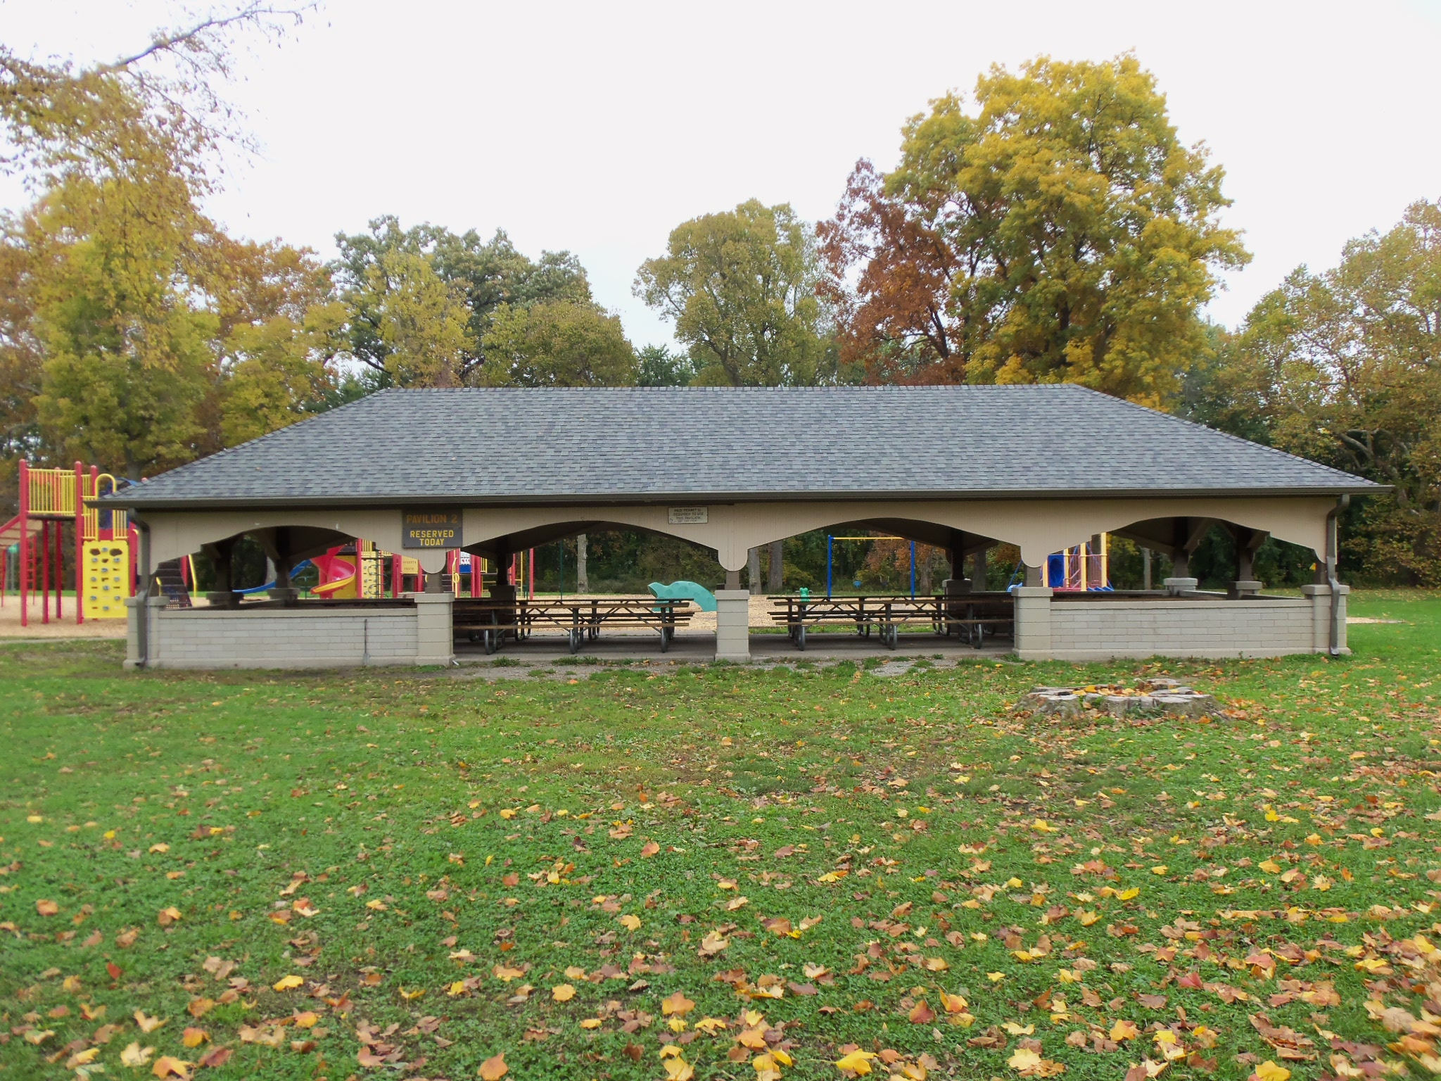
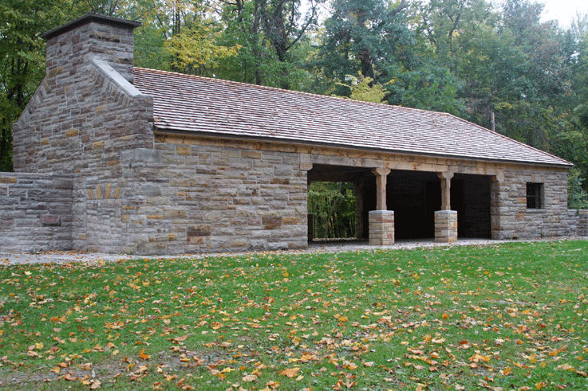
FOSTER PARK TODAY
Foster Park is also home to some unique features including the Abraham Lincoln log cabin replica, the bridal glen, the community gardens, and three rental pavilions.
Log Cabin
Bridal Glen
Community Gardens
Pavilion #1
Pavilion #2
Pavilion #3

Slide 14
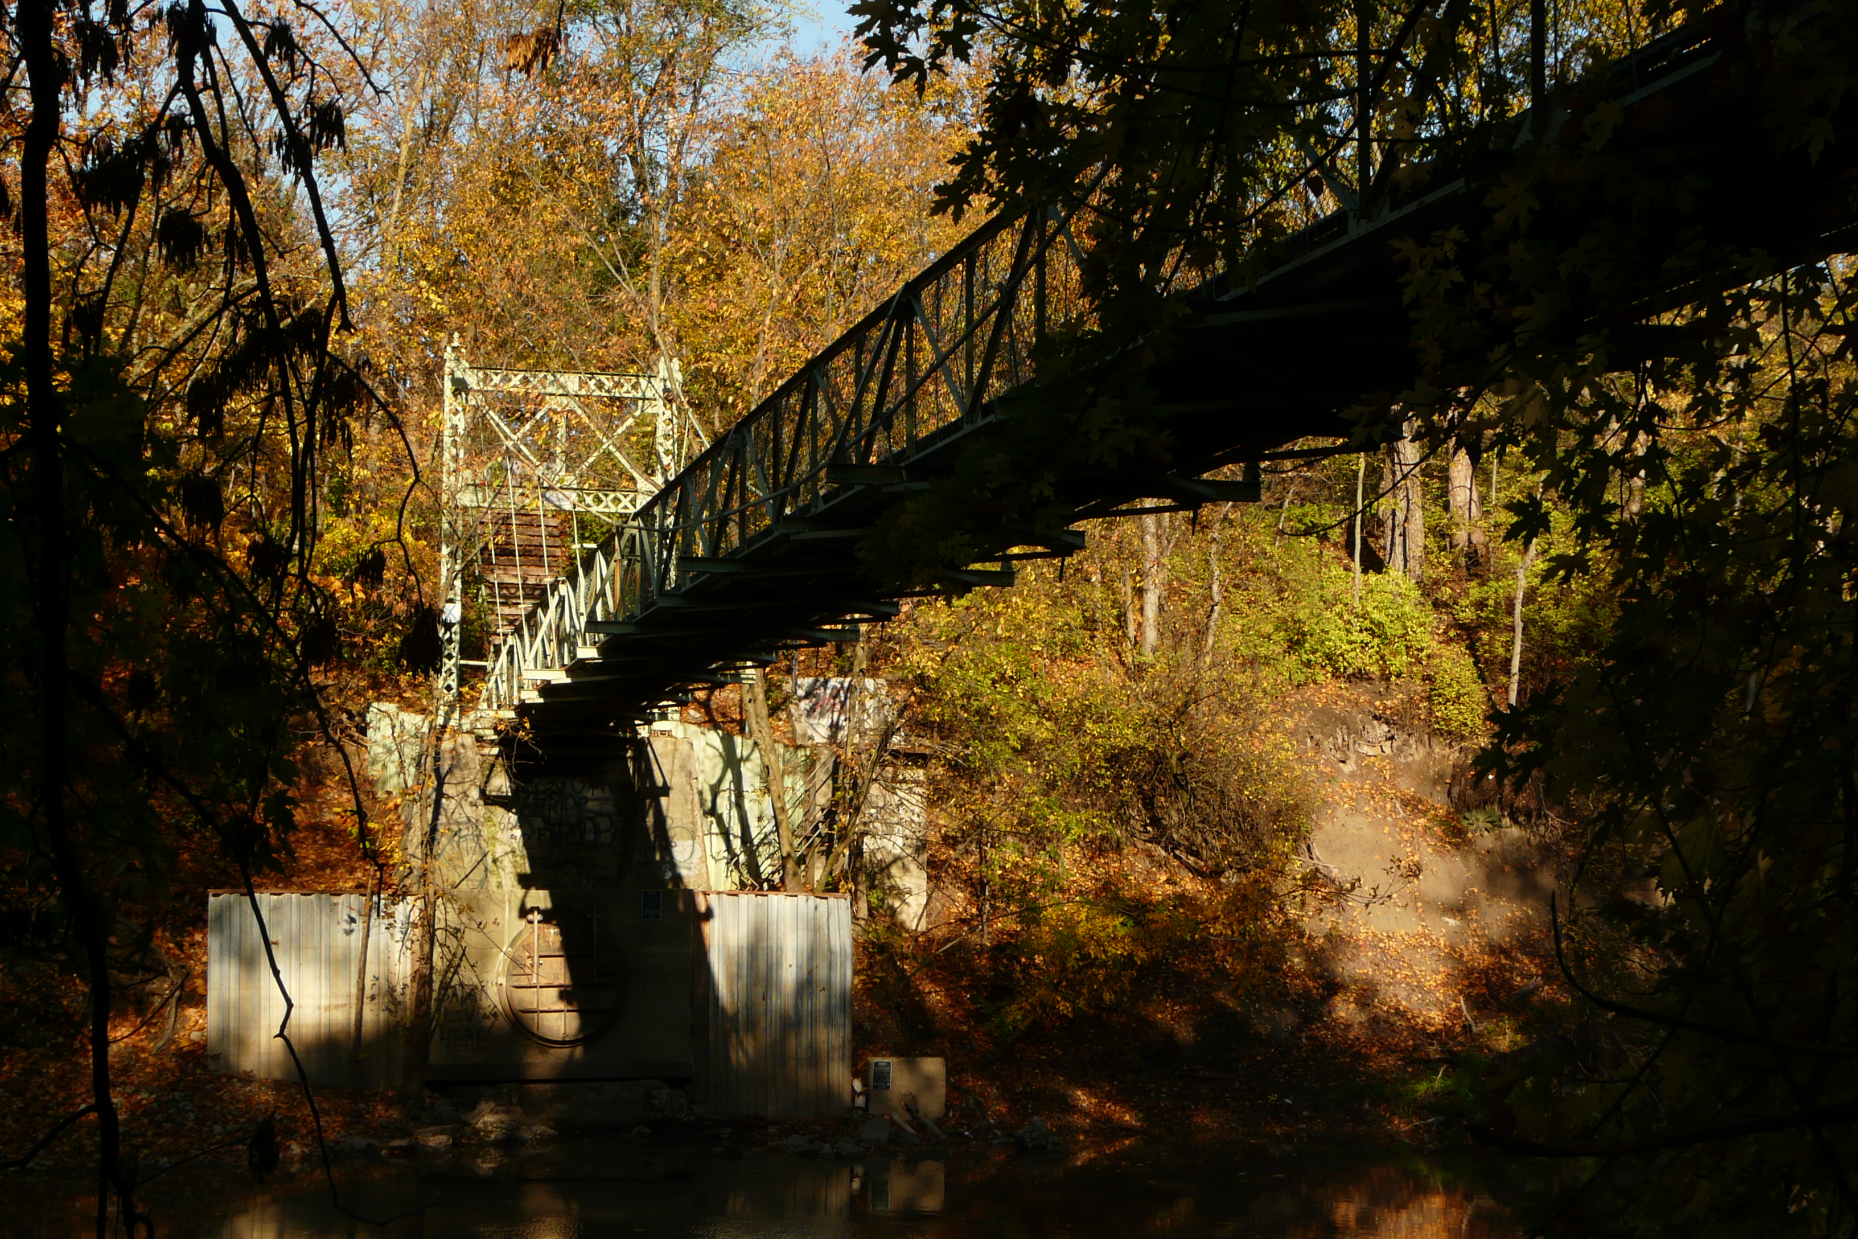
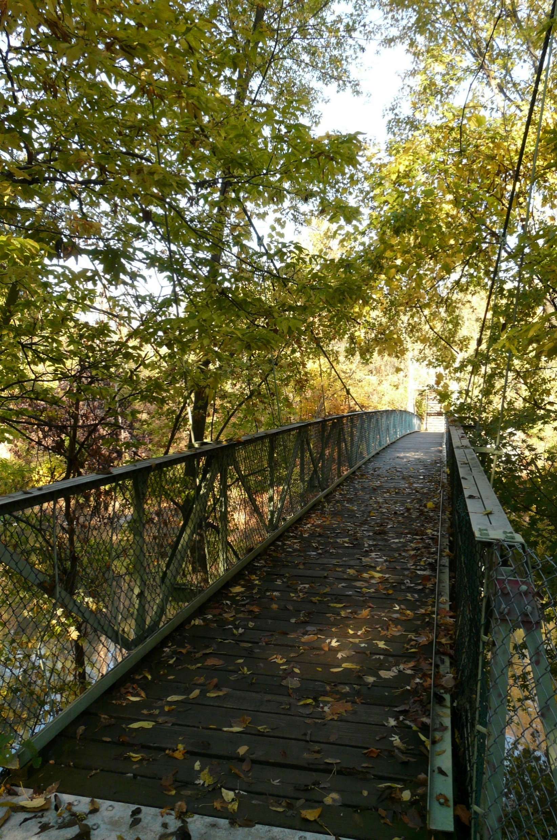
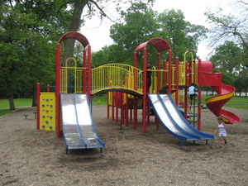
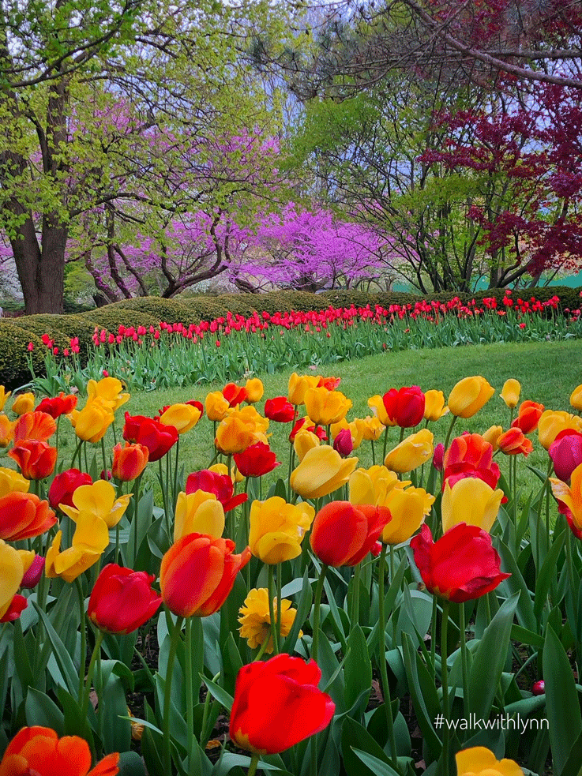
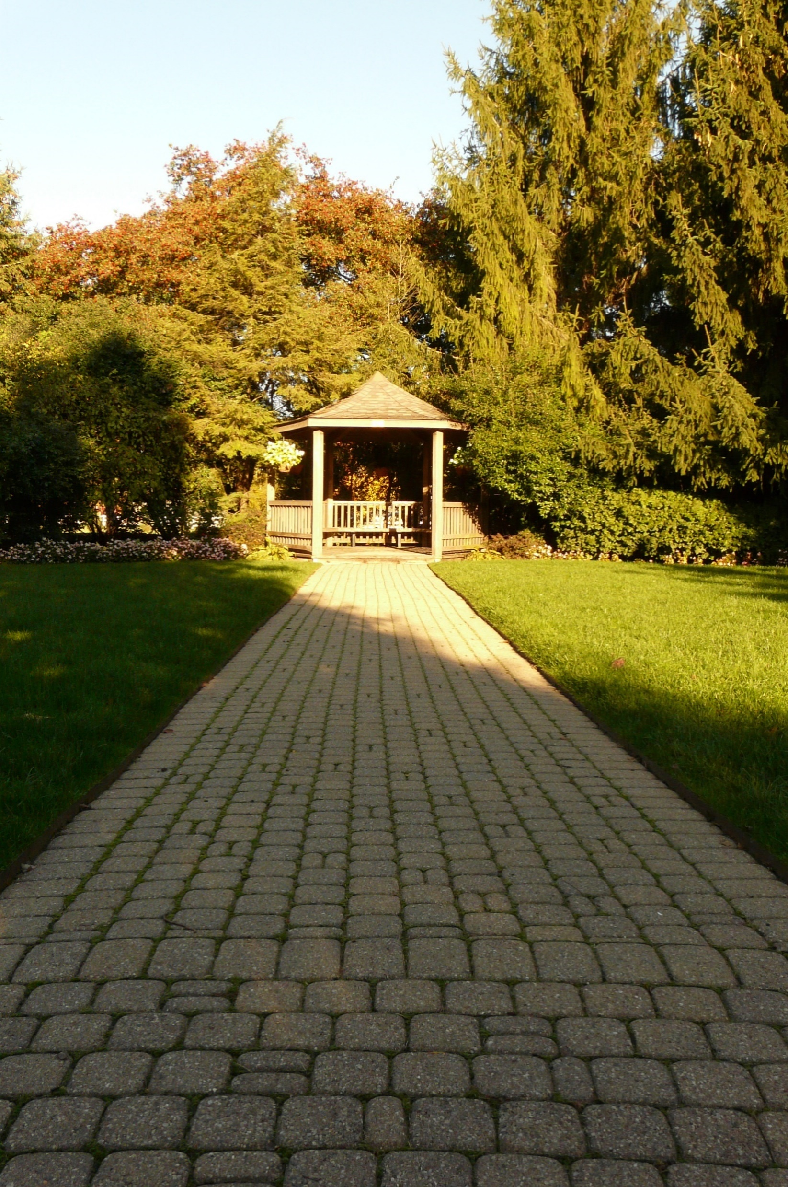
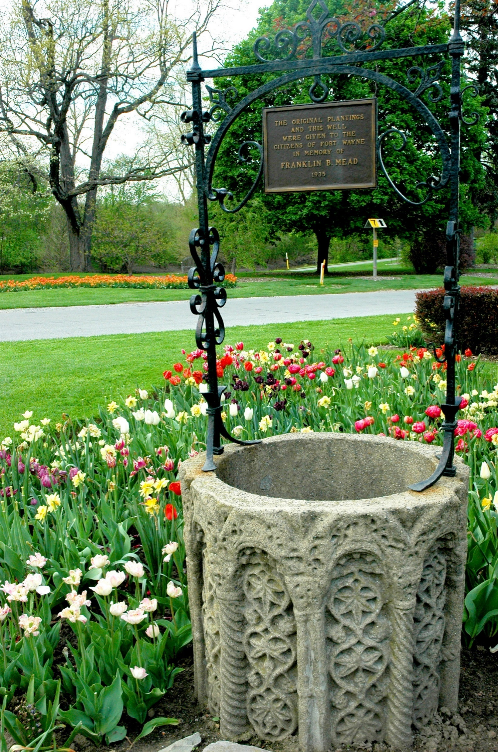
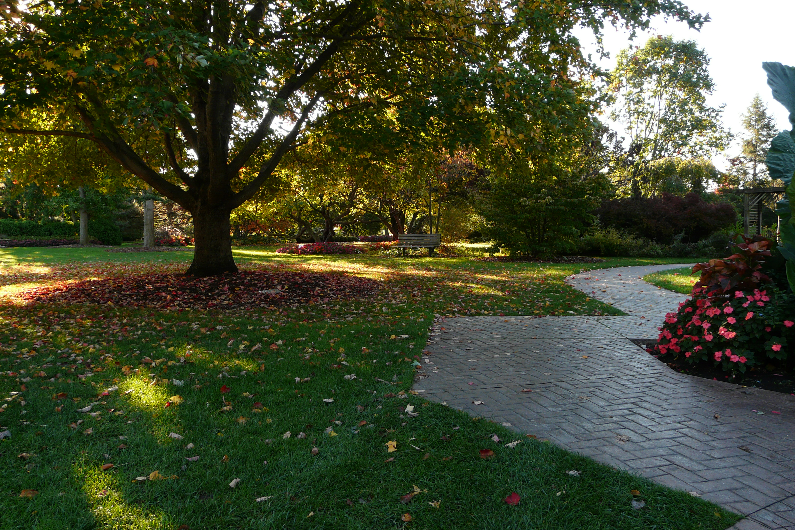
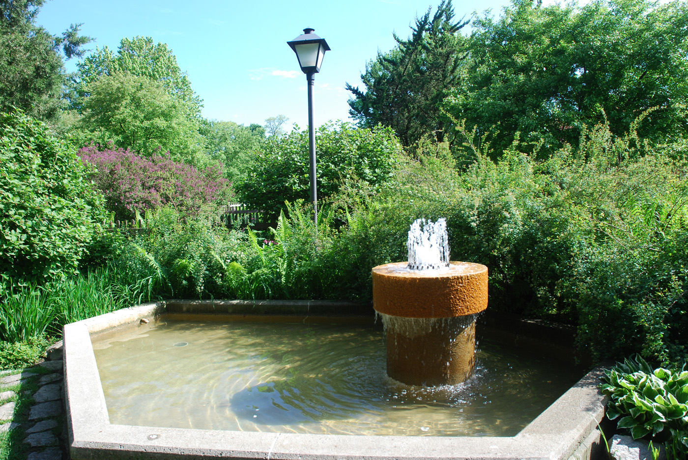
FOSTER PARK TODAY
More unique items in the park.
Suspension Bridge
Suspension Bridge
Playground
Flower Beds
Meditation Areas/Bridal Glen
Wishing Well
Diver Garden

Slide 15
Much more to come…

