Slide 1
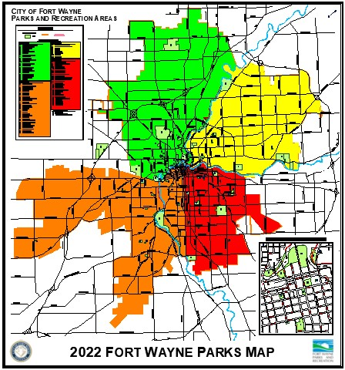
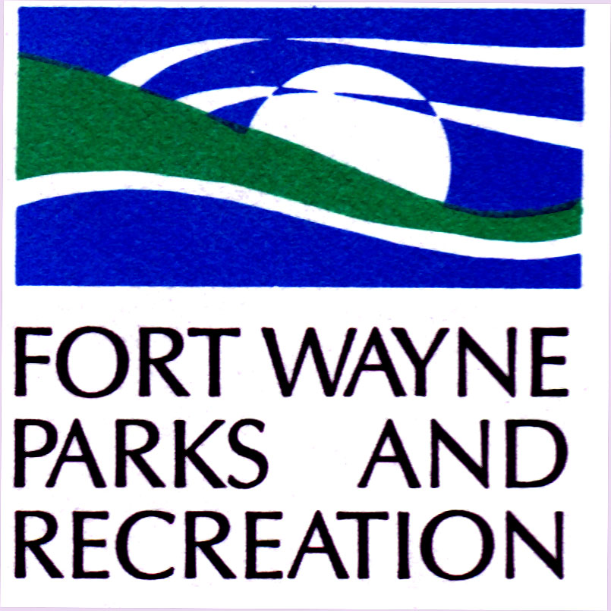
Fort Wayne Board Of Park Commissioners
Parks History and Highlights:
Ivan Lebamoff Reservoir Park
John Street Playlot
McCormick Park

Slide 2
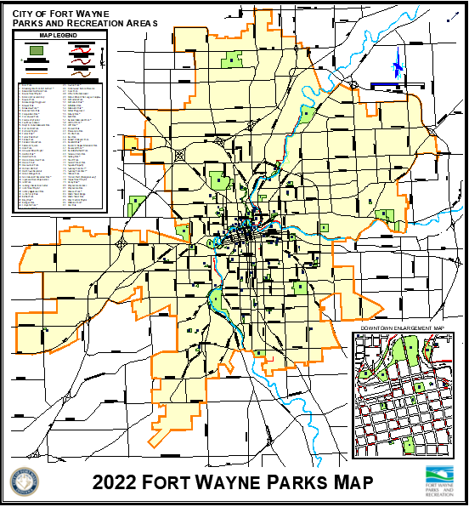
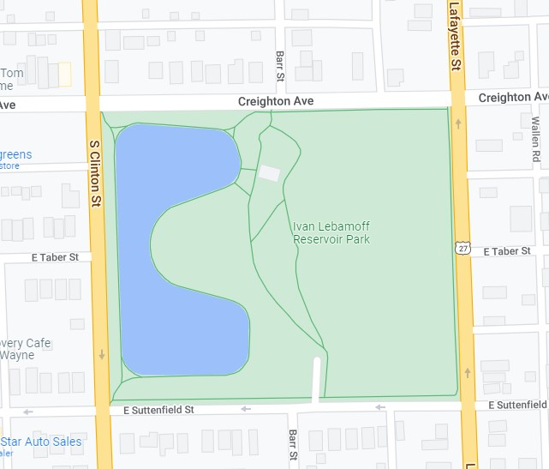
Ivan lebamoff reservoir park
2300 Clinton Street – between Creighton Ave. and E. Suttenfield St.

Slide 3
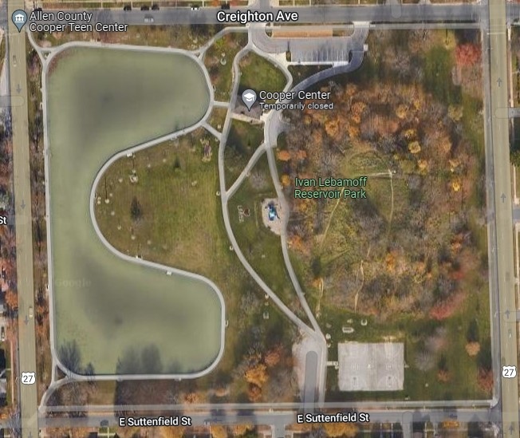
Ivan lebamoff reservoir park
Since 1880
Size in Acres: 13.1

Slide 4
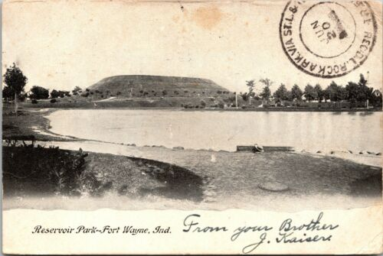
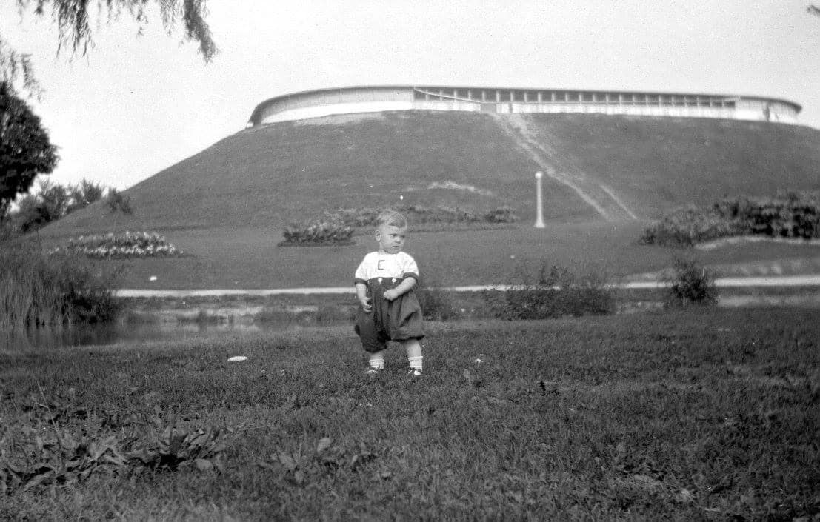
IVAN LEBAMOFF RESERVOIR park
History: Reservoir Park received its name from the fact that it is the site of the city’s first water reservoir that provided fresh municipal water to the residents of the city. In 1880, the site known as “the hill” was constructed and within the top of the hill, a 4.8 million-gallon concrete tank was built to supply water and water pressure to the faucets of the residents of the city. Water was pumped from deep wells and stored in the tank until needed. The park’s lake was created when soil was dug to form the earthen embankment along the water tank’s sides.

Slide 5
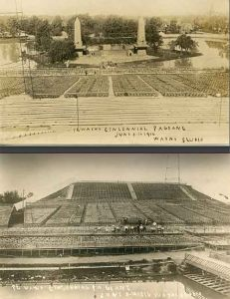
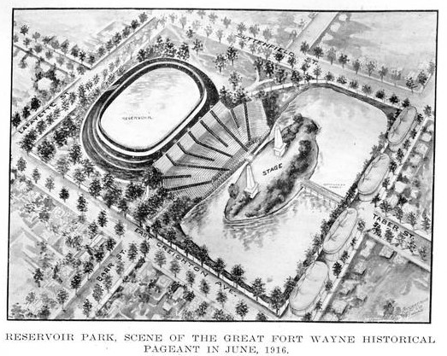
Ivan Lebamoff Reservoir park
History: In 1916, Reservoir Park was host to an elaborate event celebrating Indiana’s 100th birthday. It was known as “the Great Fort Wayne Historical Pageant”. As part of the event, the largest temporary construction project in the city’s history was completed to hold 14,000 people. The seating rose from the edge of the lake to the top of the reservoir hill. The event included over 1,000 costumed participants on the pylon-flanked stage and tickets were fifty cents each. The event included a visit and talk from President William Howard Taft, lasted for two weeks and was viewed by an estimated 50,000 people.

Slide 6
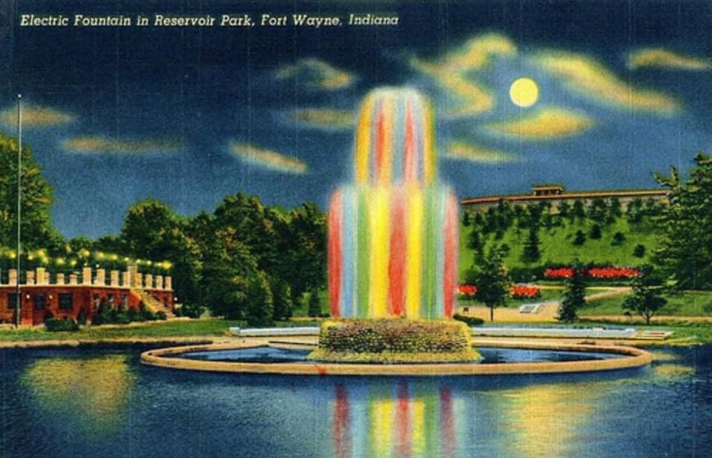
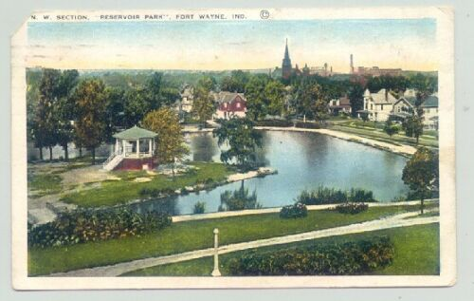
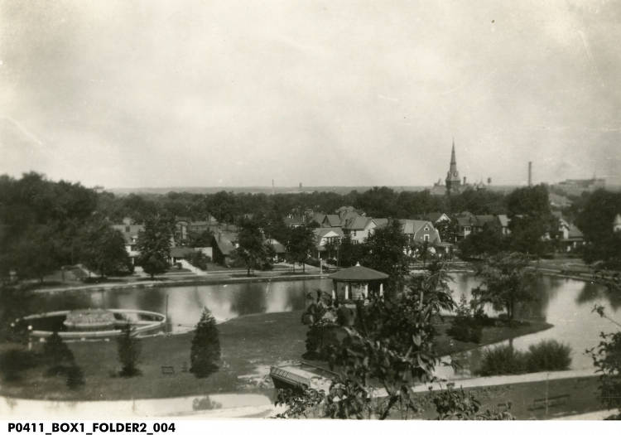
Ivan lebamoff reservoir park
The reservoir tank served the city until 1955 when it was retired due to deteriorating condition. In 1959 the city took bids to completely raze the tank, along with the hill. However costs to do so were high and the citizens of Fort Wayne protested the removal of the hill. Therefore the tank cap was bulldozed off and the tank was filled in with soil.
The park was home not only to the reservoir tank, but also to a center island with a bandstand gazebo, a building housing the water pumping equipment, and the city’s first lighted electric water fountain. All of which have since been removed.

Slide 7
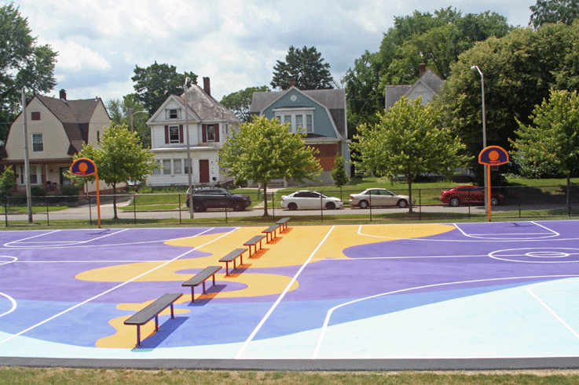
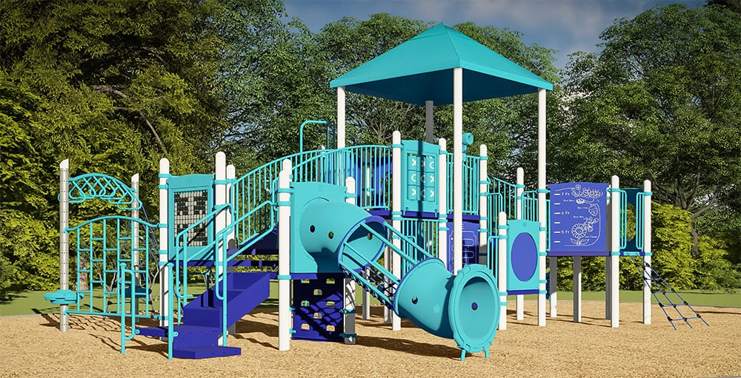
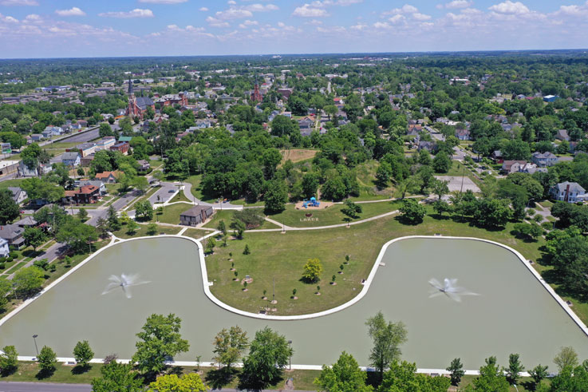
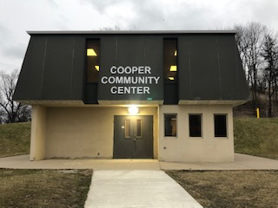
IVAN LEBAMOFF RESERVOIR PARK - TODAY
In 2009, the Park was renamed Ivan Lebamoff Reservoir Park after former Mayor Lebamoff (1972-1975) who was also on the City Park Board. During his tenure, Lebamoff helped find funding to rebuild the deteriorating Reservoir Park in the mid 1970s and transferred the property from City Utilities to the Parks and Recreation Department. Today the park is a beautiful and active park with basketball courts, a playground, the Cooper Community Youth Center, and of course the scenic pond with two fountains.

Slide 8
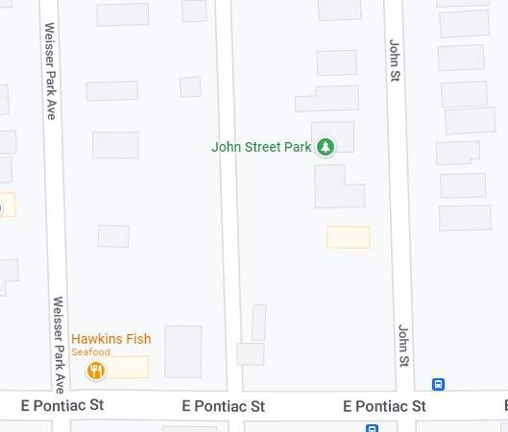
John street playlot
2500 John Street

Slide 9
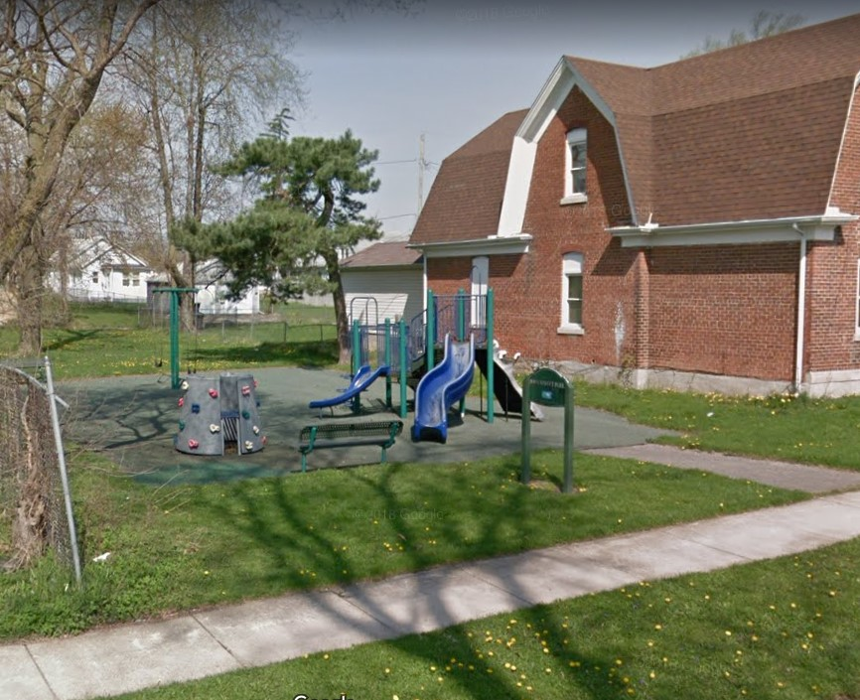
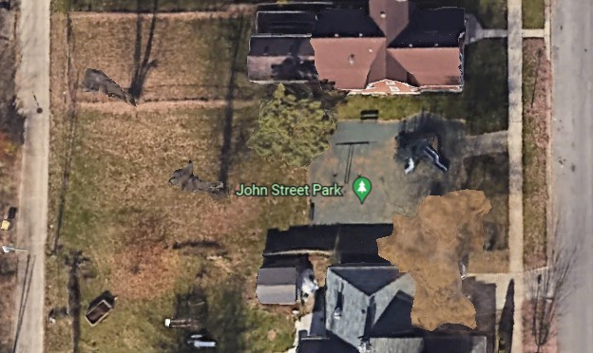
John street playlot
Since 1975
Size in Acres: .17
History:John Street Park was privately owned by Sheldon Hine who sold it to Robert Musser for “one dollar and other valuable consideration.” The Parks and Recreation Department then purchased this land in 1975 from Mr. Musser and converted it into John Street Park.
This park features a playset with multiple slides, swing set and climber.

Slide 10
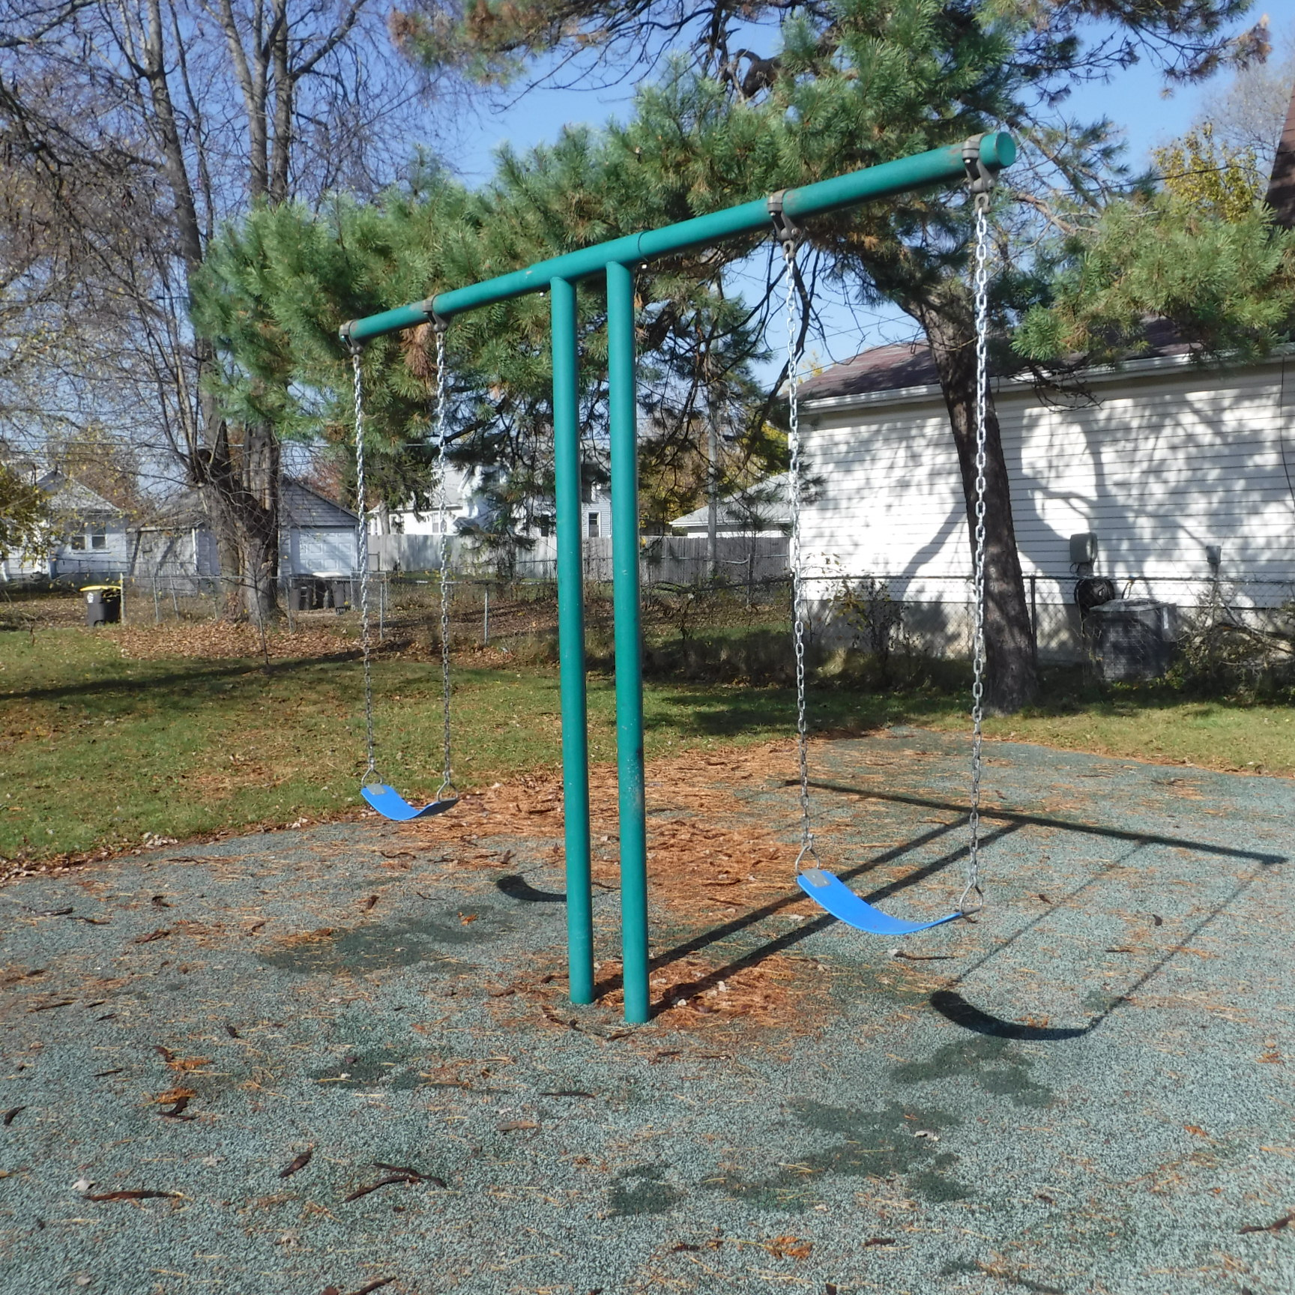
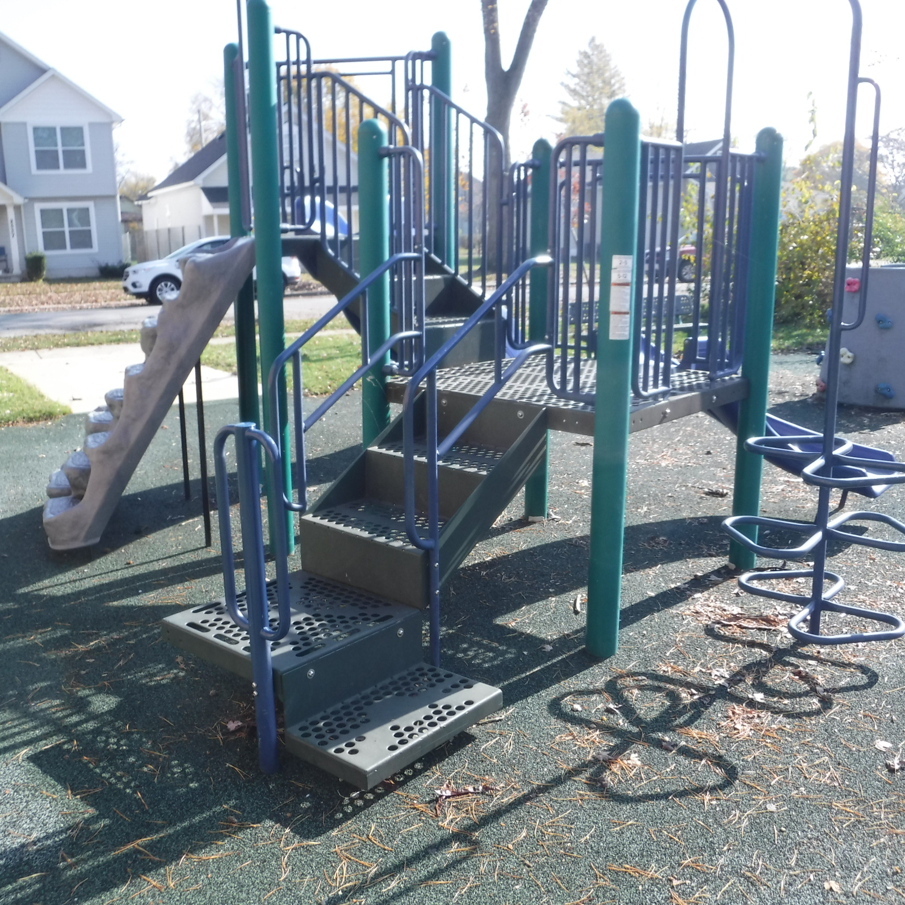
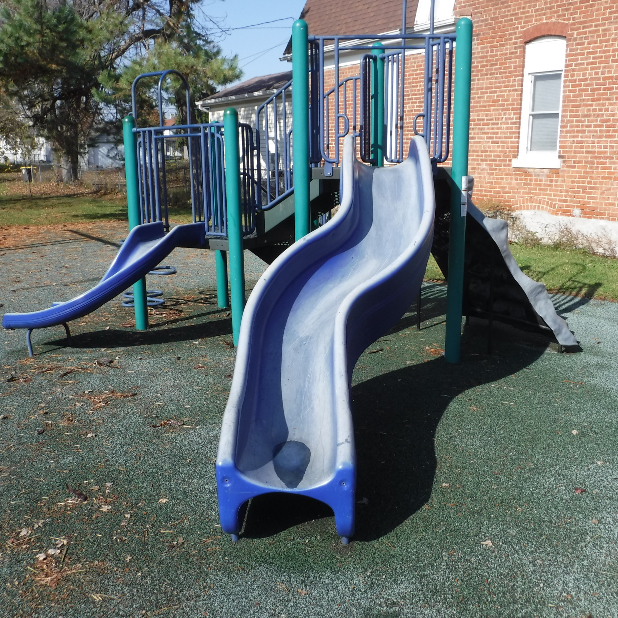
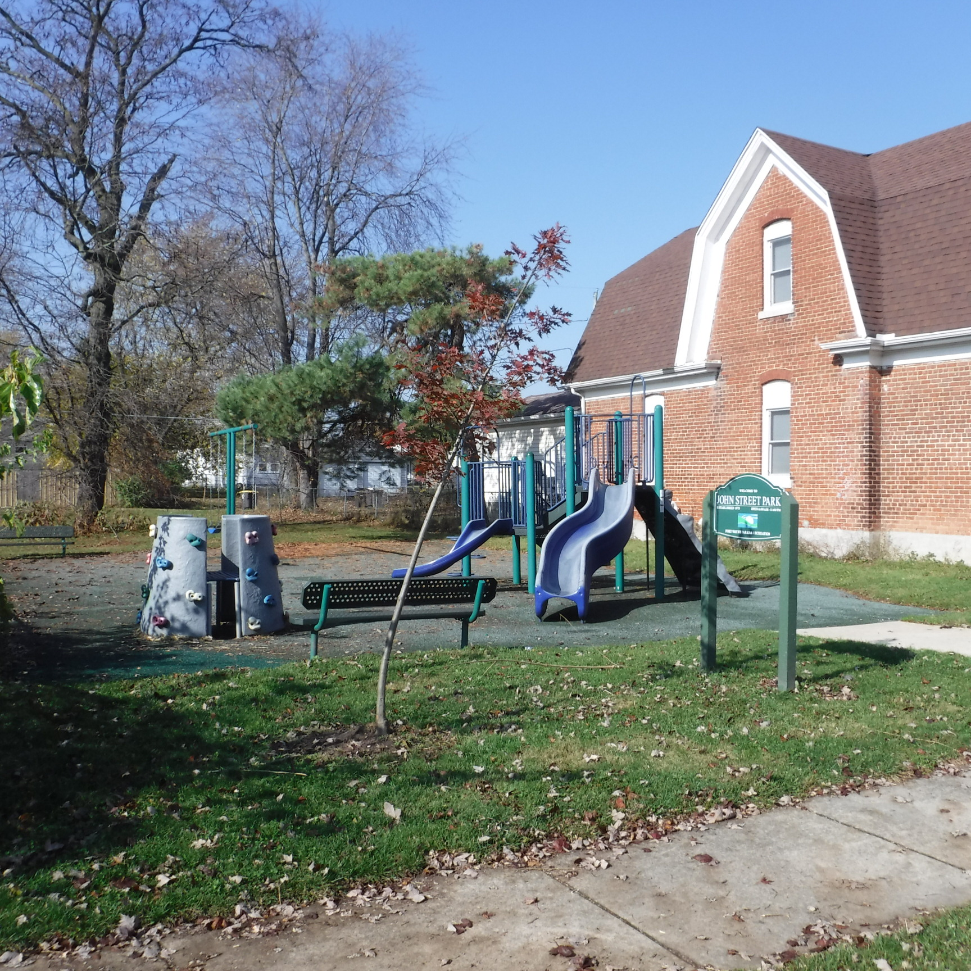
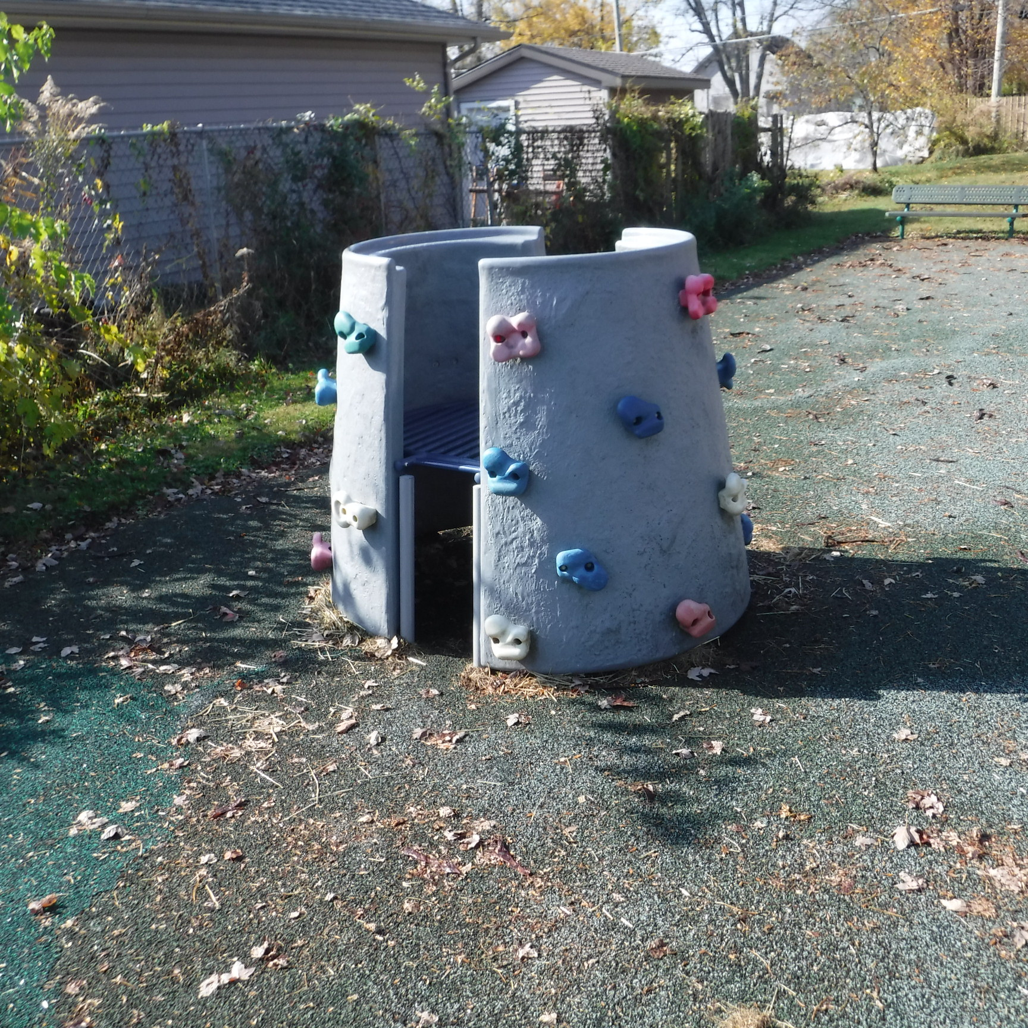
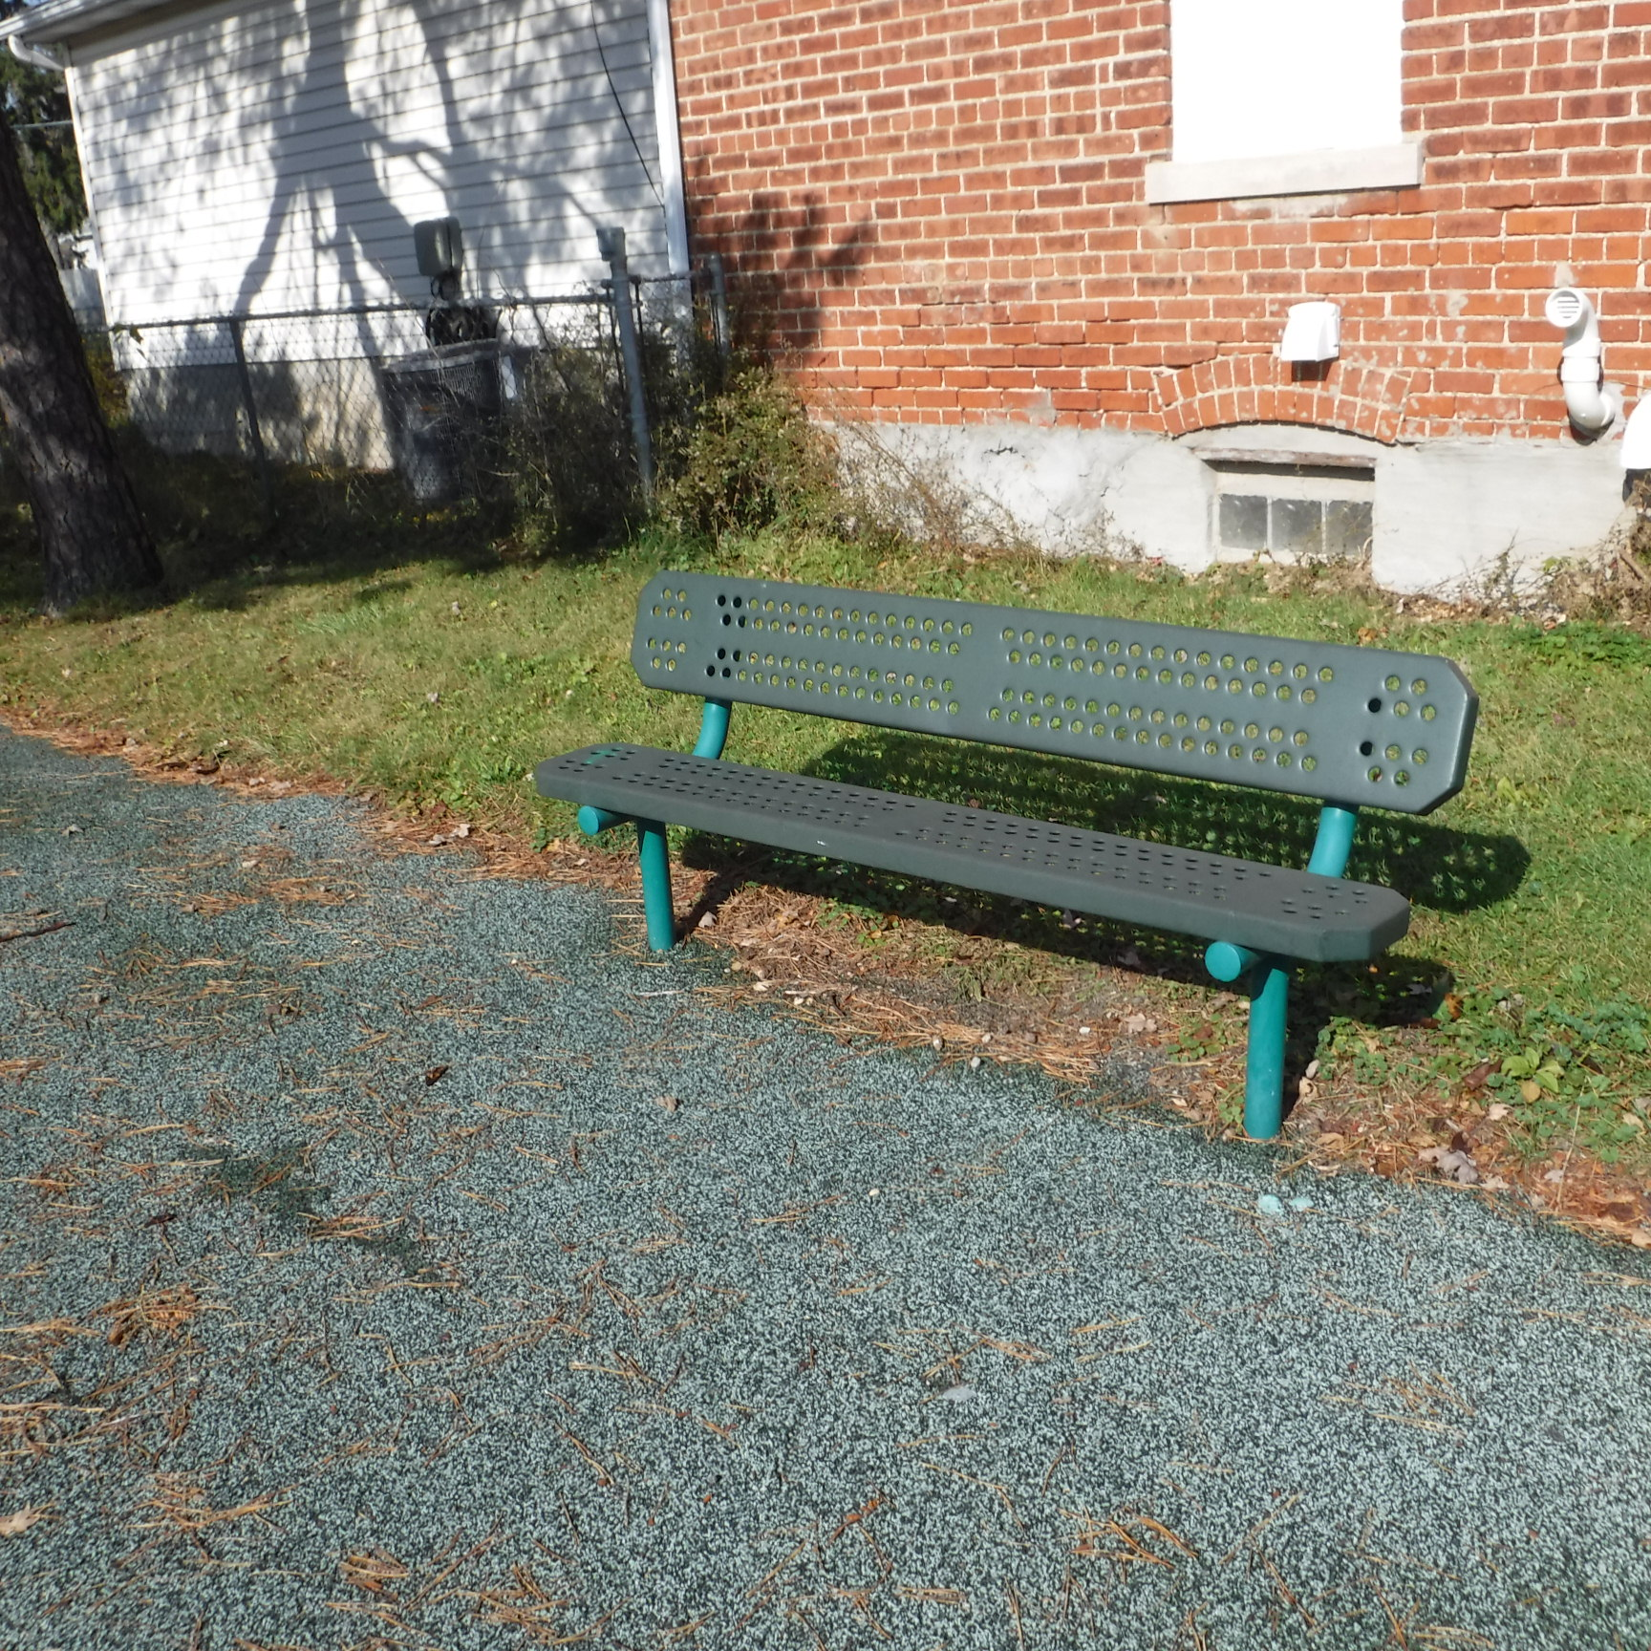

Slide 11
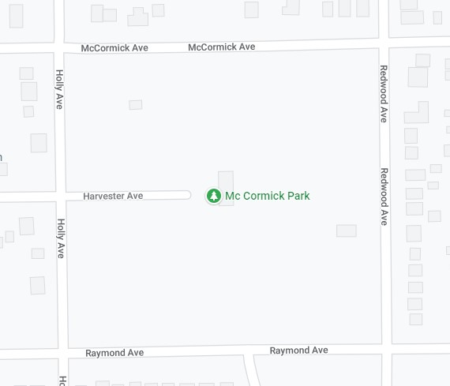
Mccormick park
2300 Raymond St.

Slide 12
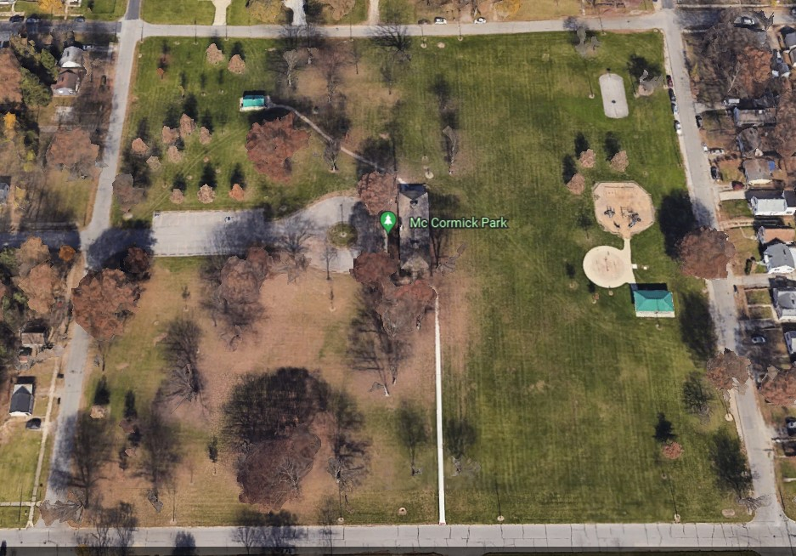
mccormick park
Since 1827
Size in Acres: 9.0
McCormick Ave.
Holly Ave.
Redwood Ave.
Raymond Ave.

Slide 13
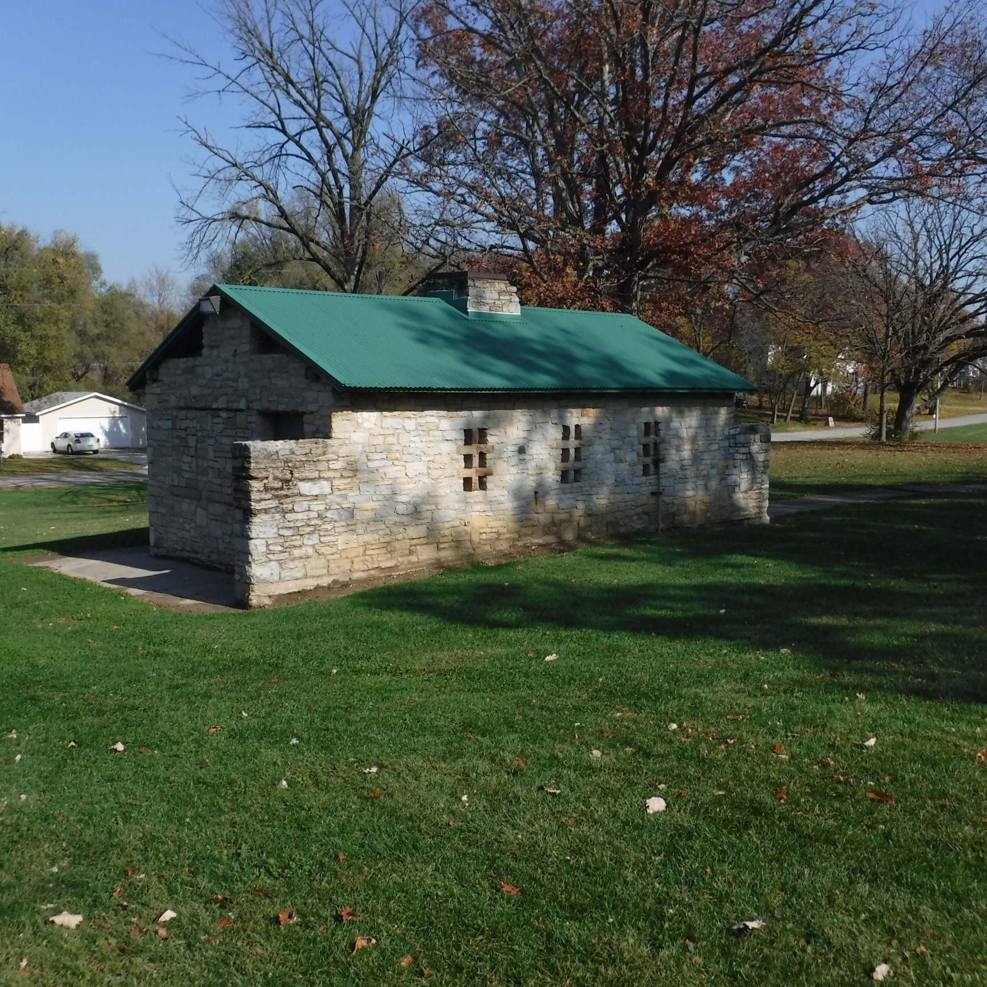
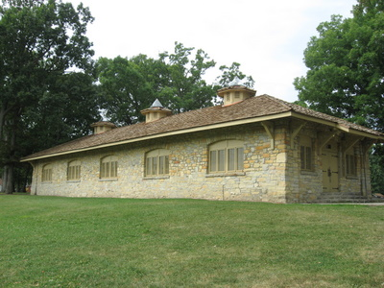
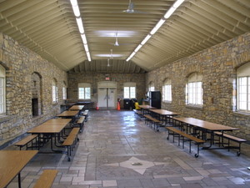
McCORMICK PARK
History: In 1927 lots bounded by Creighton, Redwood, Raymond & Holly Avenues and all streets and alleys within the boundaries were vacated and became McCormick Park. The property was a gift from the International Harvester Company. The park is home to some of the most beautiful, historic architecture in the city including the historic McCormick Pavilion and the adjacent restroom building built in 1936. It is believed that these buildings were built through the Works Progress Administration (WPA) program by Presidential Order to provide paid jobs for the unemployed during the Great Depression in the United States.

Slide 14
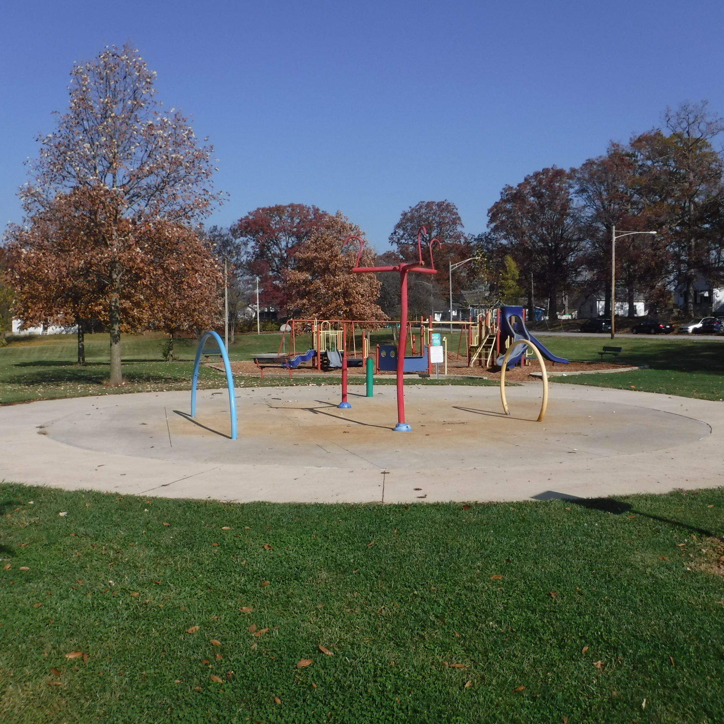
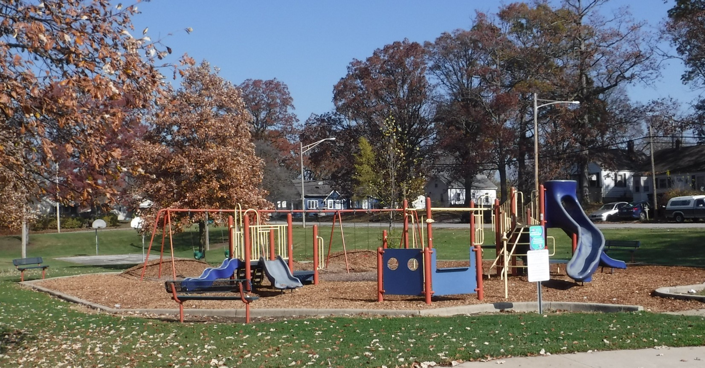
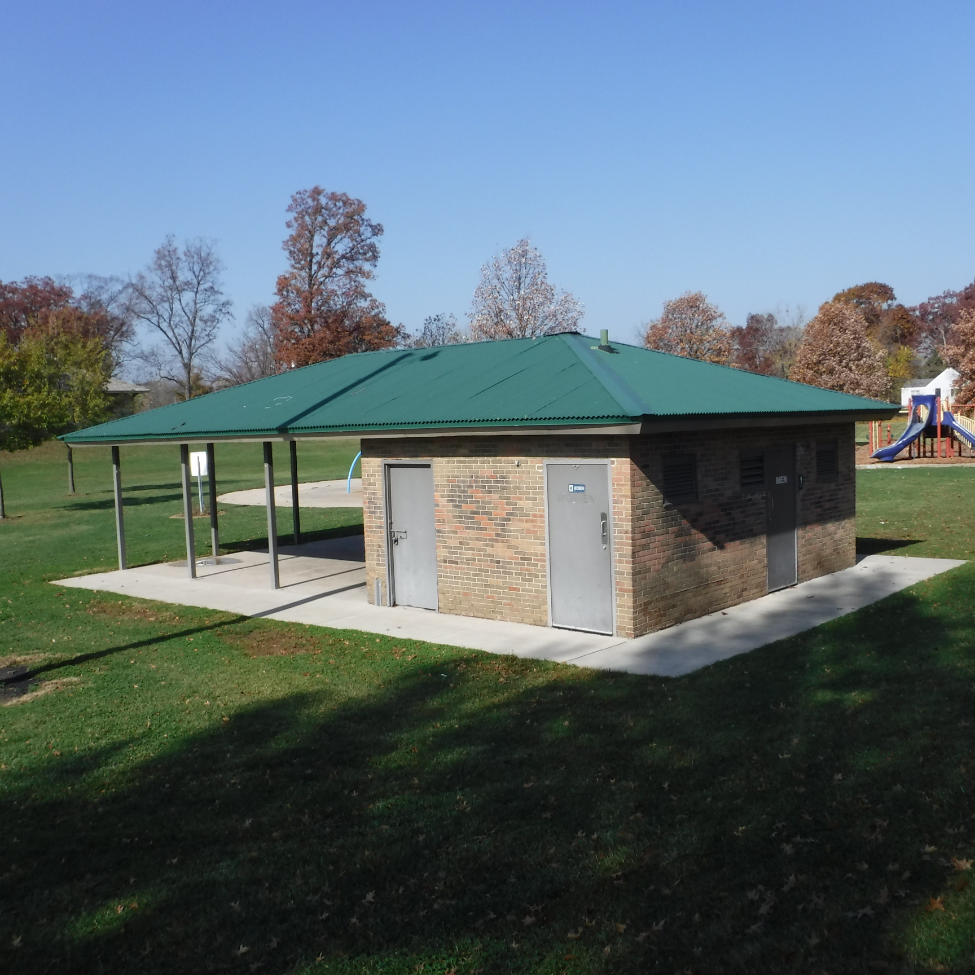
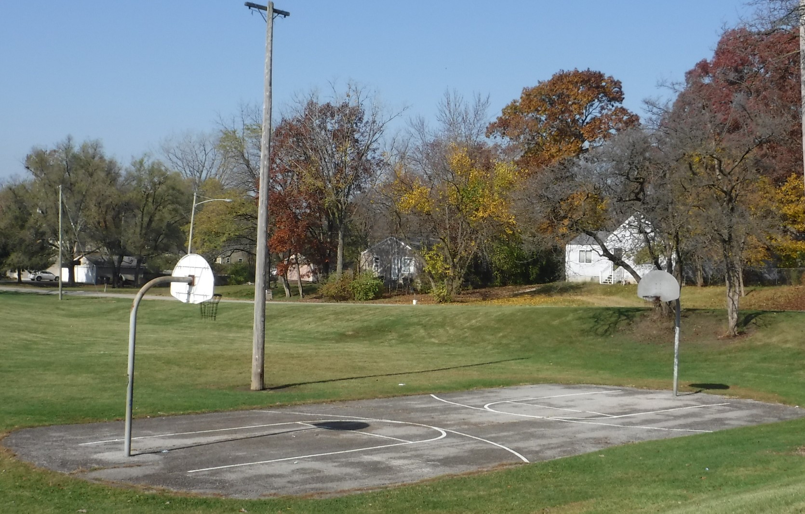
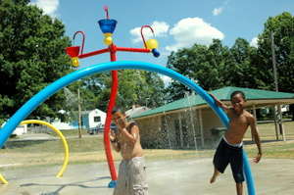
McCORMICK PARK TODAY
While the western side of the park is a quiet, tree covered area, the eastern side of the park provides ample summer fun with a children’s playground, a basketball court, an open-air shelter with public restrooms and a large splashpad area.

Slide 15
Much more to come…

