Slide 1
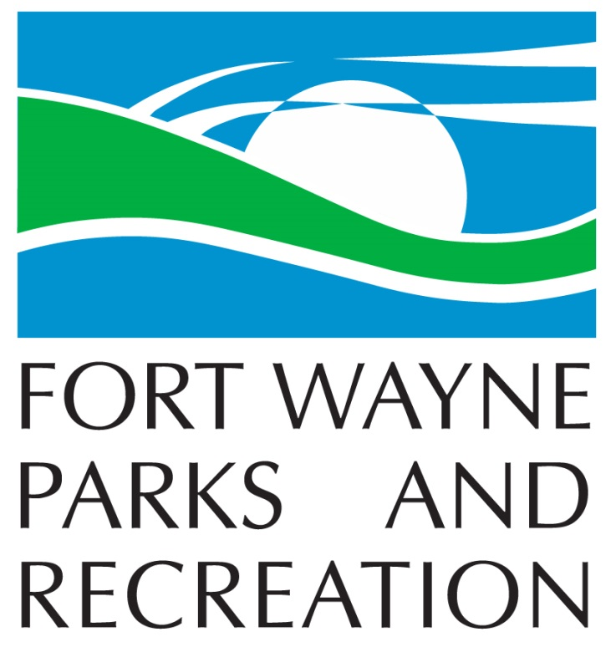
2020 PROJECT UPDATE

Slide 2
COMPLETED PROJECTS

Slide 3
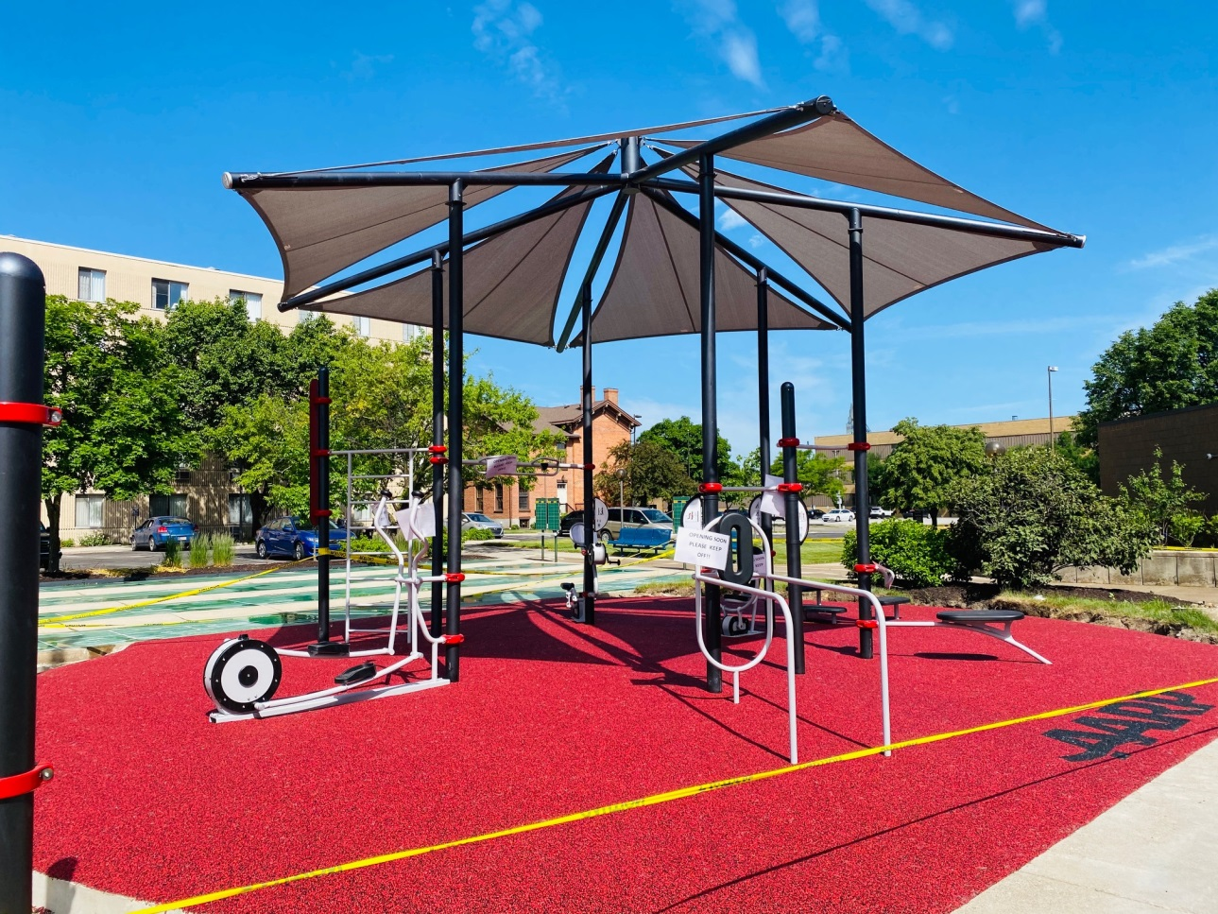
Community Center Fitlot/AARP Outdoor Fitness

Slide 4
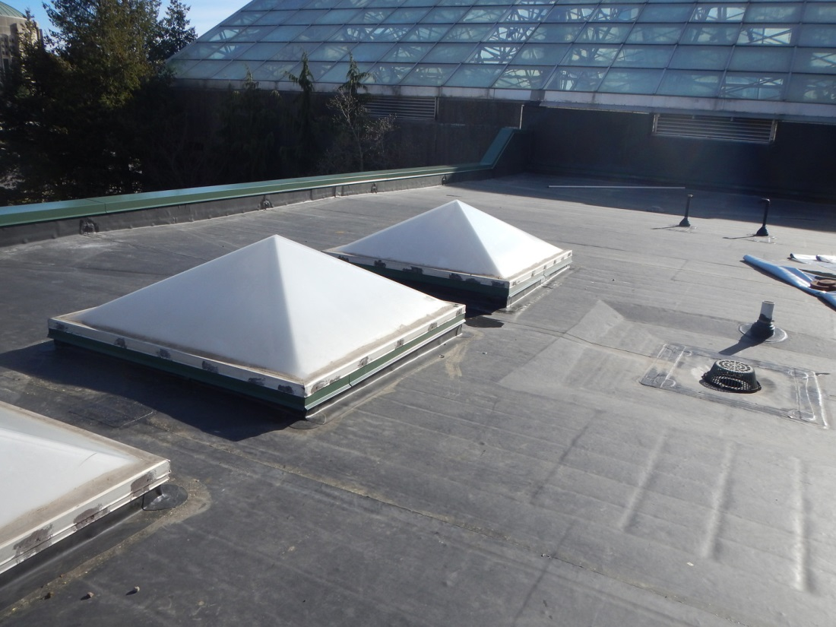
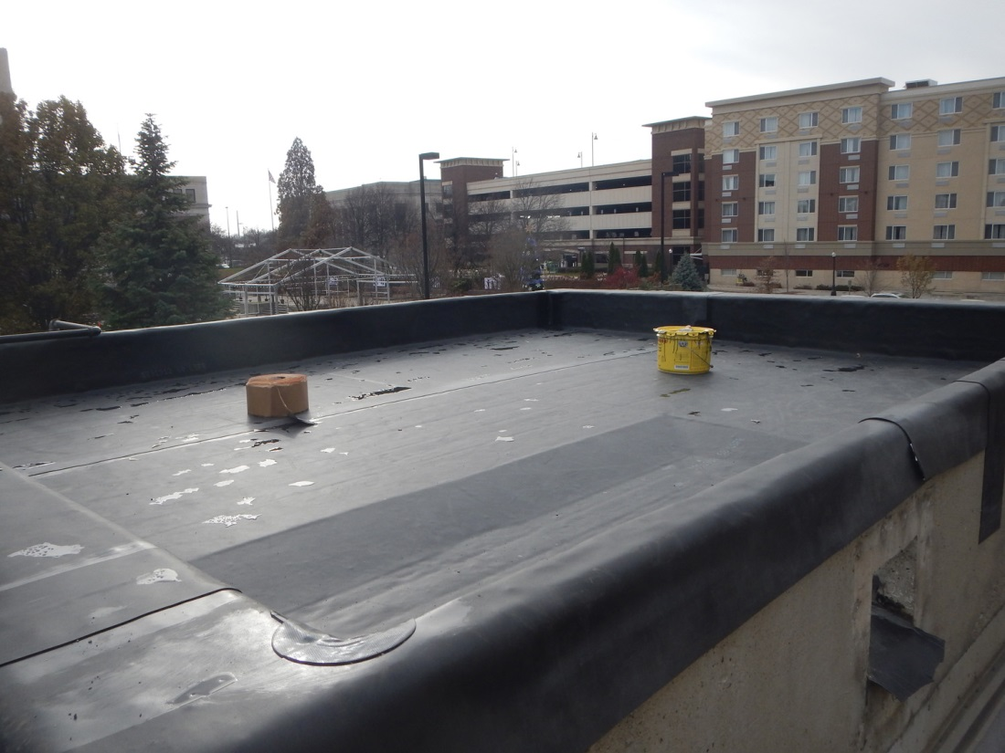
Botanical Conservatory Roof Project

Slide 5
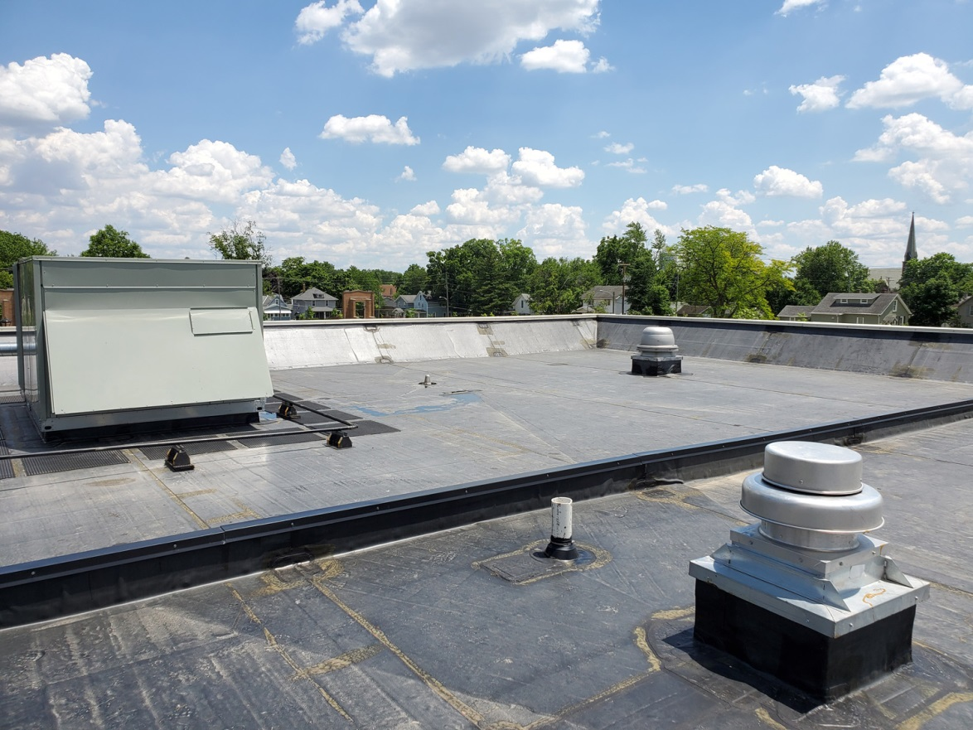
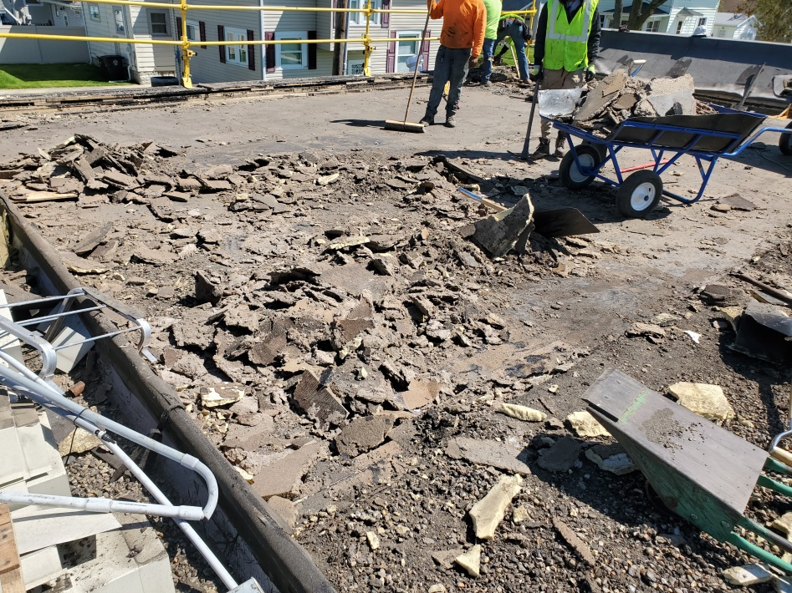
David Hefner Pavilion Roof Project
Demolition
Completed

Slide 6
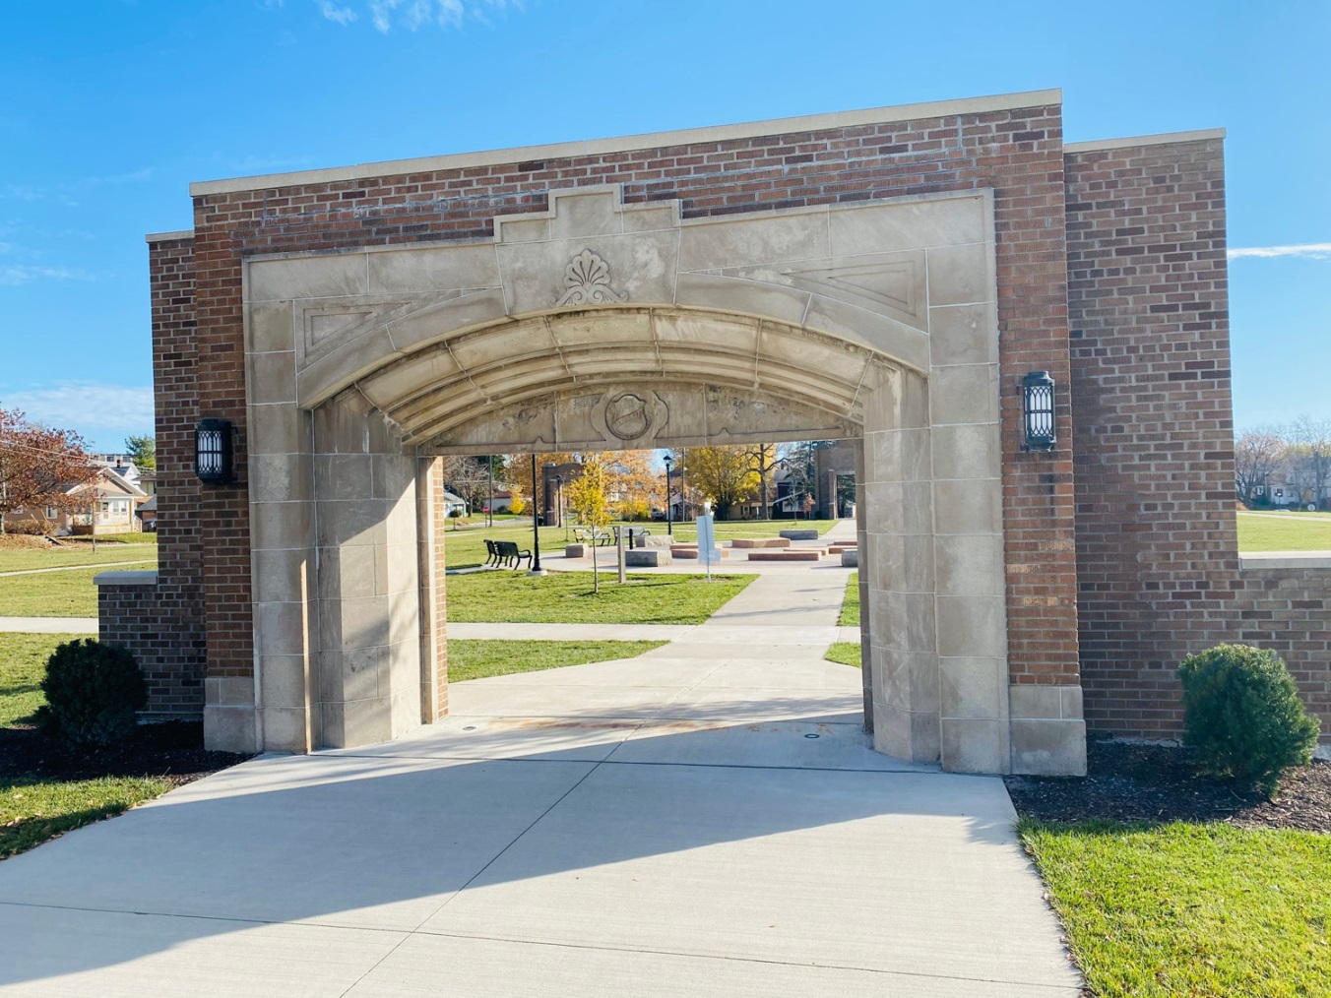
Franklin School Park Arch Repair

Slide 7
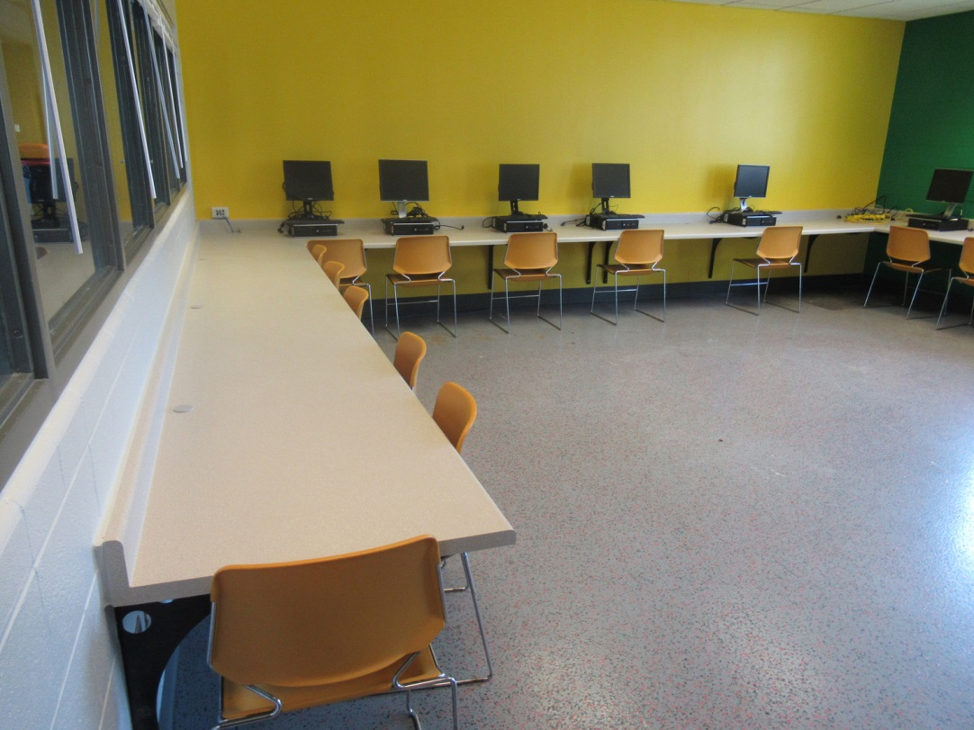
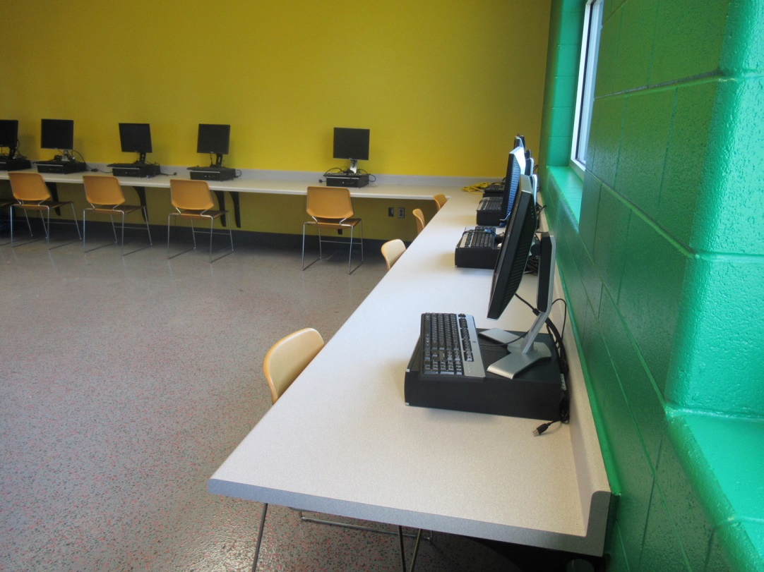
Weisser Youth Center Interior

Slide 8
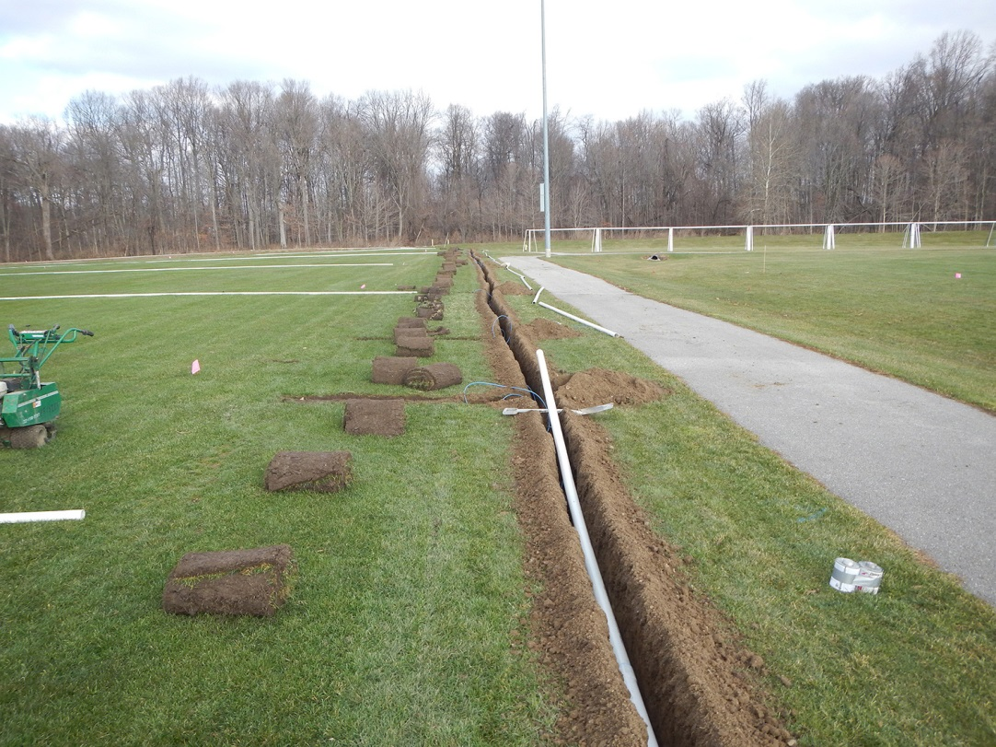
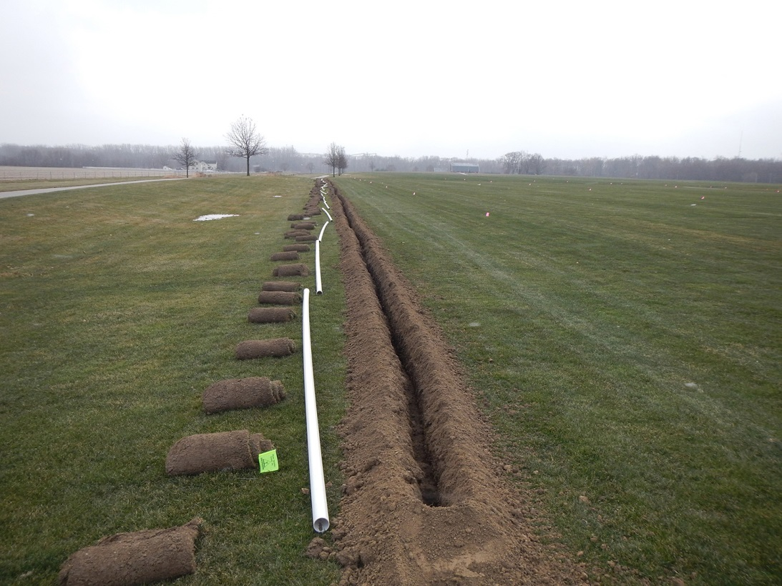
Kreager Soccer Fields Irrigation

Slide 9
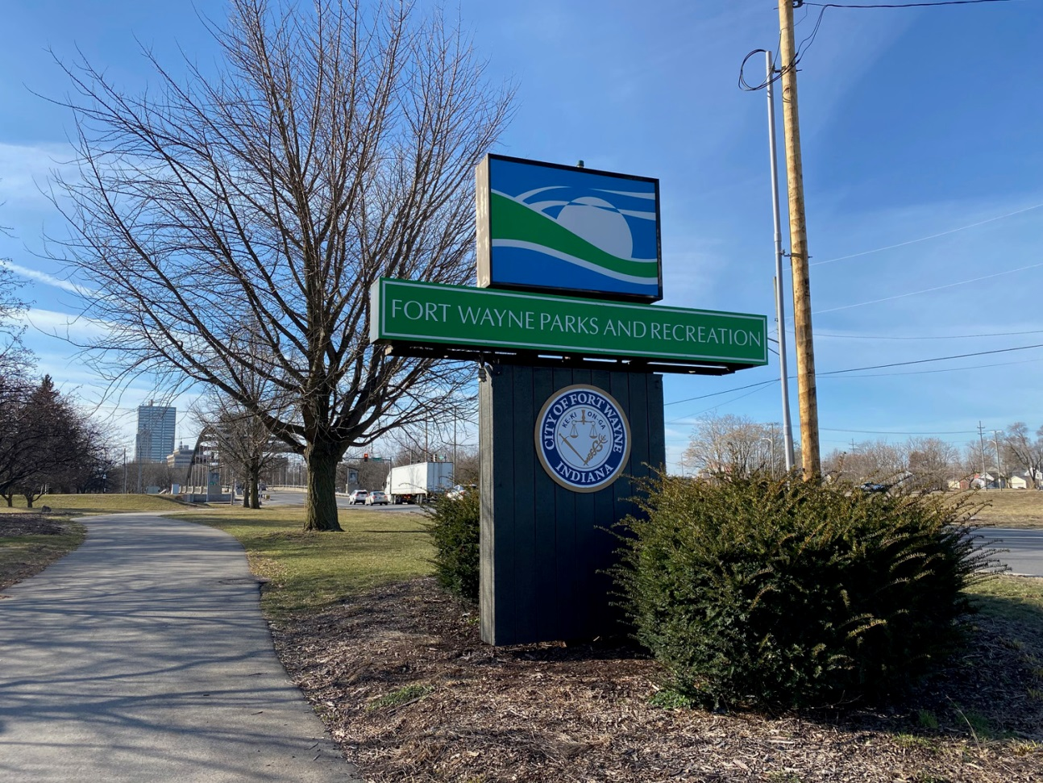
Lawton Park Sign Renovation

Slide 10
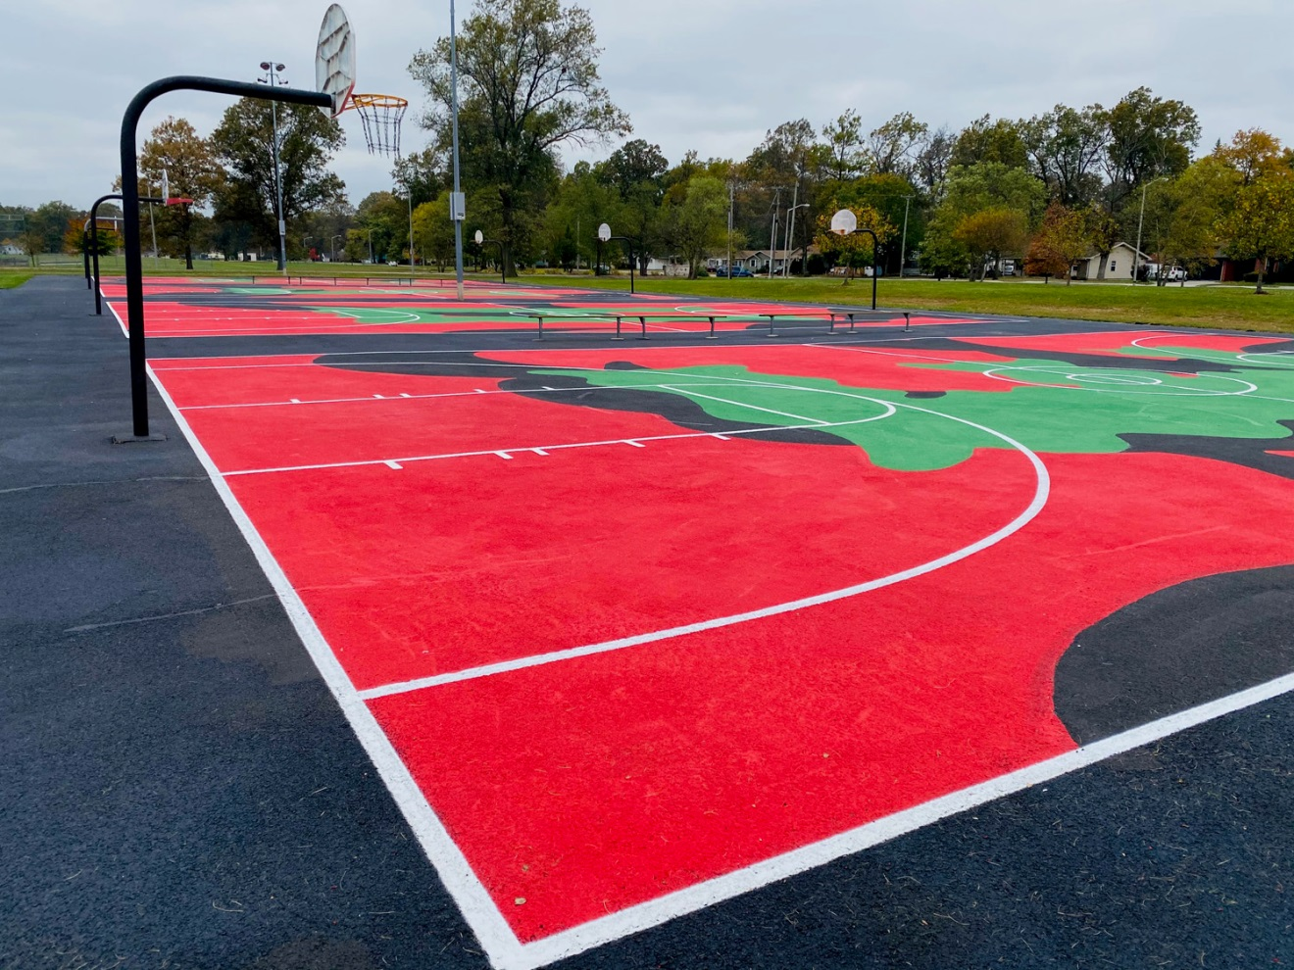
McMillen Basketball Courts

Slide 11
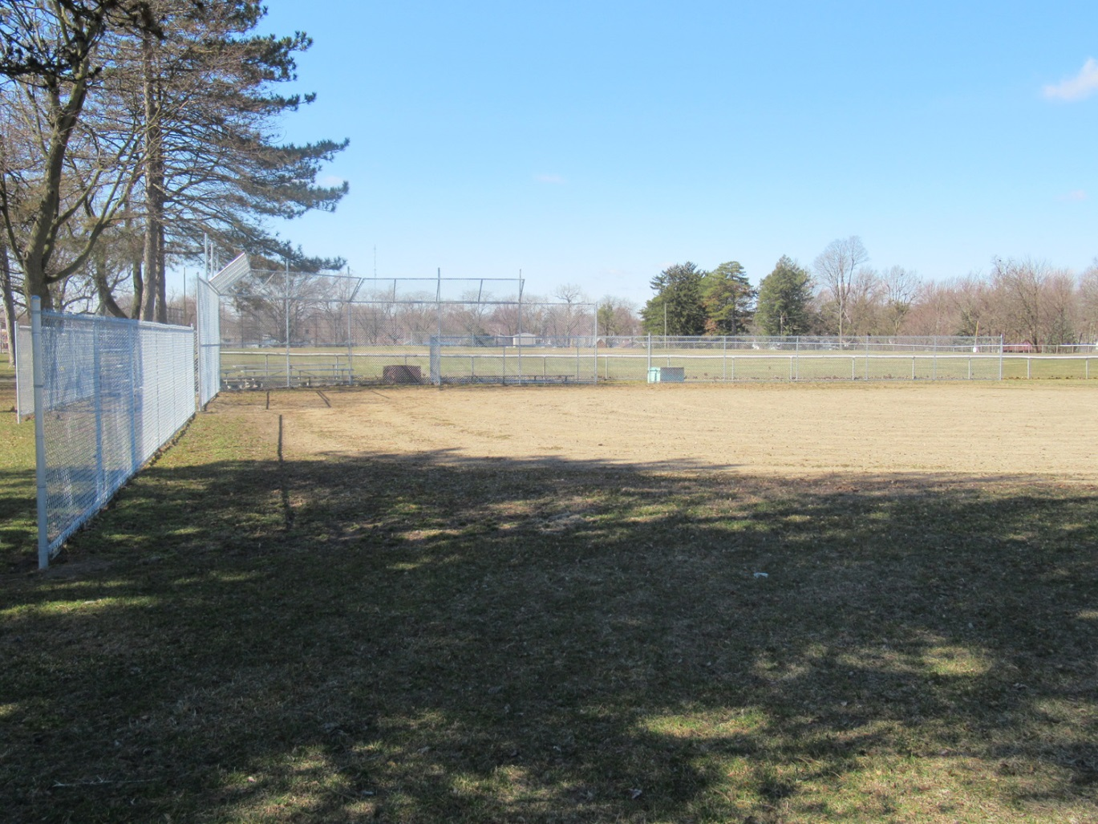
Northside Ball Diamond Fence

Slide 12
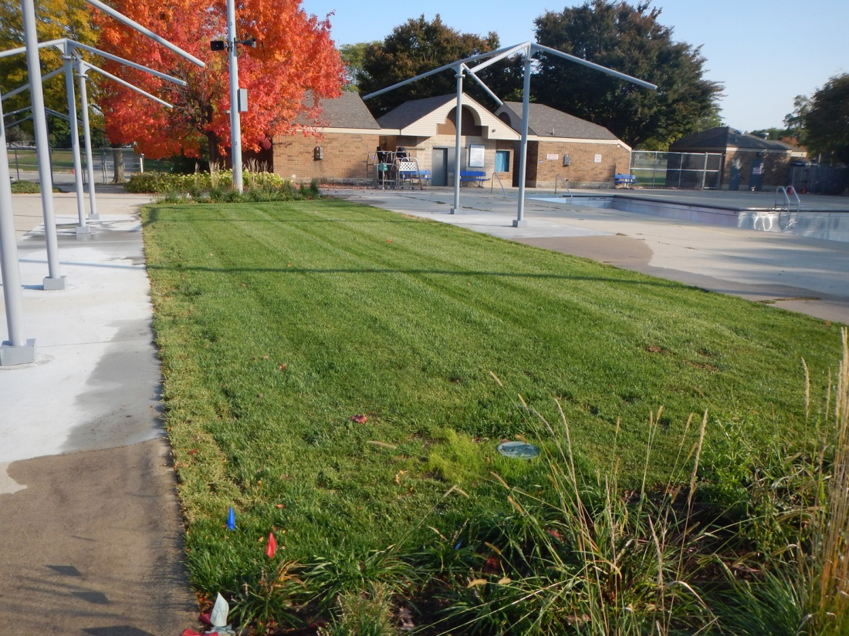
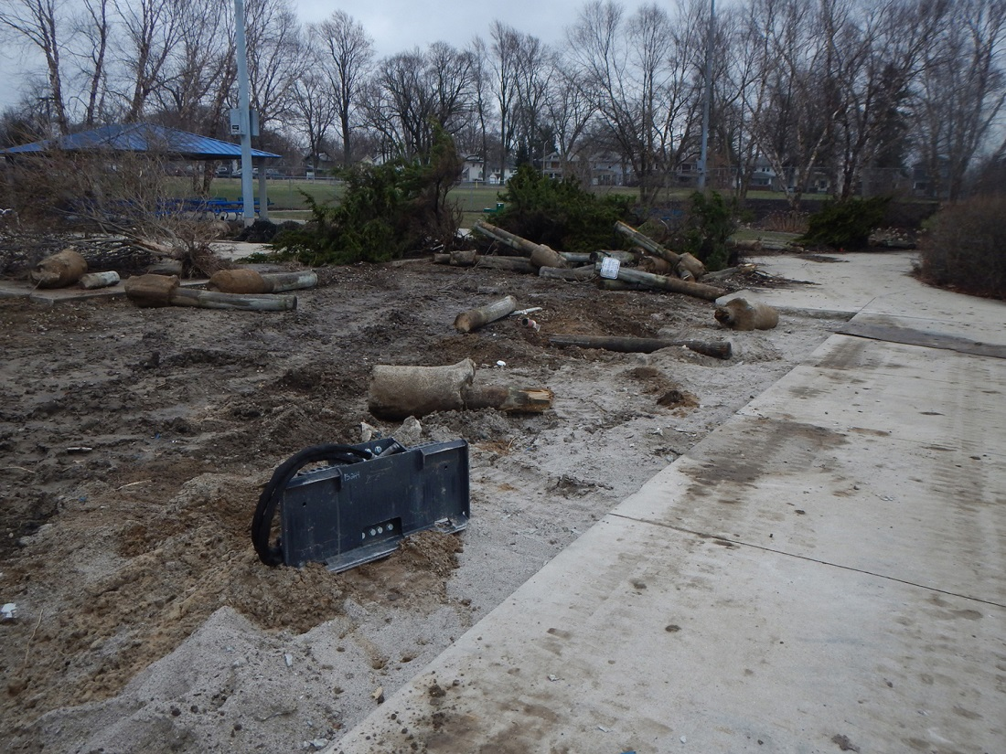
Aquatics Site Improvements – Northside & McMillen
Demolition
Completed

Slide 13
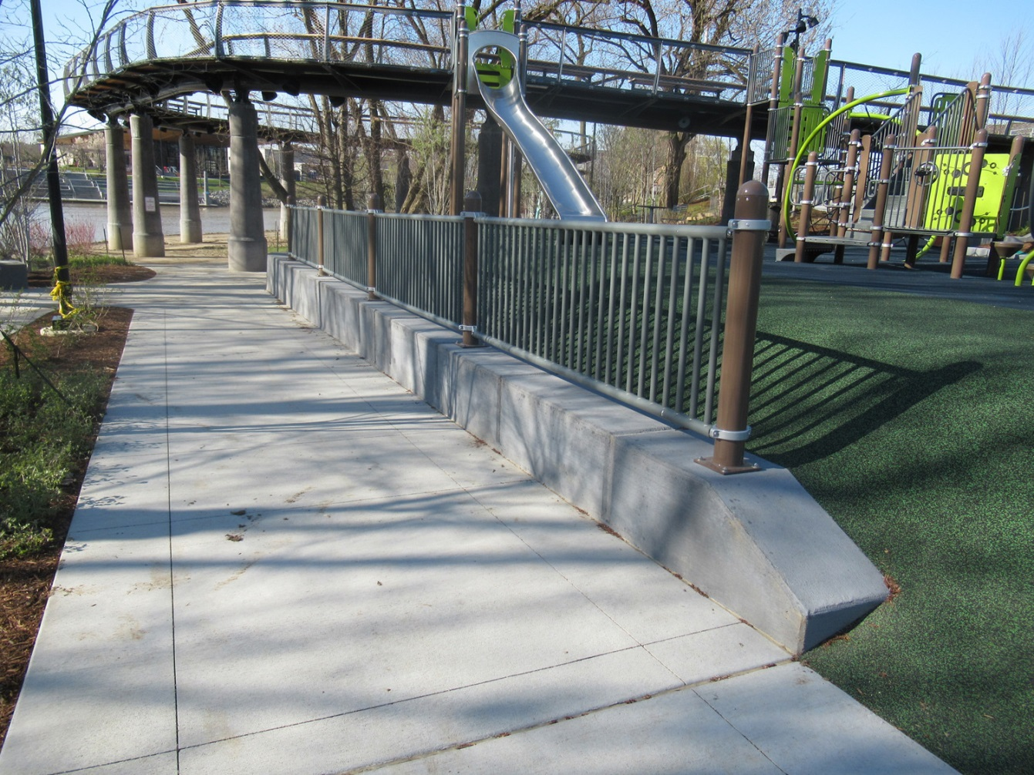
Promenade Playground Additions

Slide 14
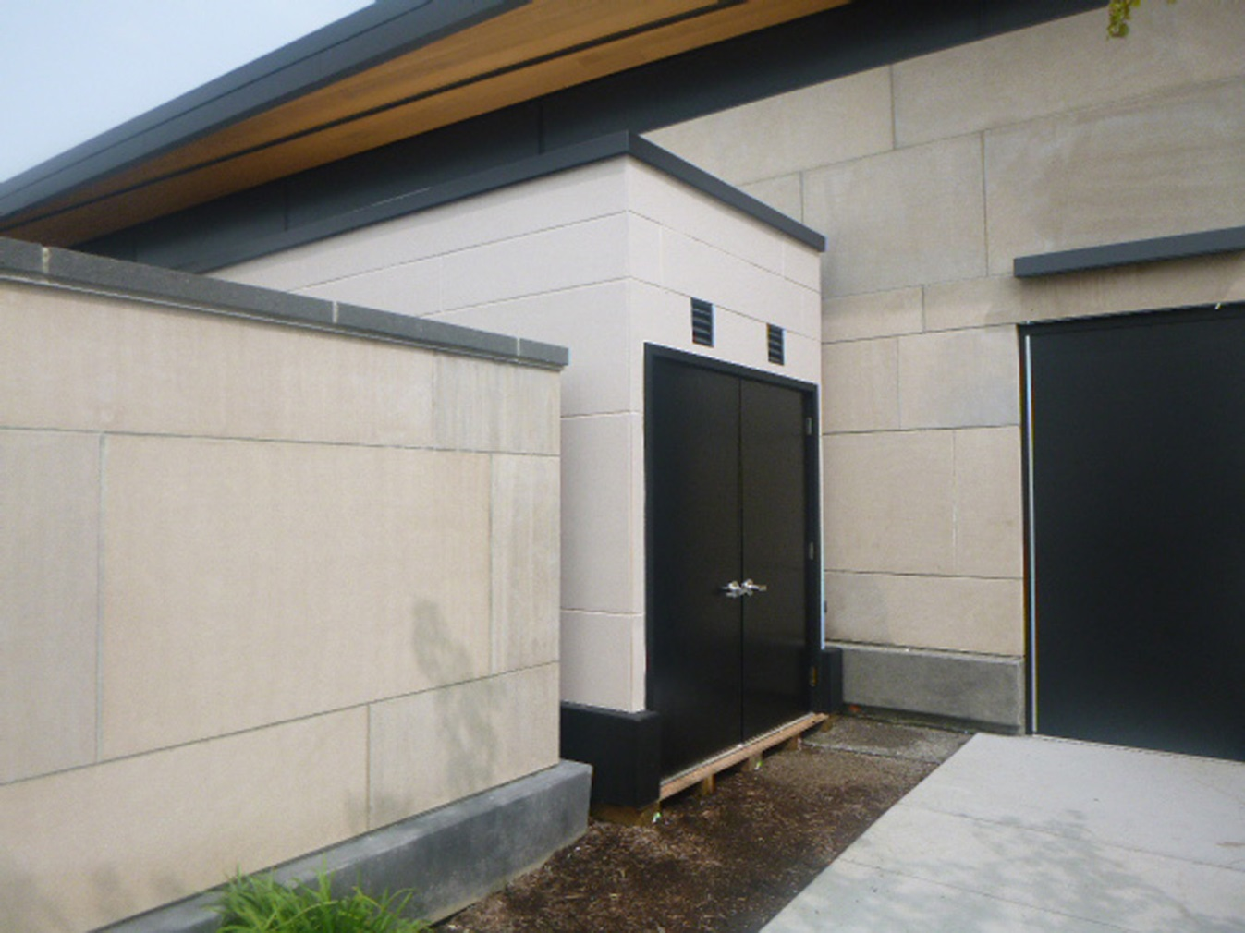
Promenade Storage Addition

Slide 15
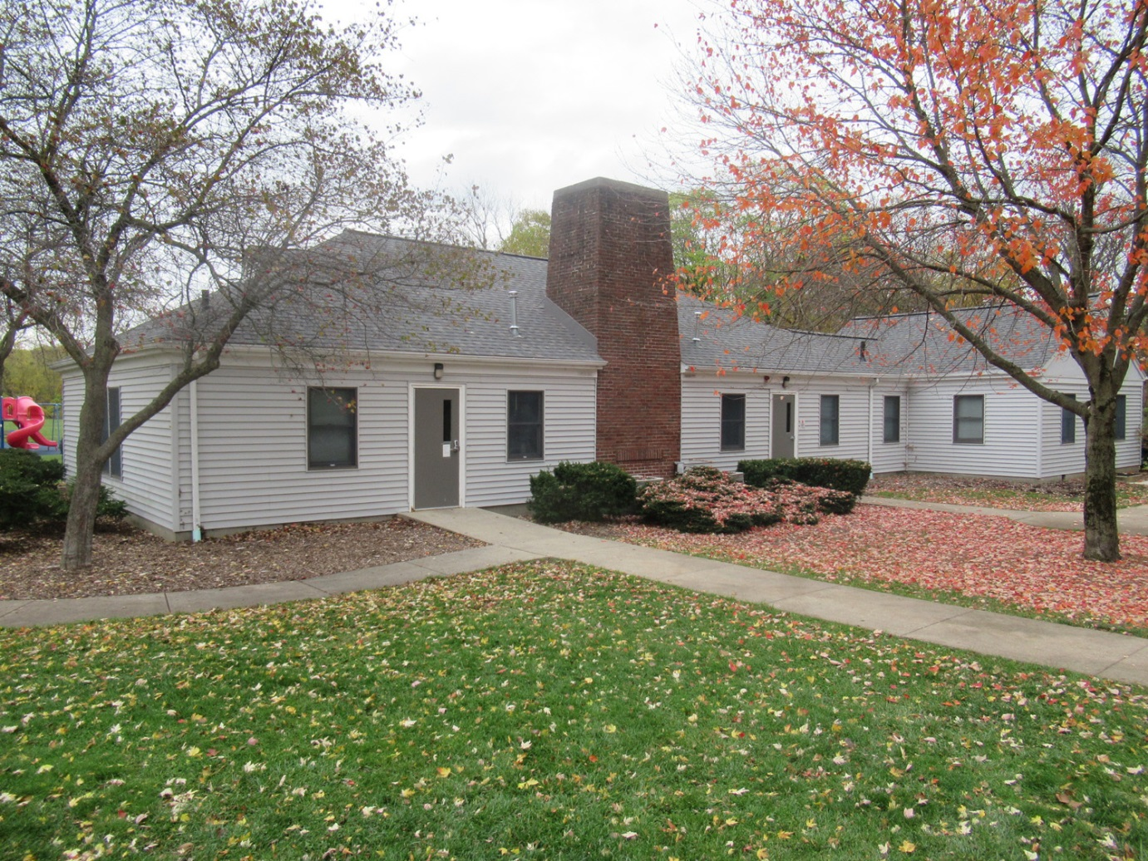
Sears Pavilion Roof Project

Slide 16
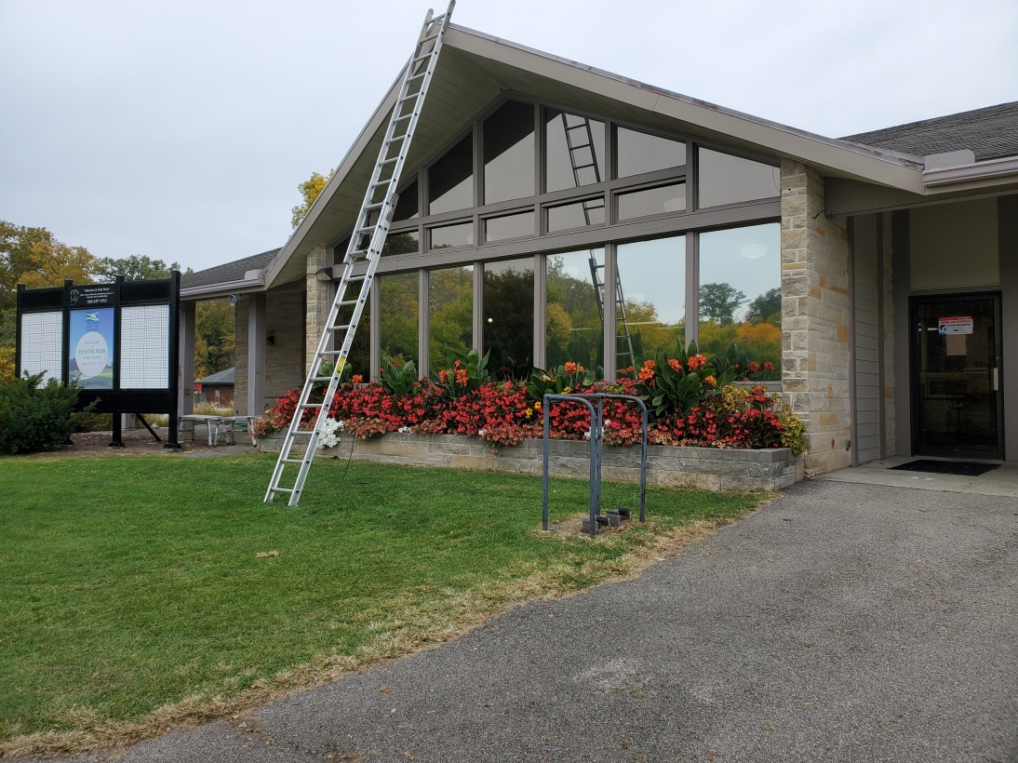
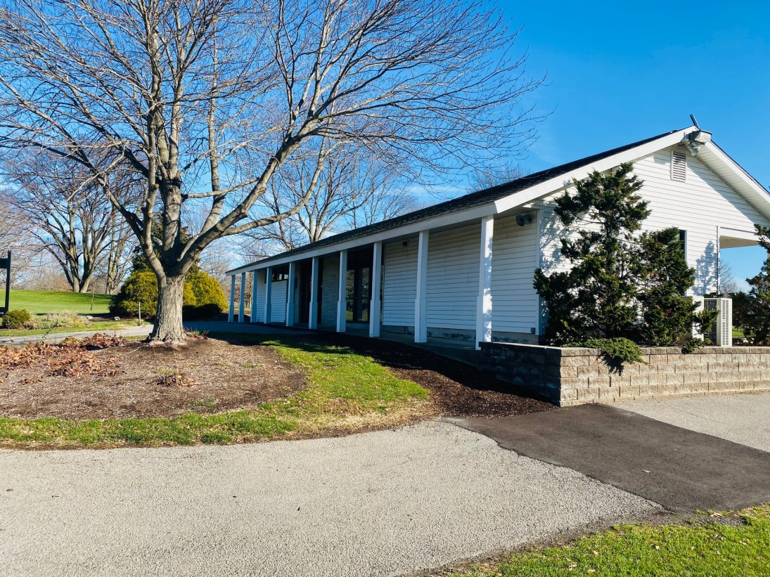
Golf Clubhouse Exterior Improvements Foster & Shoaff

Slide 17
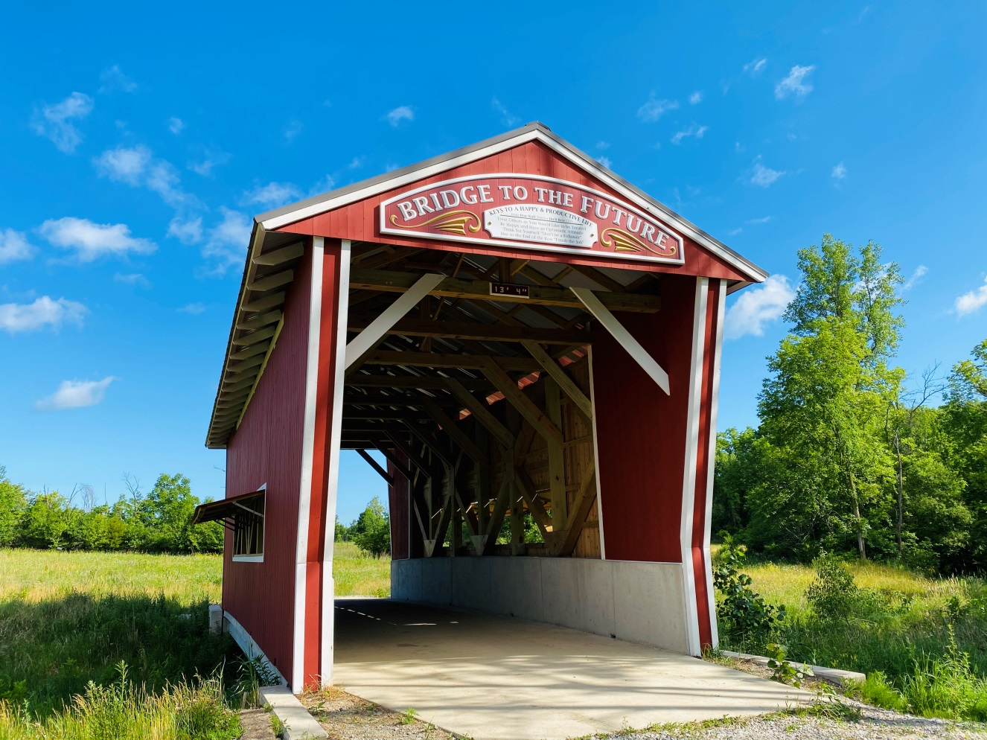
Salomon Farm Covered Bridge

Slide 18
IN-PROGRESS PROJECTS

Slide 19
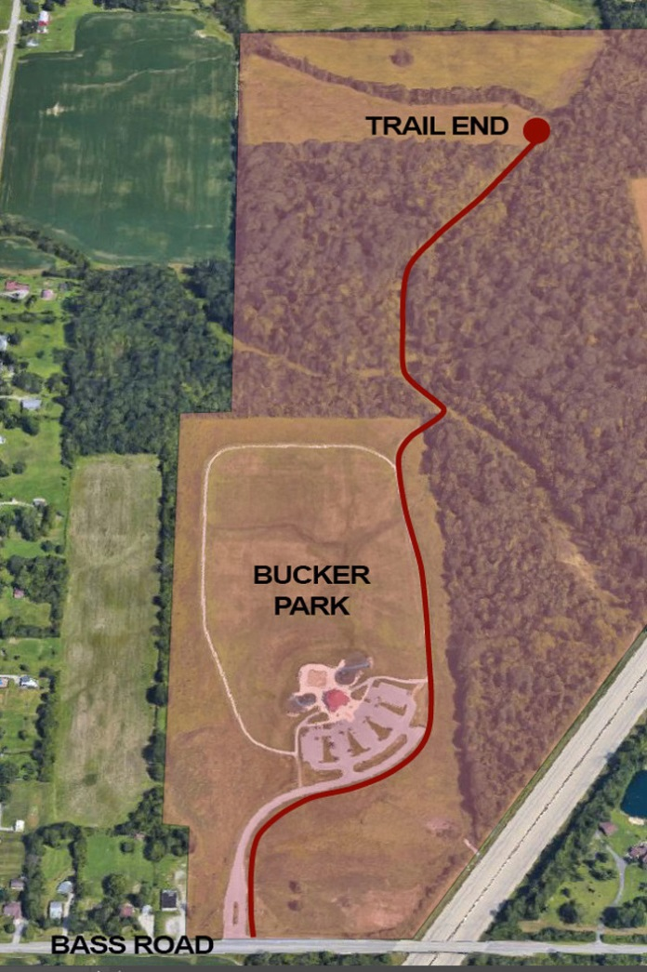
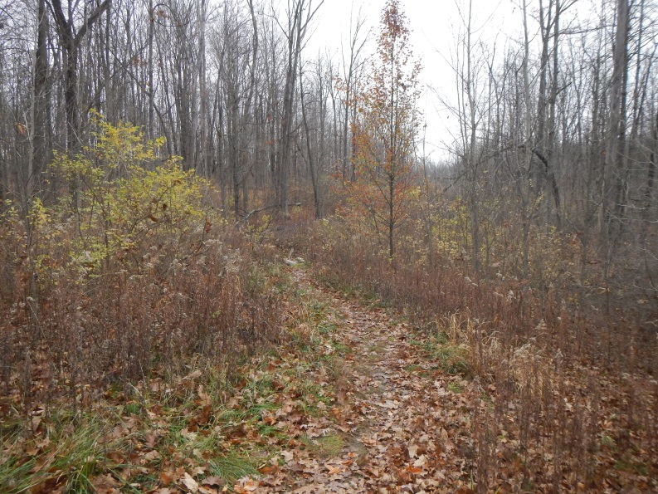
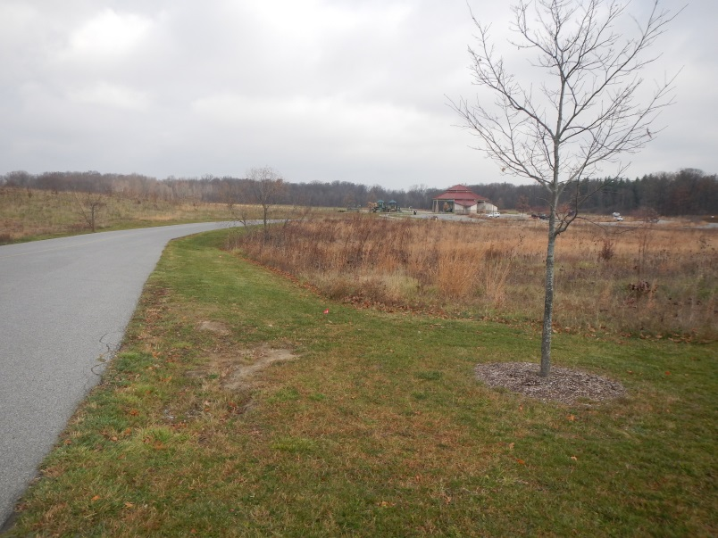
Buckner Park New Trail

Slide 20
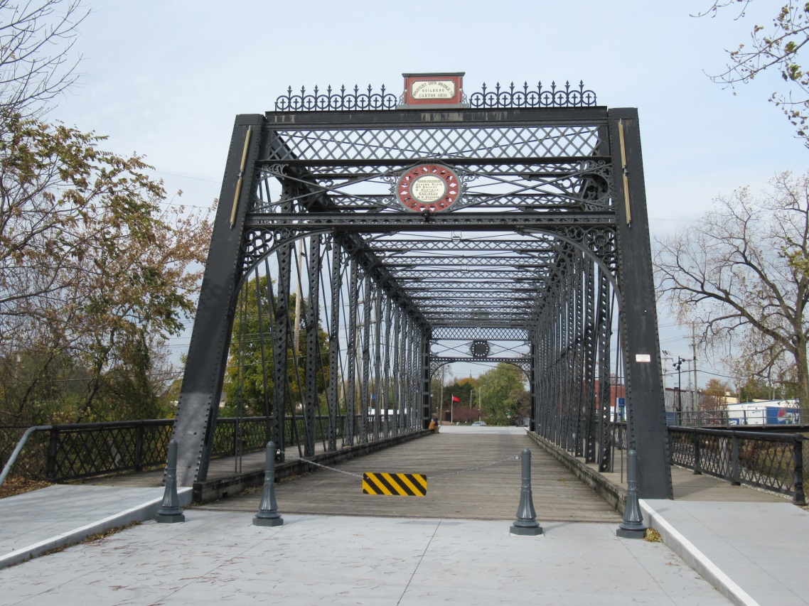
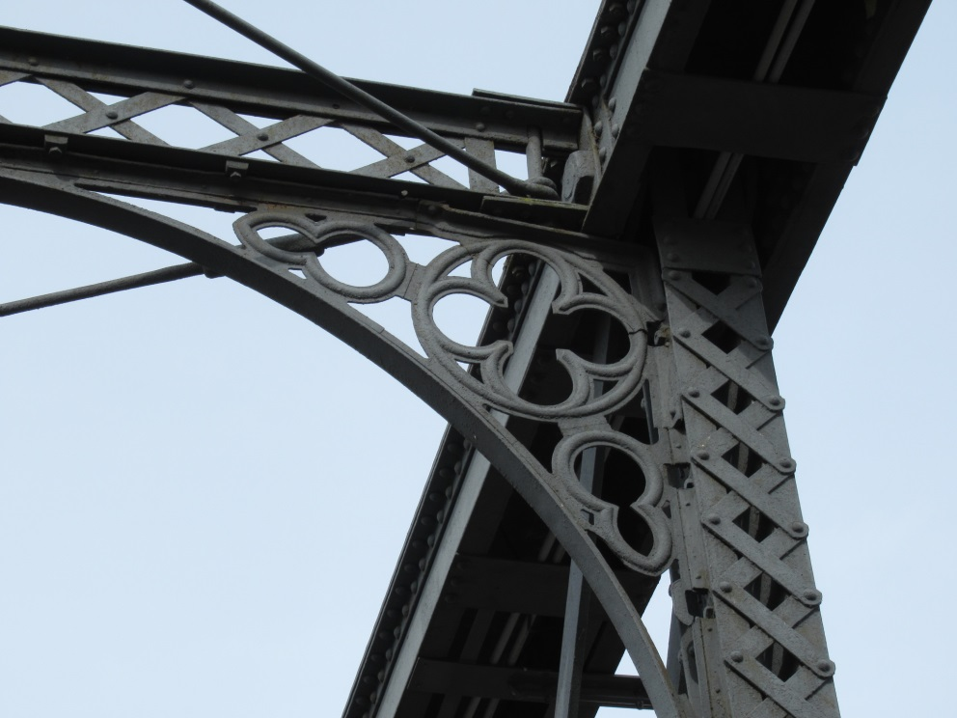
Wells Street Bridge Truss Renovation

Slide 21
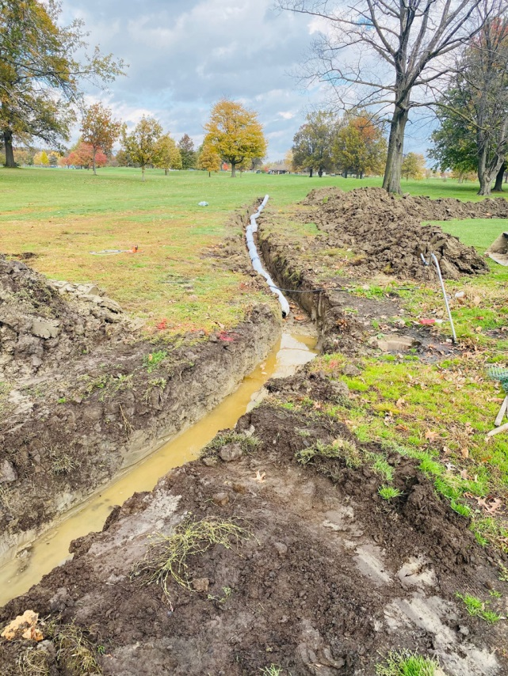
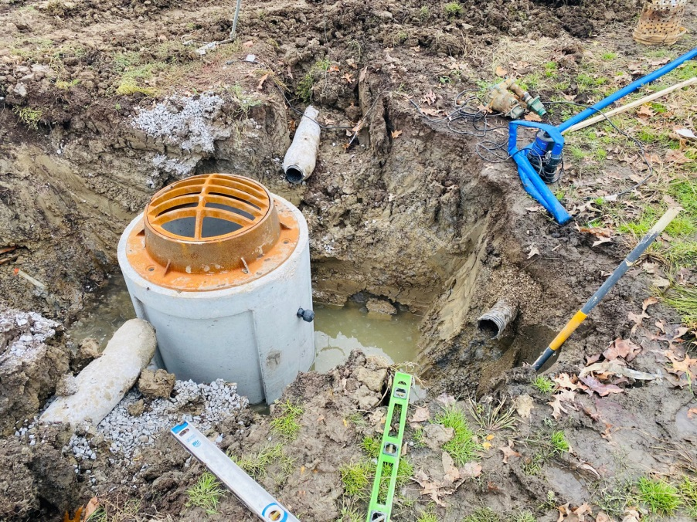
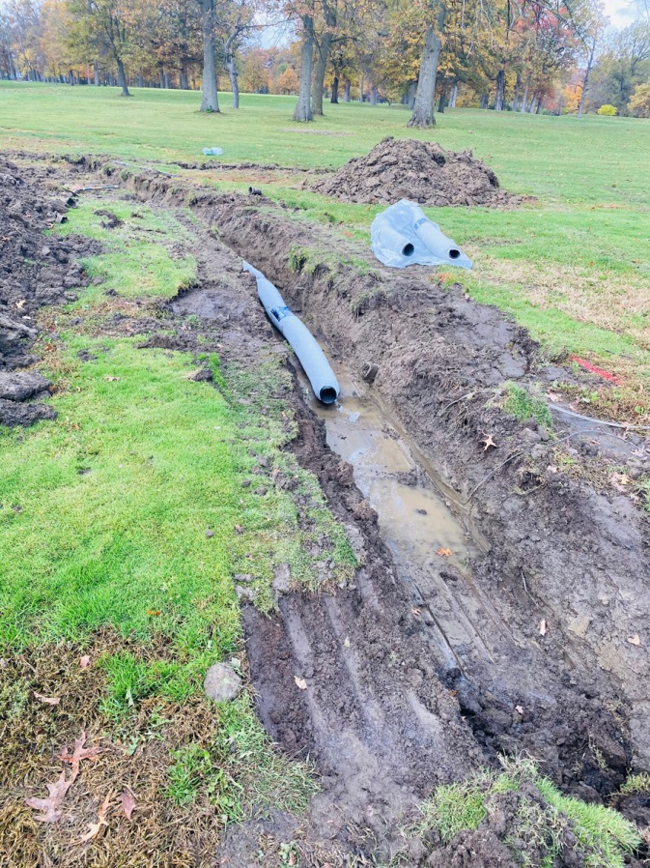
McMillen Golf Course Drainage

Slide 22
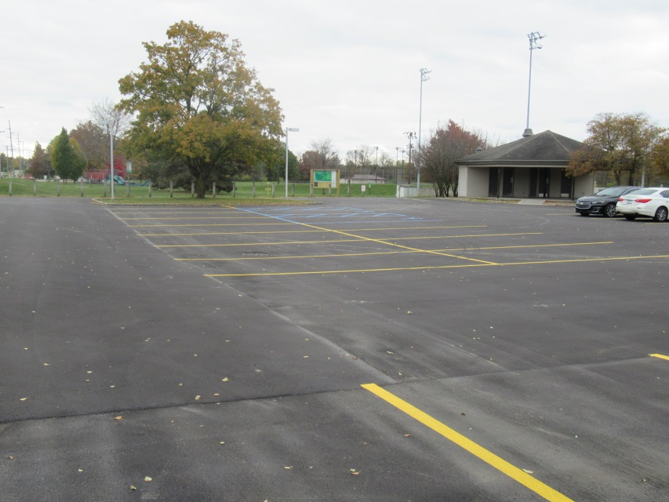
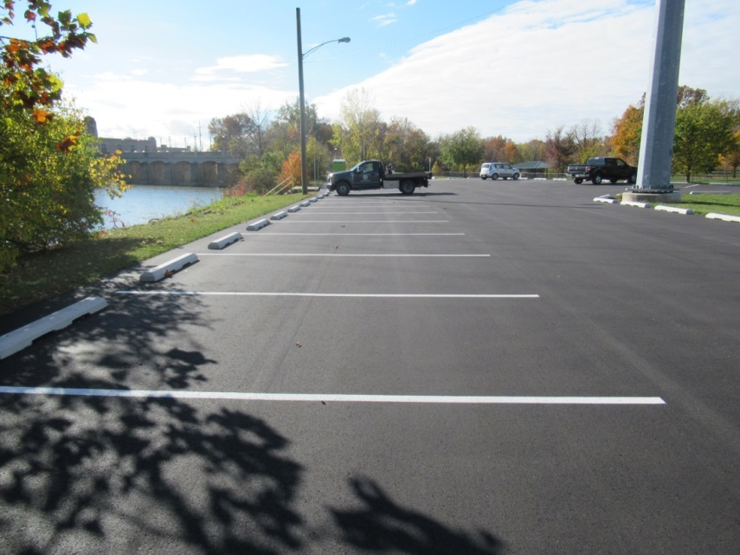
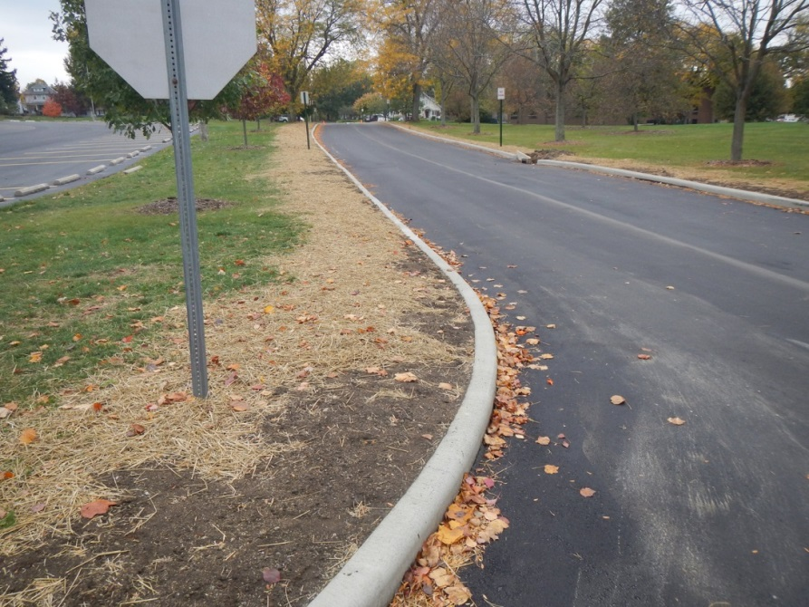
Paving Projects
Johnny Appleseed
Tillman
Northside

Slide 23
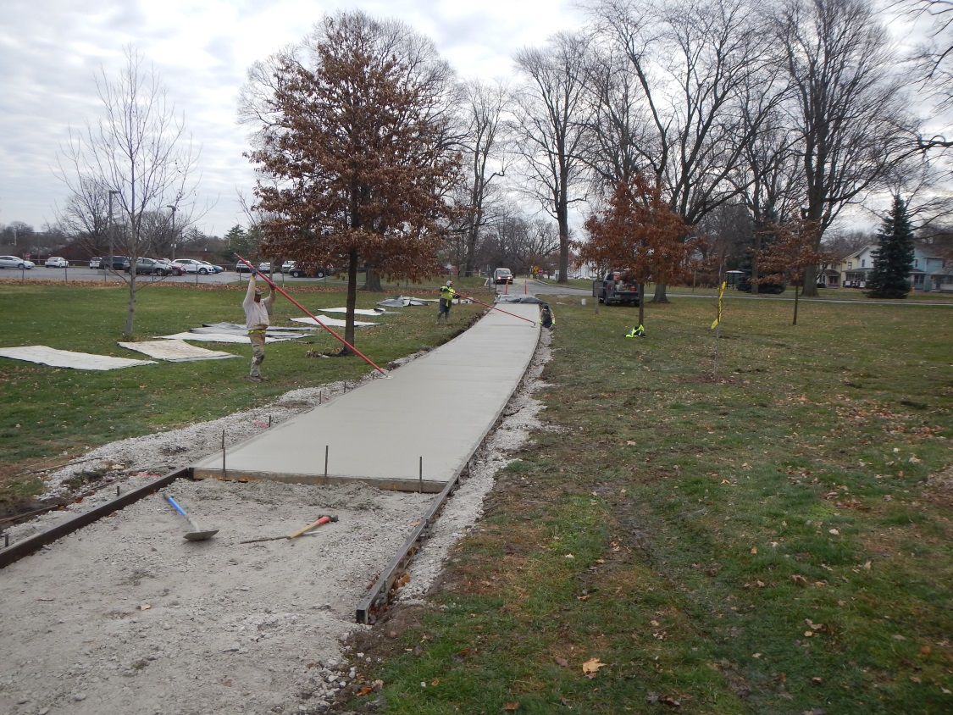
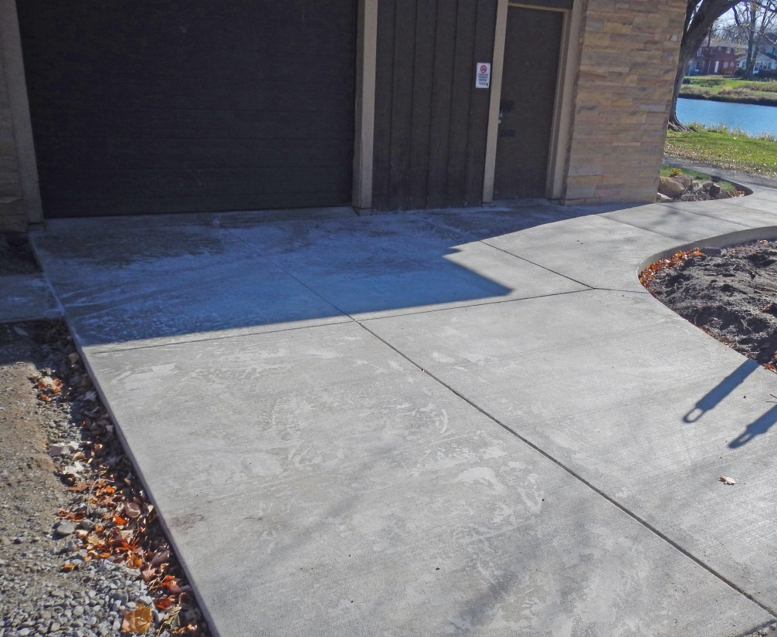
Sidewalk Improvements
Lakeside
Northside

Slide 24
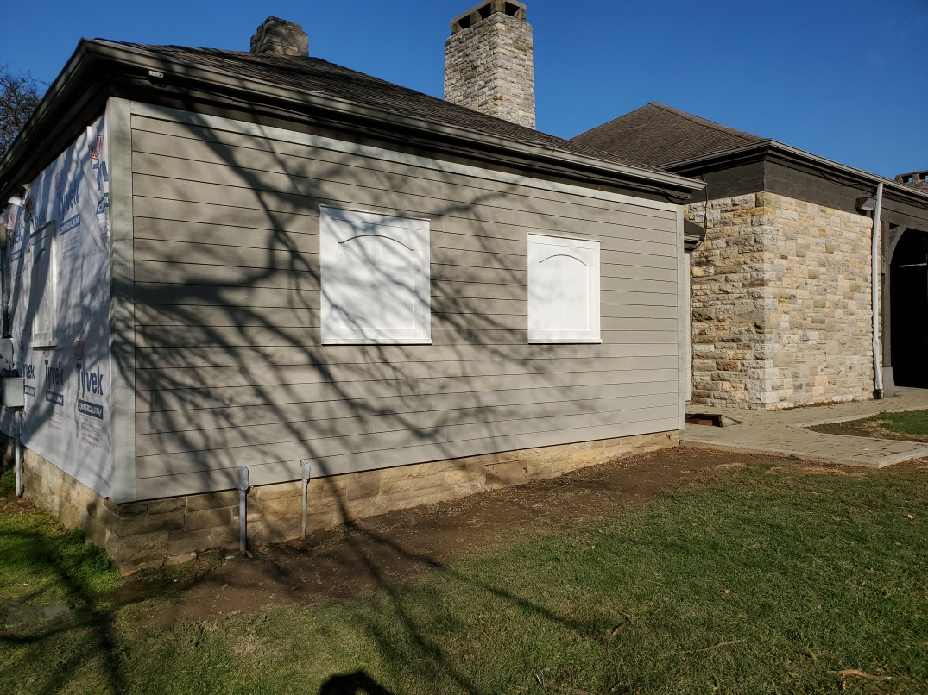
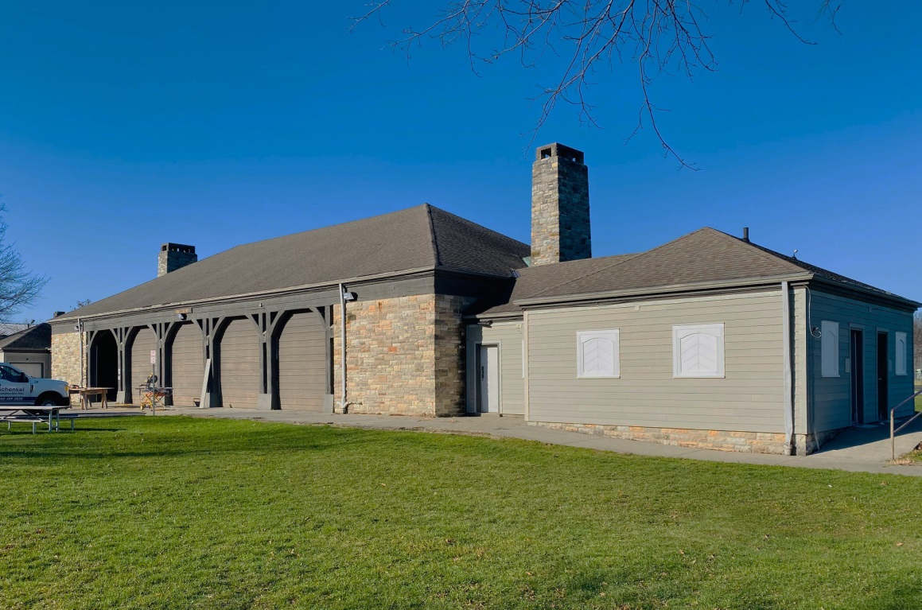
McMillen Pavilion Exterior Renovation

Slide 25
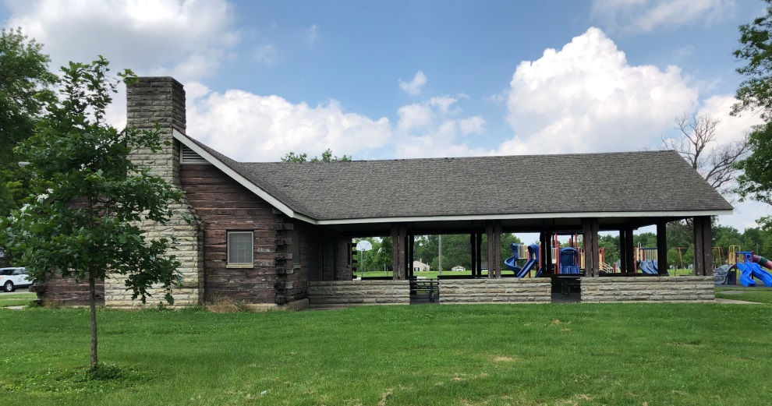
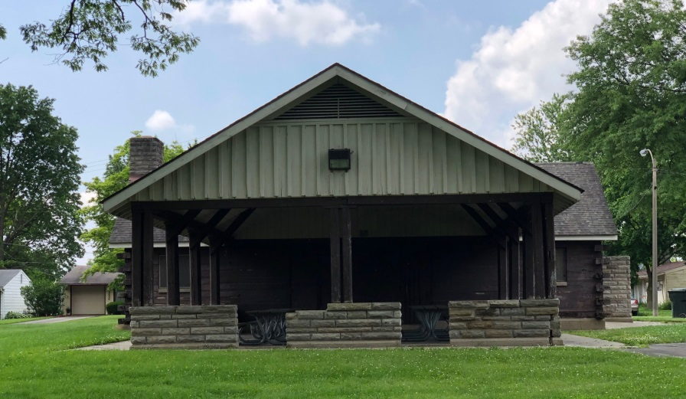
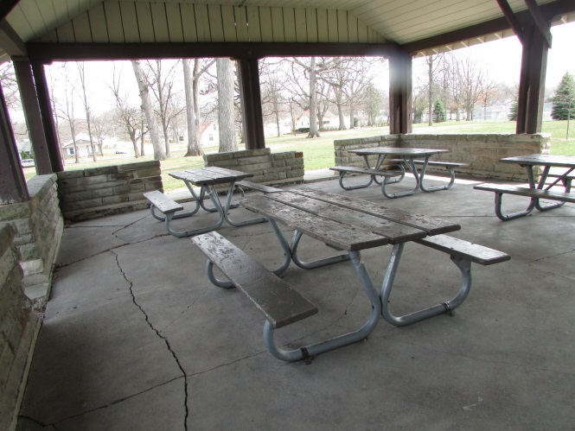
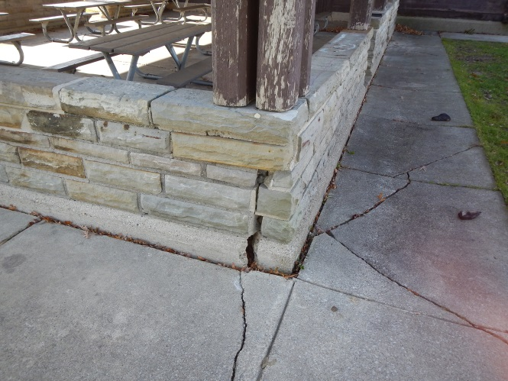
Kettler Open-Air Pavilion
New Terrace
New Sidewalks
Repaired Foundation
& Limestone Wall

Slide 26
Promenade Park Restroom

Slide 27
MORE TO COME
IN 2021

