Slide 1
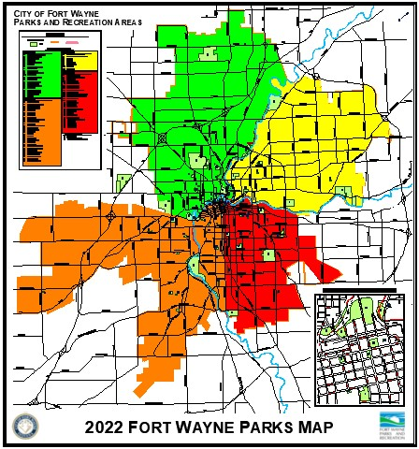
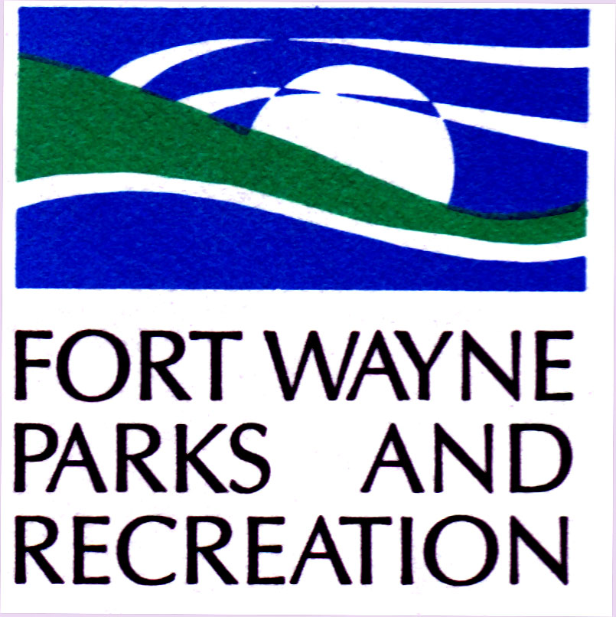
Fort Wayne Board Of Park Commissioners
Parks History and Highlights:
Guldlin Park
Indian Village (Sears) Park
McCulloch Park

Slide 2
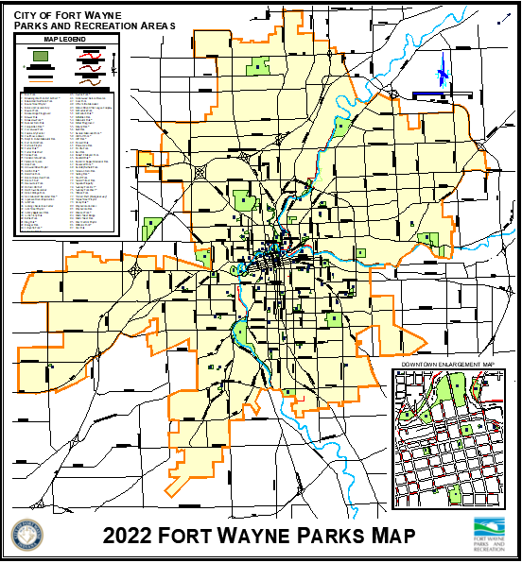
Guldlin park
Van Buren and Michaels Street

Slide 3
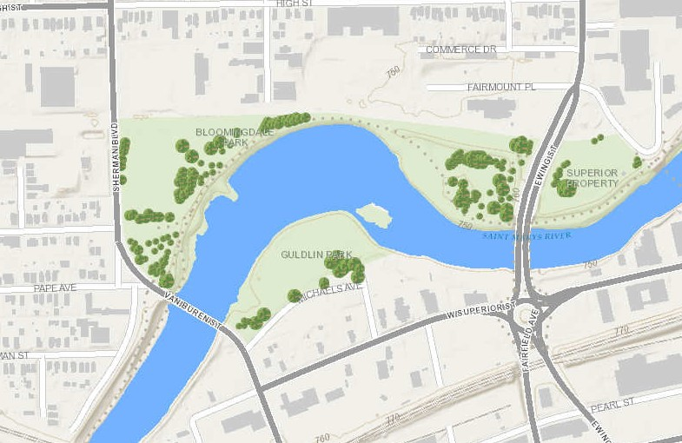
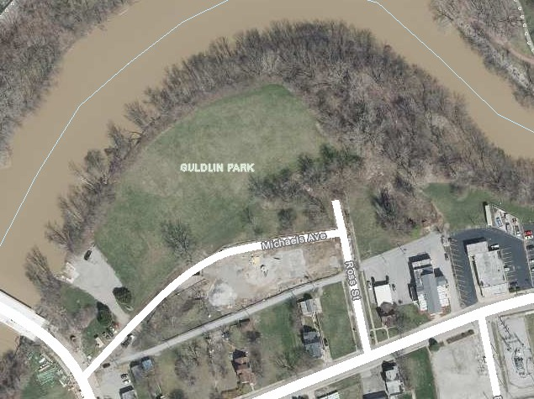
Guldlin park
Since 1897
Size in Acres: 8.2

Slide 4
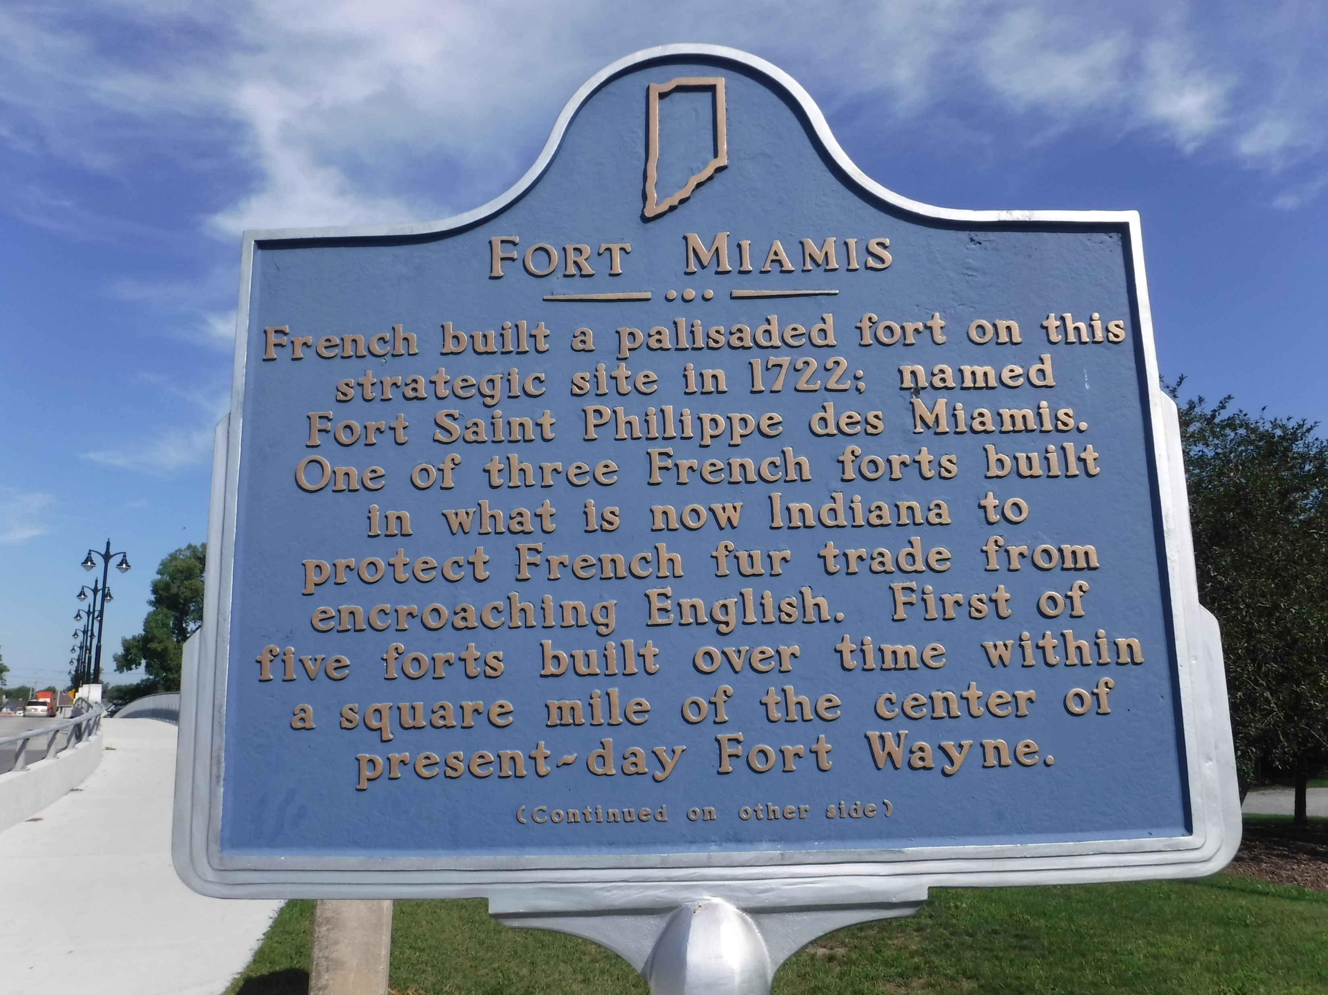
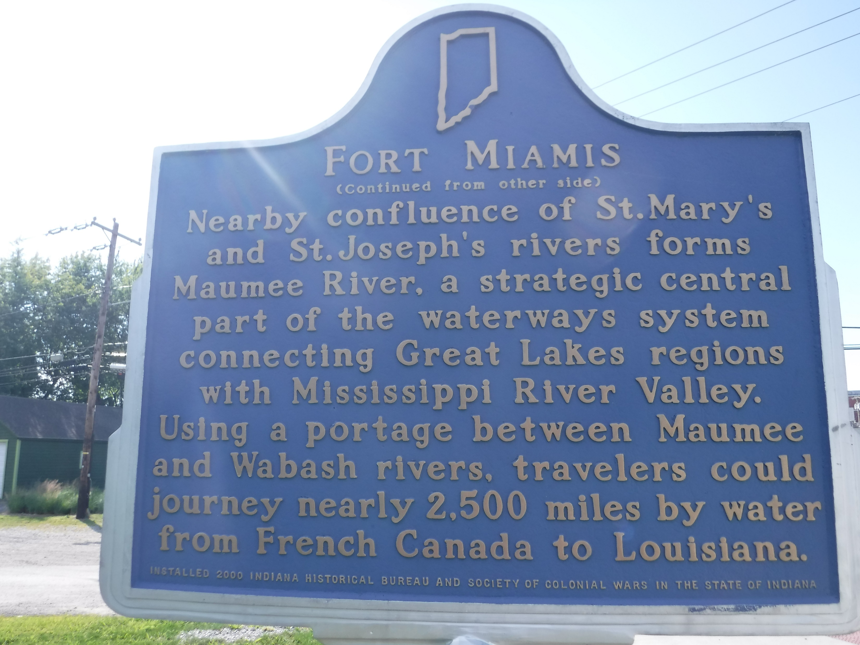
Guldlin park
History: The site is the location of the first fort built in 1722. The fort was called Fort St. Philippe or Fort Miamis. In1897 the city purchased the land for seven thousand dollars. The land that would later become Guldlin Park was originally intended to be used as the location of a water pumping station. Before construction began, it was decided that the station should be built on the other side of the St. Mary's River, and the originally proposed plot of land was left vacant.

Slide 5
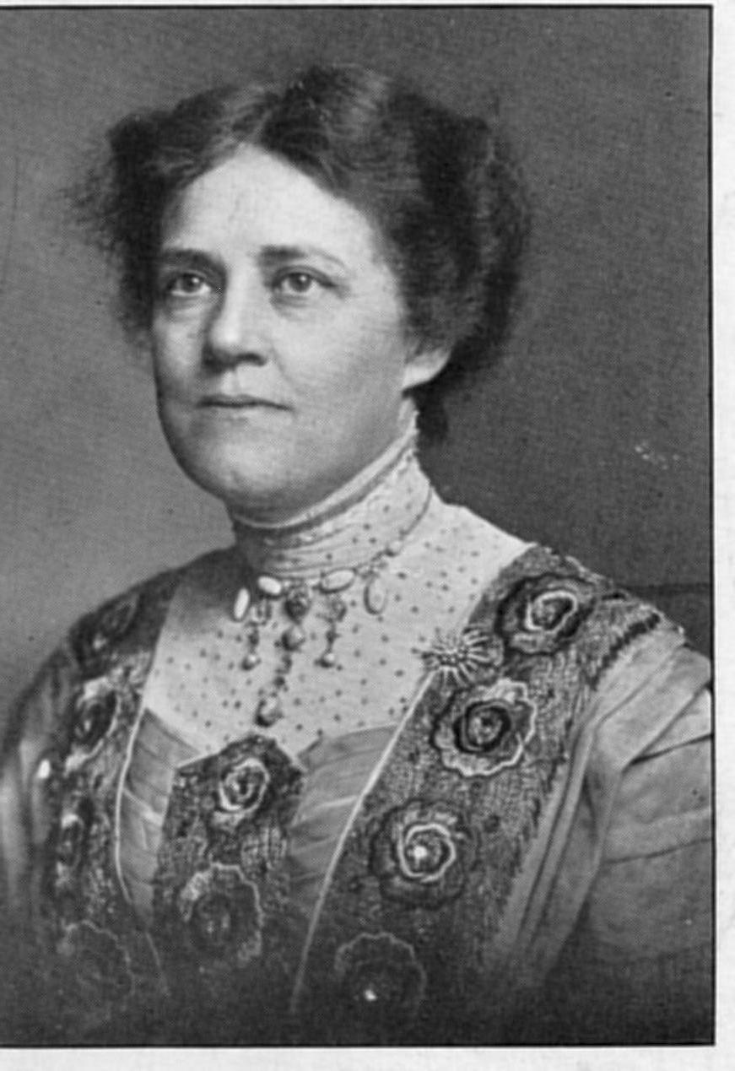
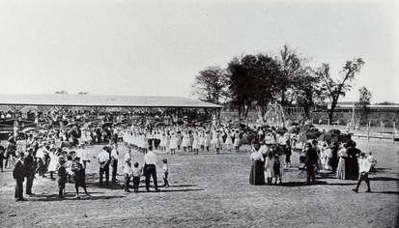
Guldlin park
History: The site was then developed as the location of the city’s first playground through the efforts of Addie Guldlin, after who the present day park is named. Ms. Guldlin was described as “a little woman but a dynamo of energy”. She was prominent in the movement to extend the right to vote to women and served as the state Director of Indiana’s Woman’s Franchise League.
Concerned that children had no safe places to play in Fort Wayne, Guldlin and several other “progressive” women raised funds to create a large, safe, playground. The playground was divided into a girls’ section and a boys’ section, with each having numerous swings, see-saws, wading pools, and sandboxes. The park was dedicated on May 20, 1911, and named in honor of Guldlin. Unfortunately, all of this was swept away in the great flood of 1913.

Slide 6
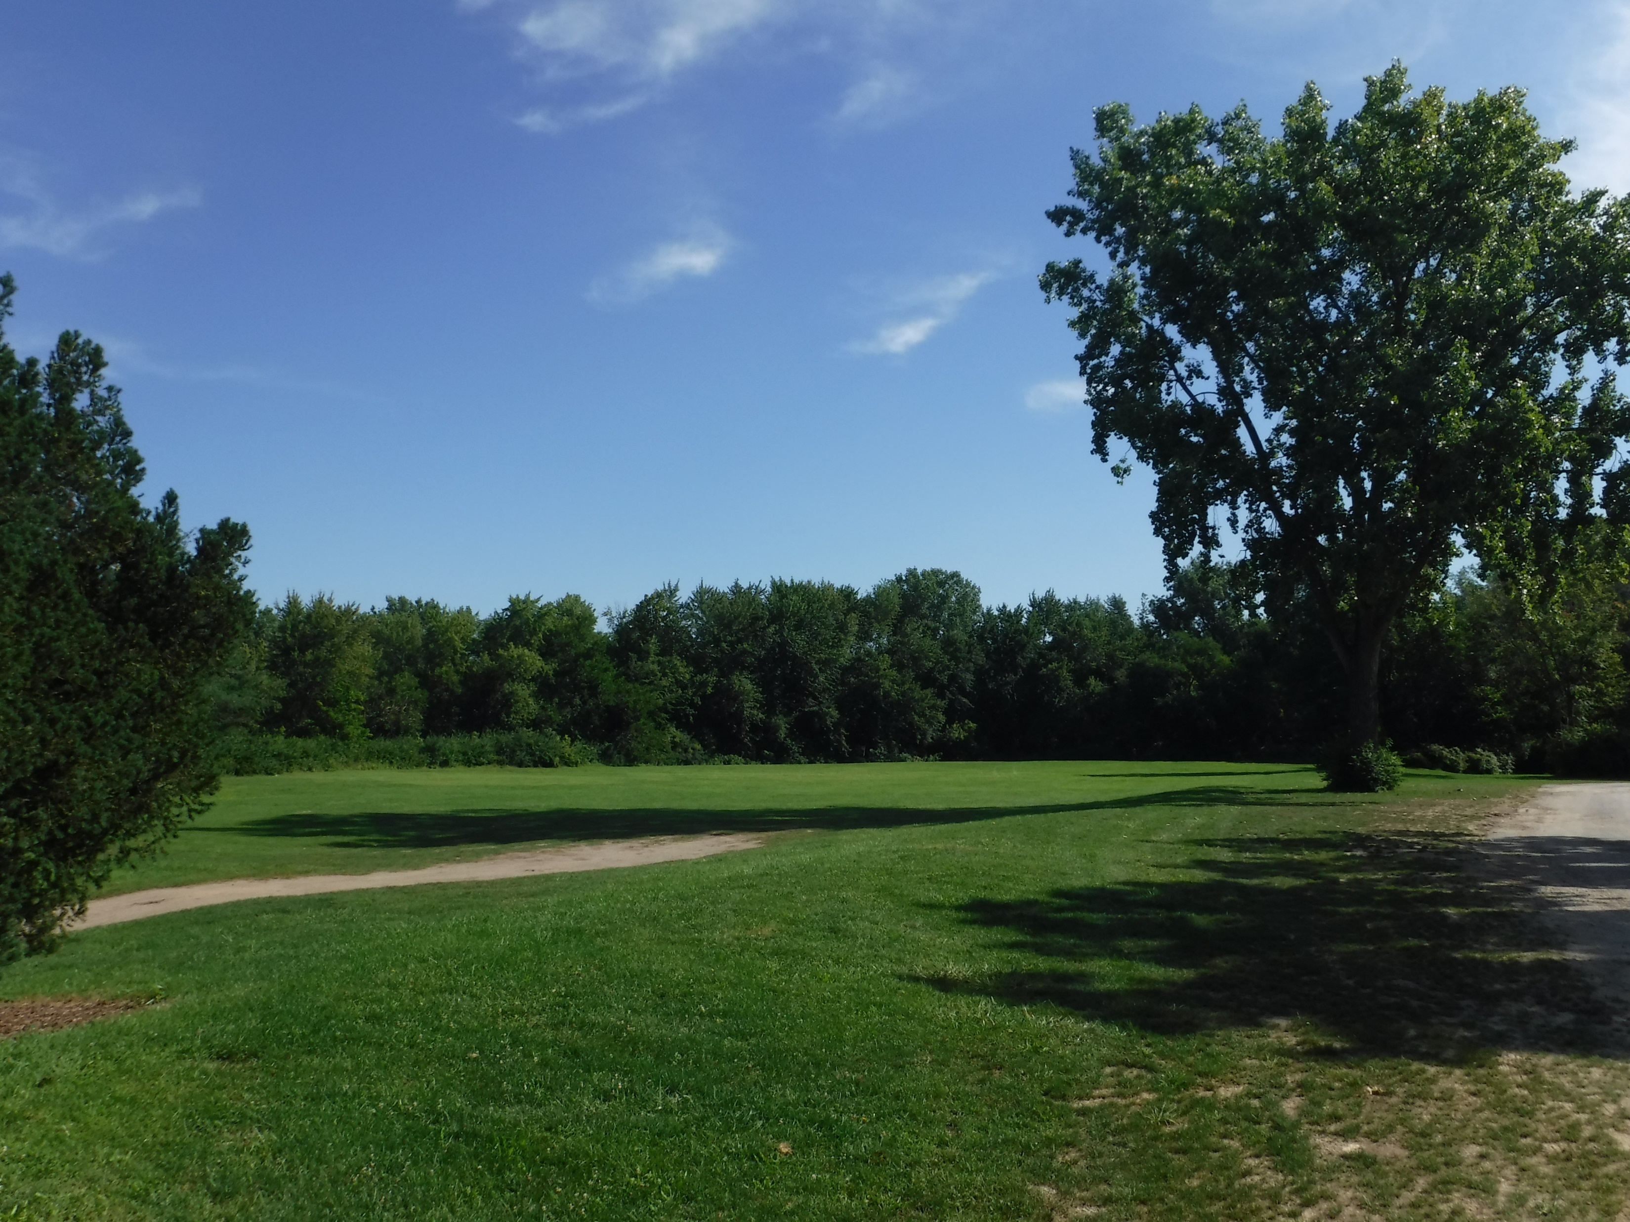
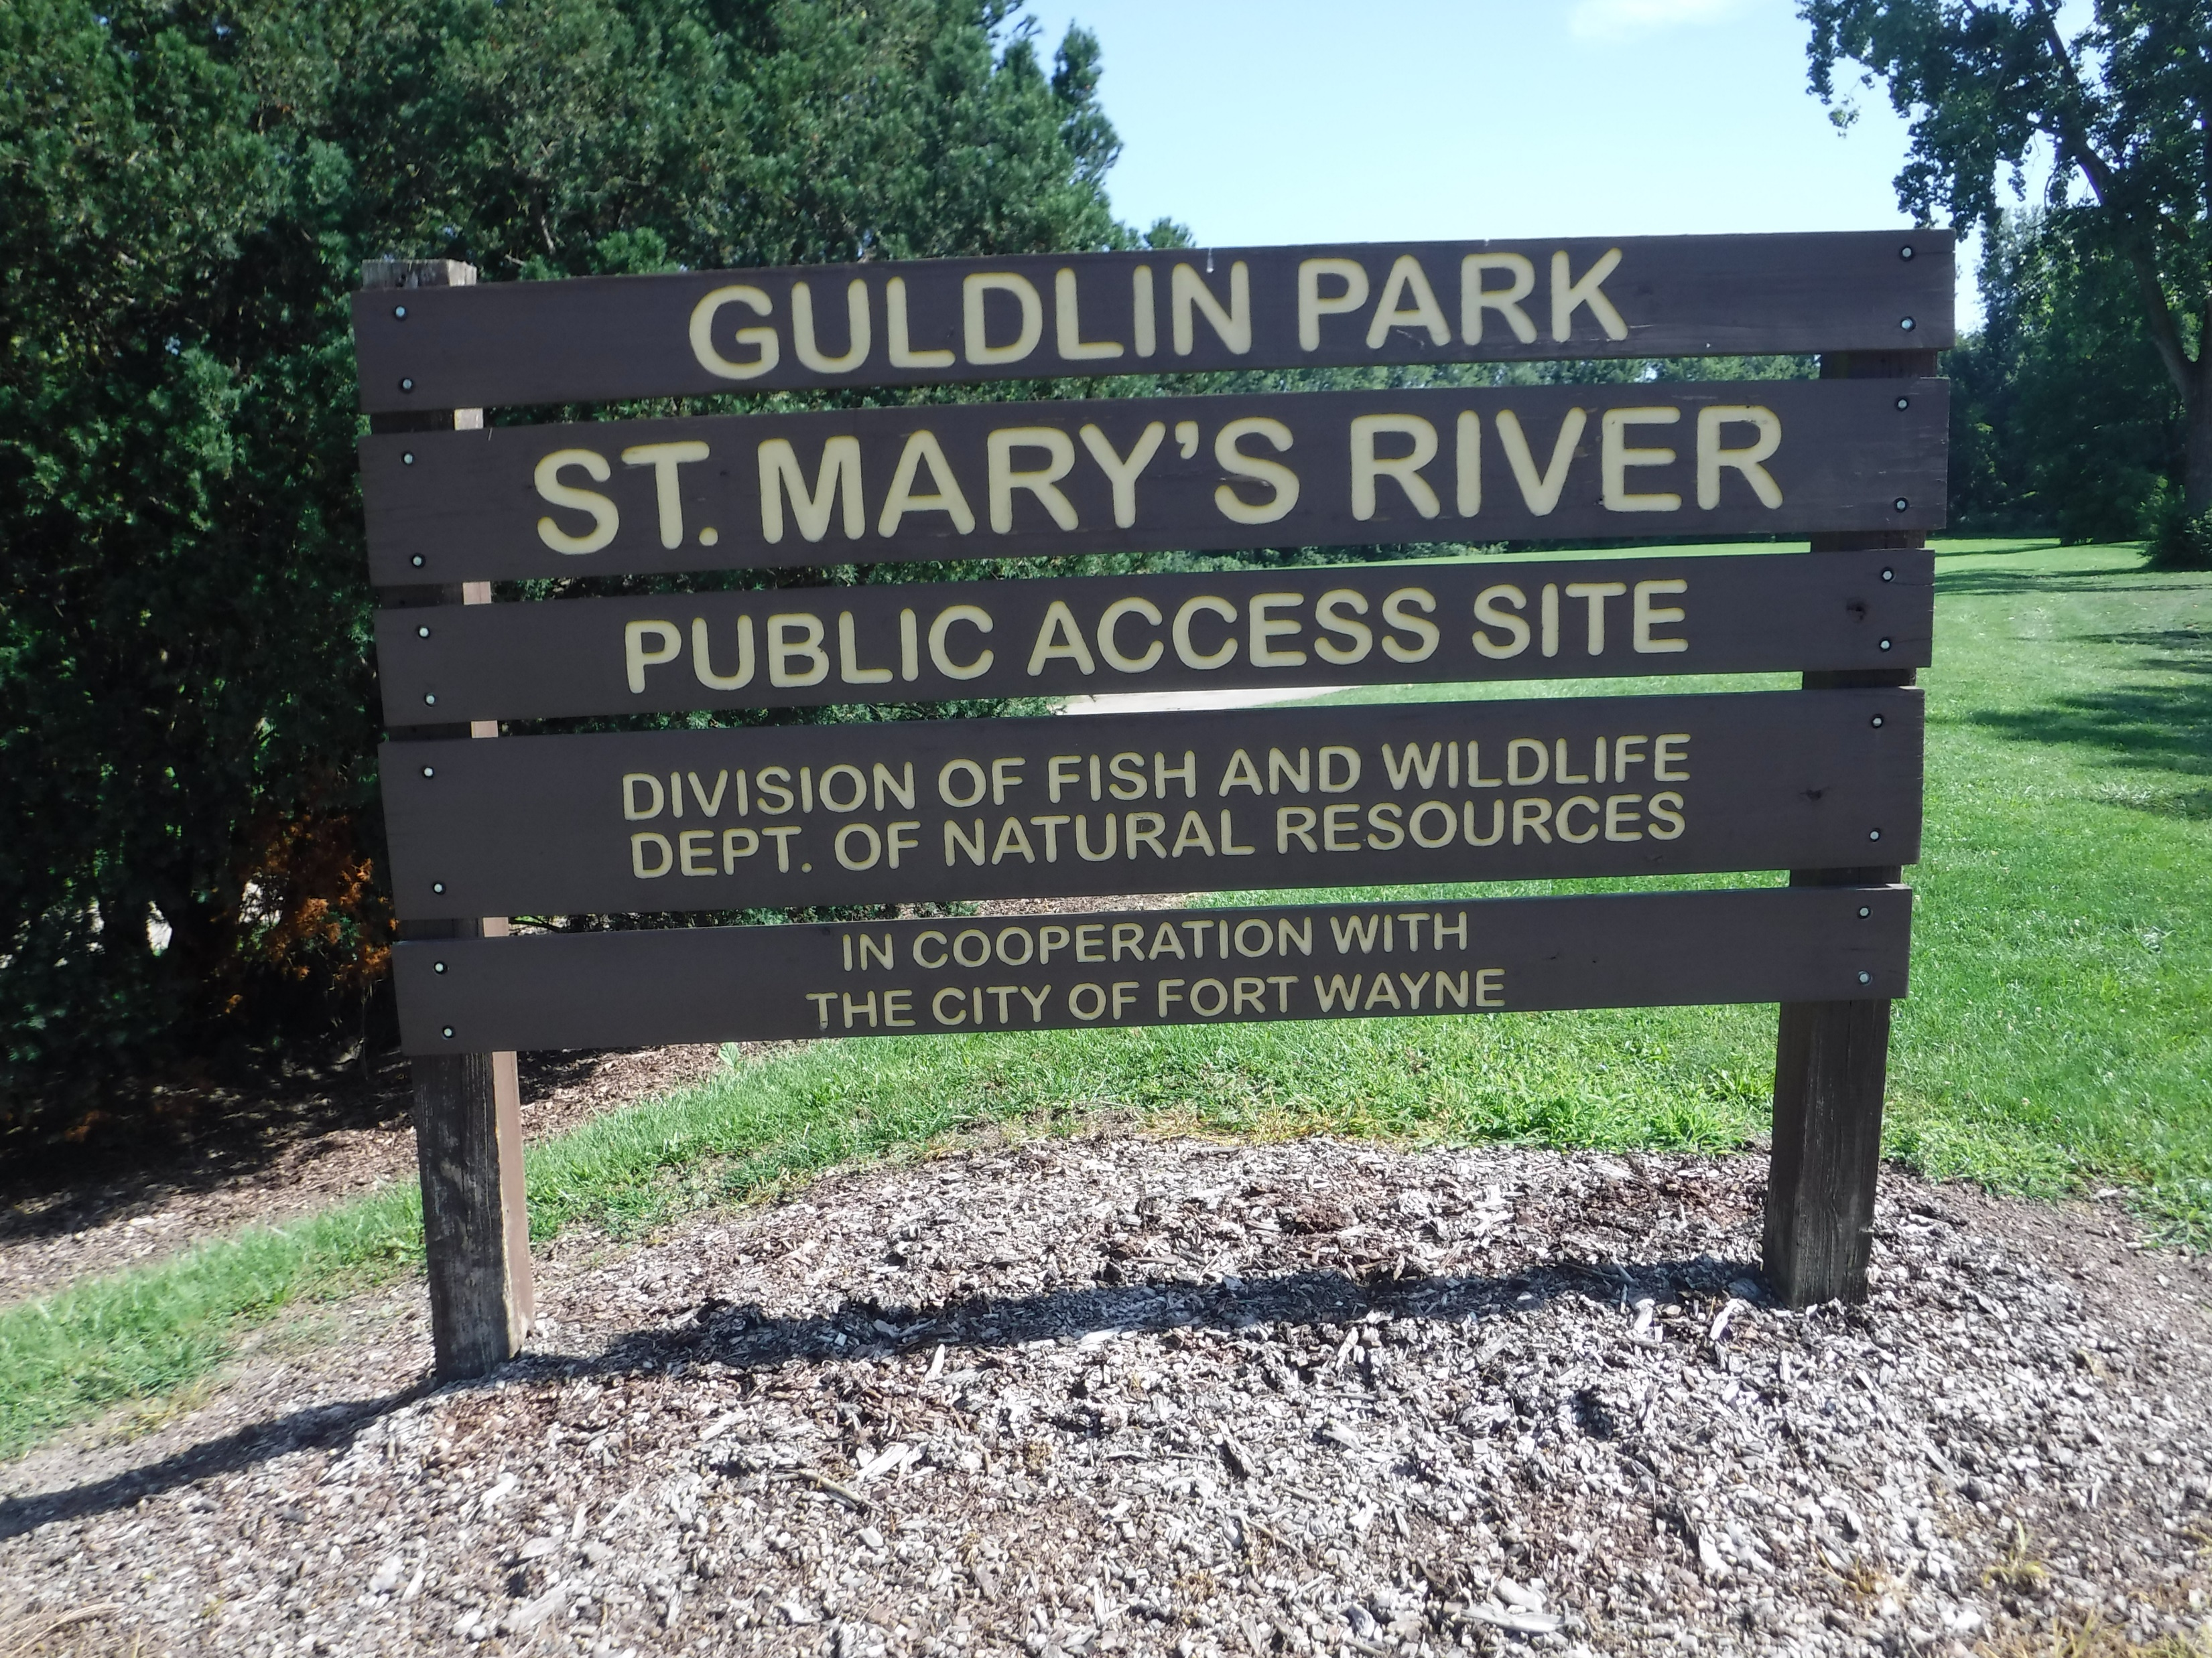
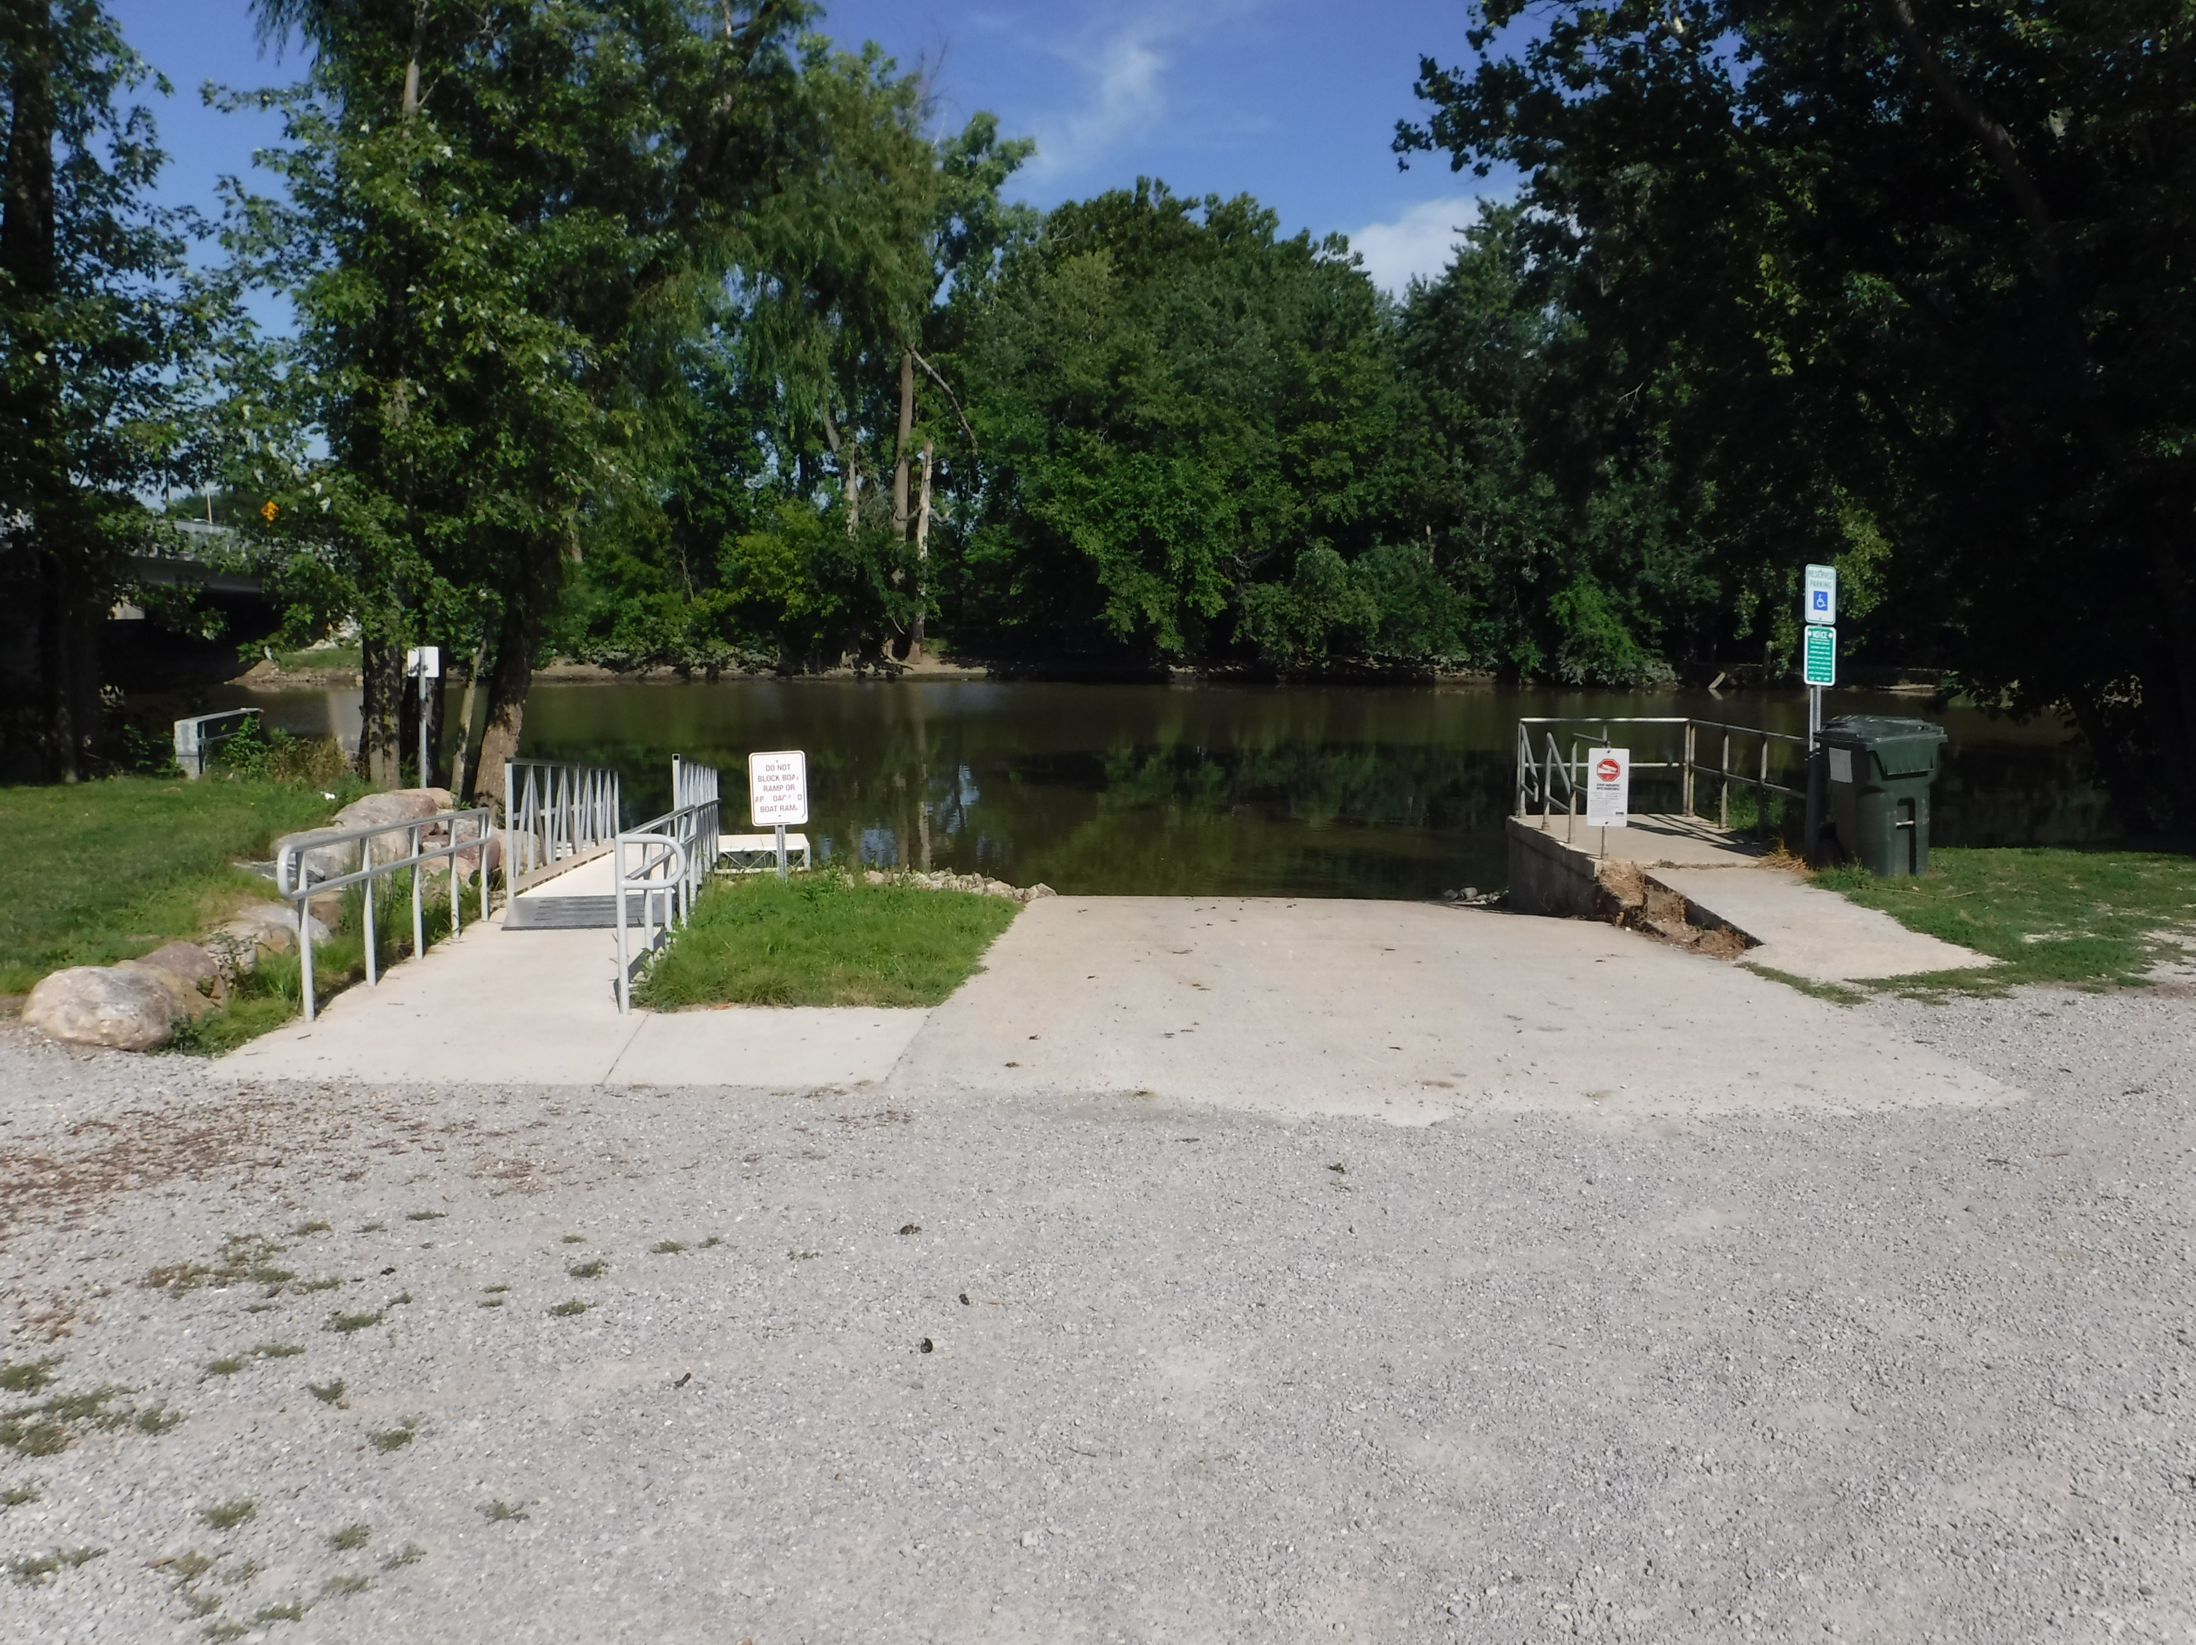
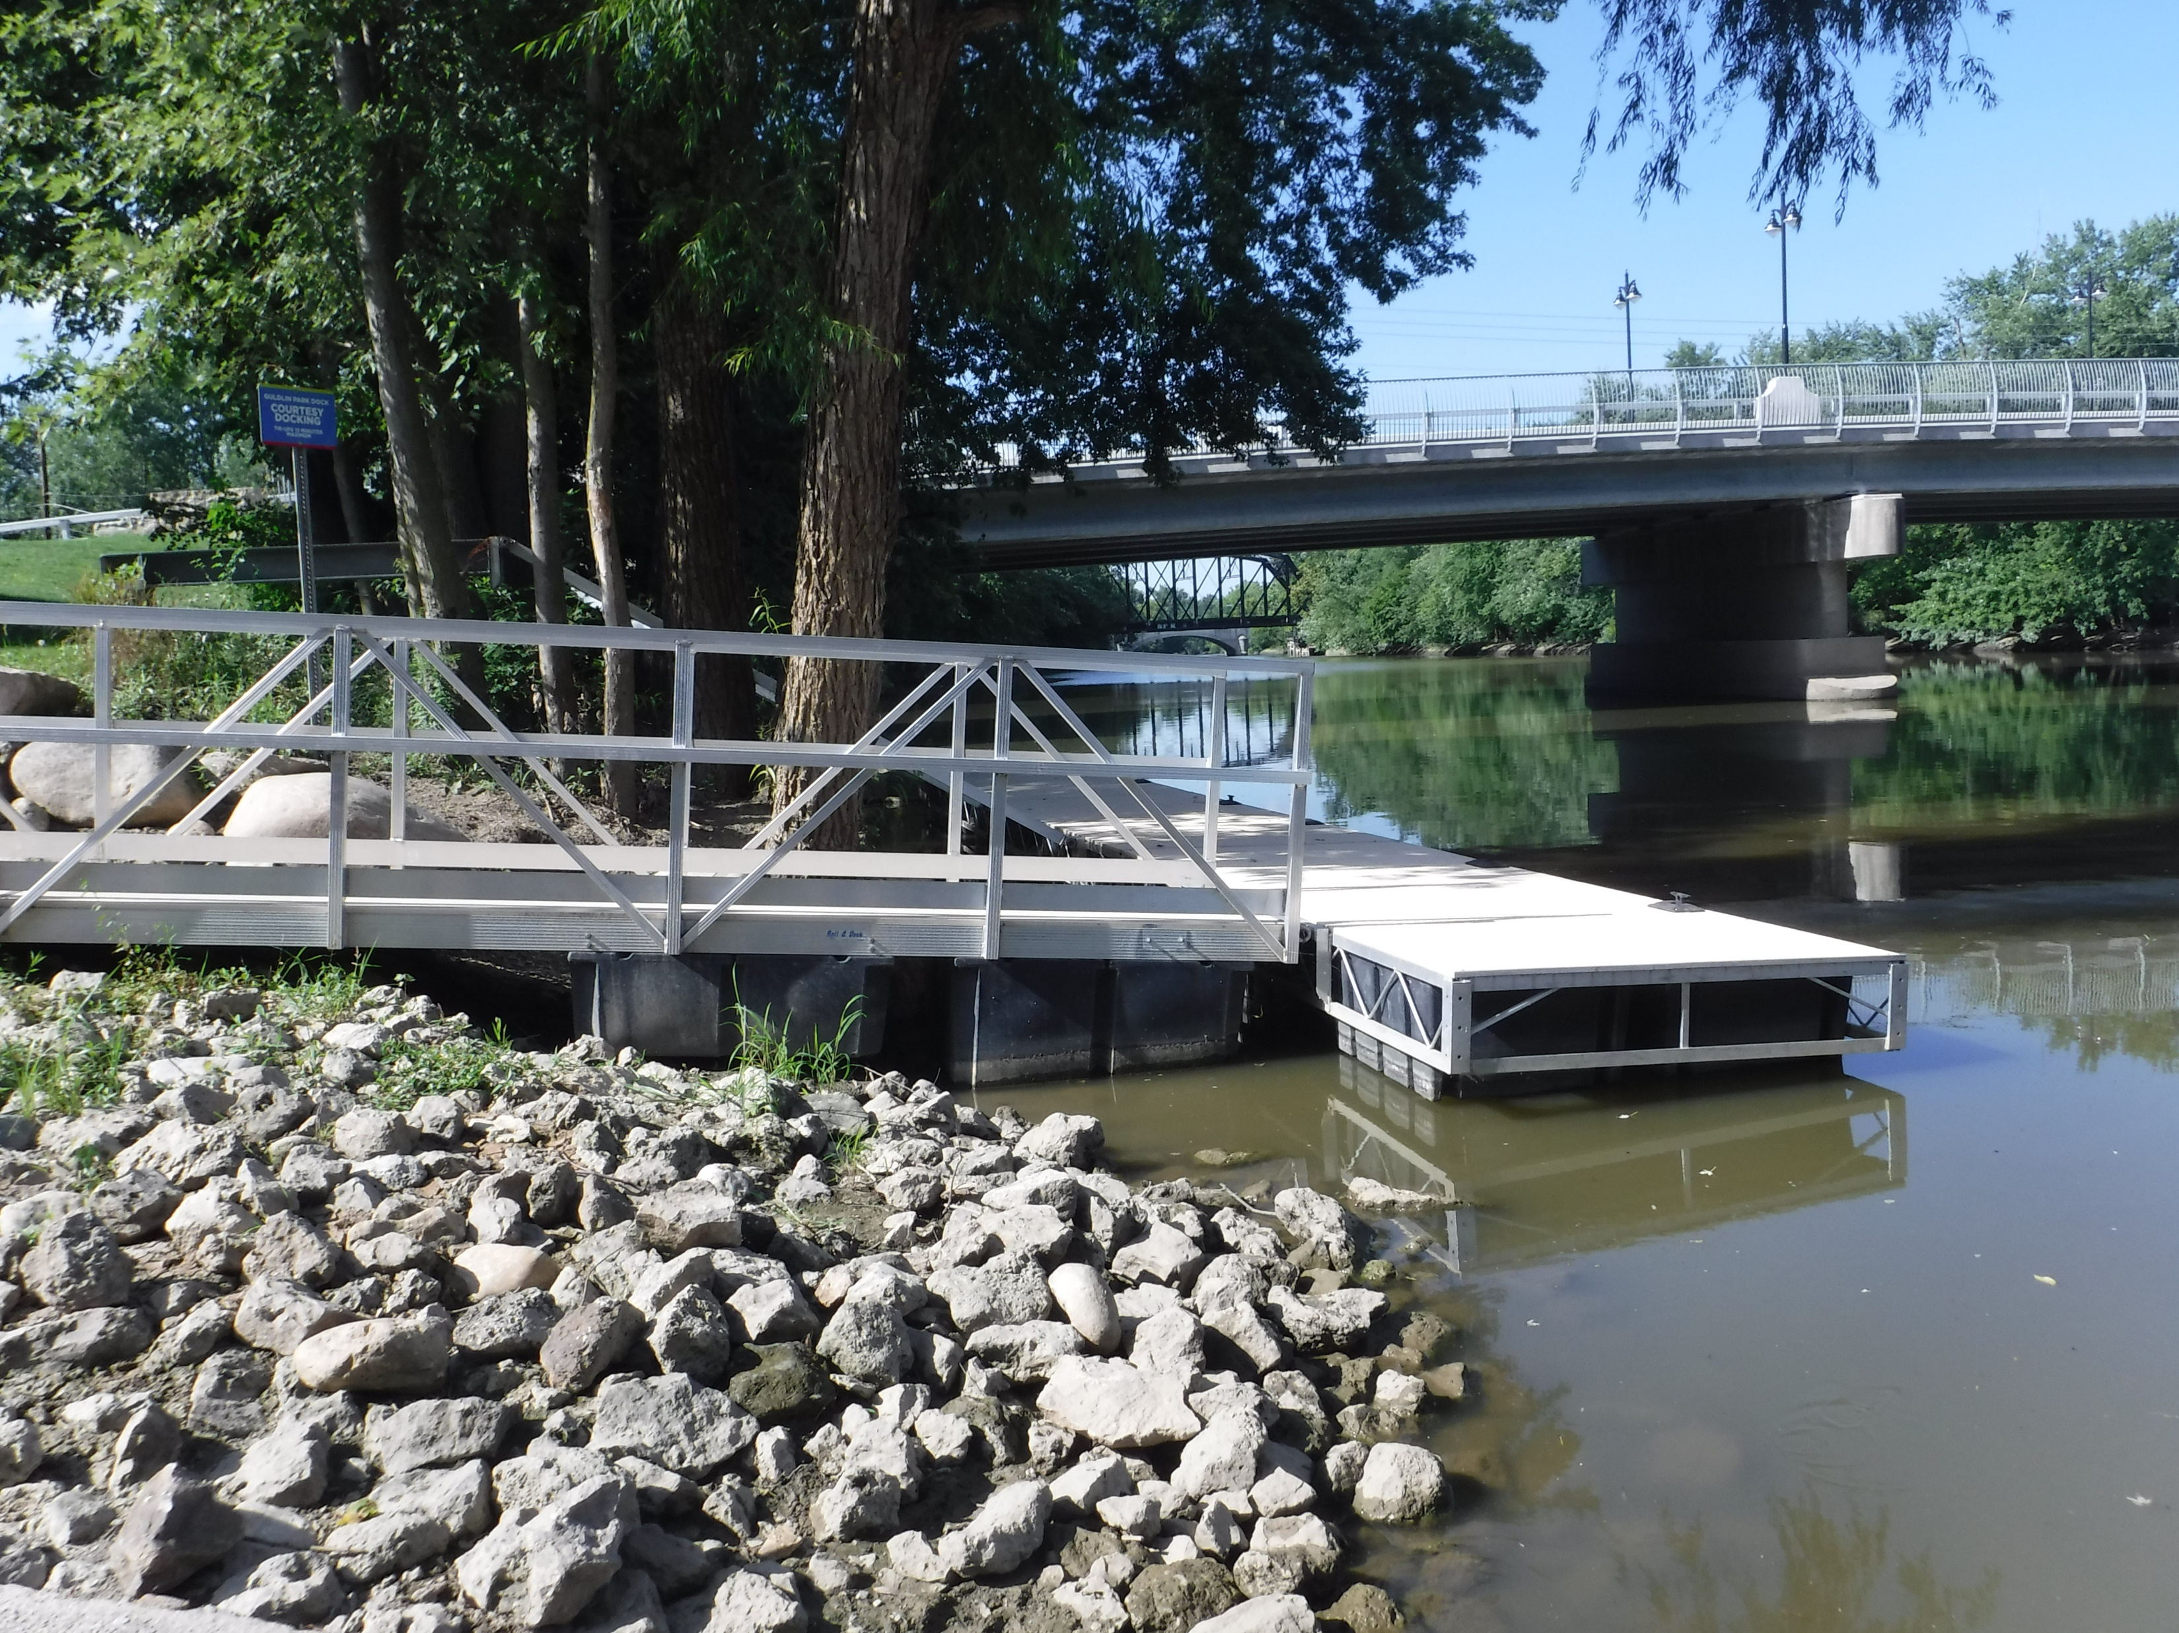
Guldlin park
The Park Today: Today the park is a picturesque area of grassy open space and is the site of a public access boat ramp and a boat dock providing boat access to the St. Mary’s River.

Slide 7
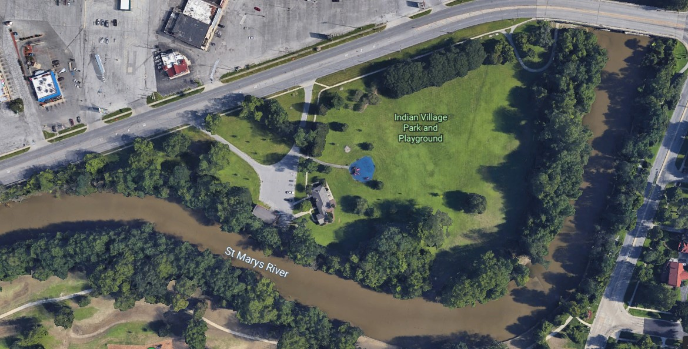
Indian village (sears) park
1701 Bluffton Road
Bluffton Road

Slide 8
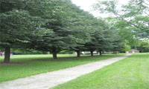
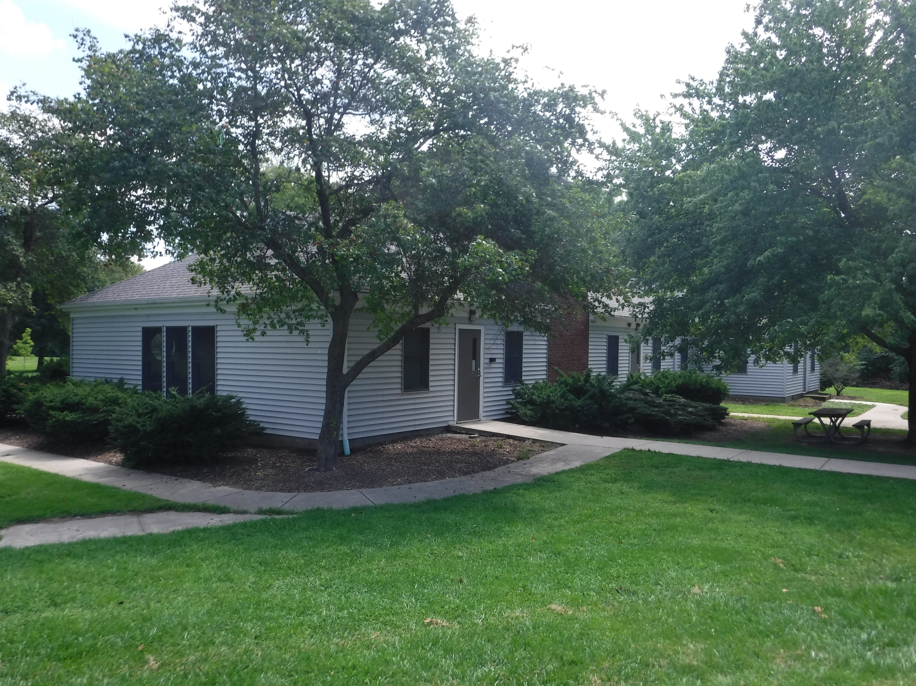
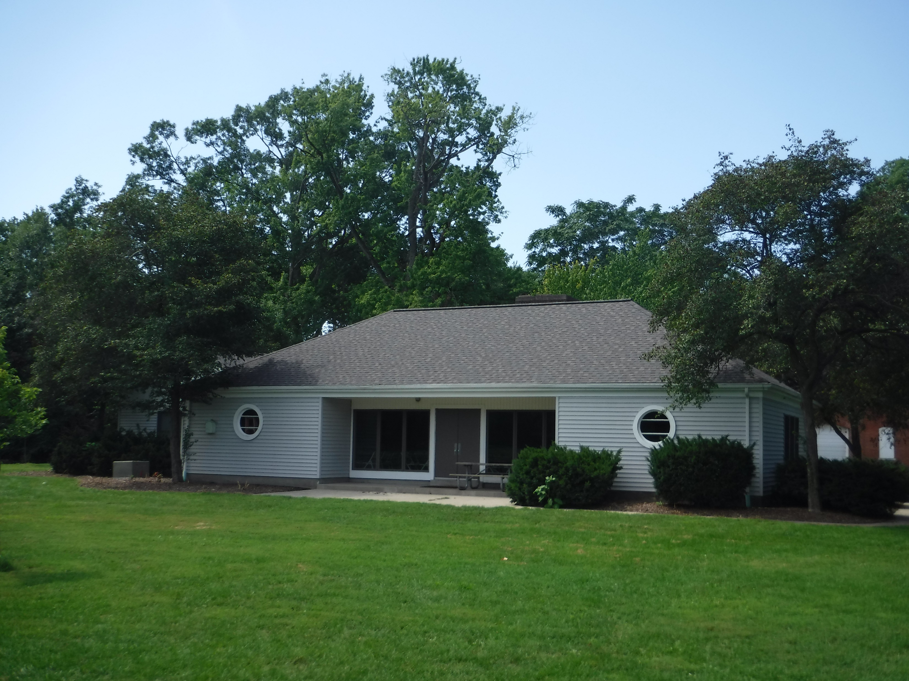
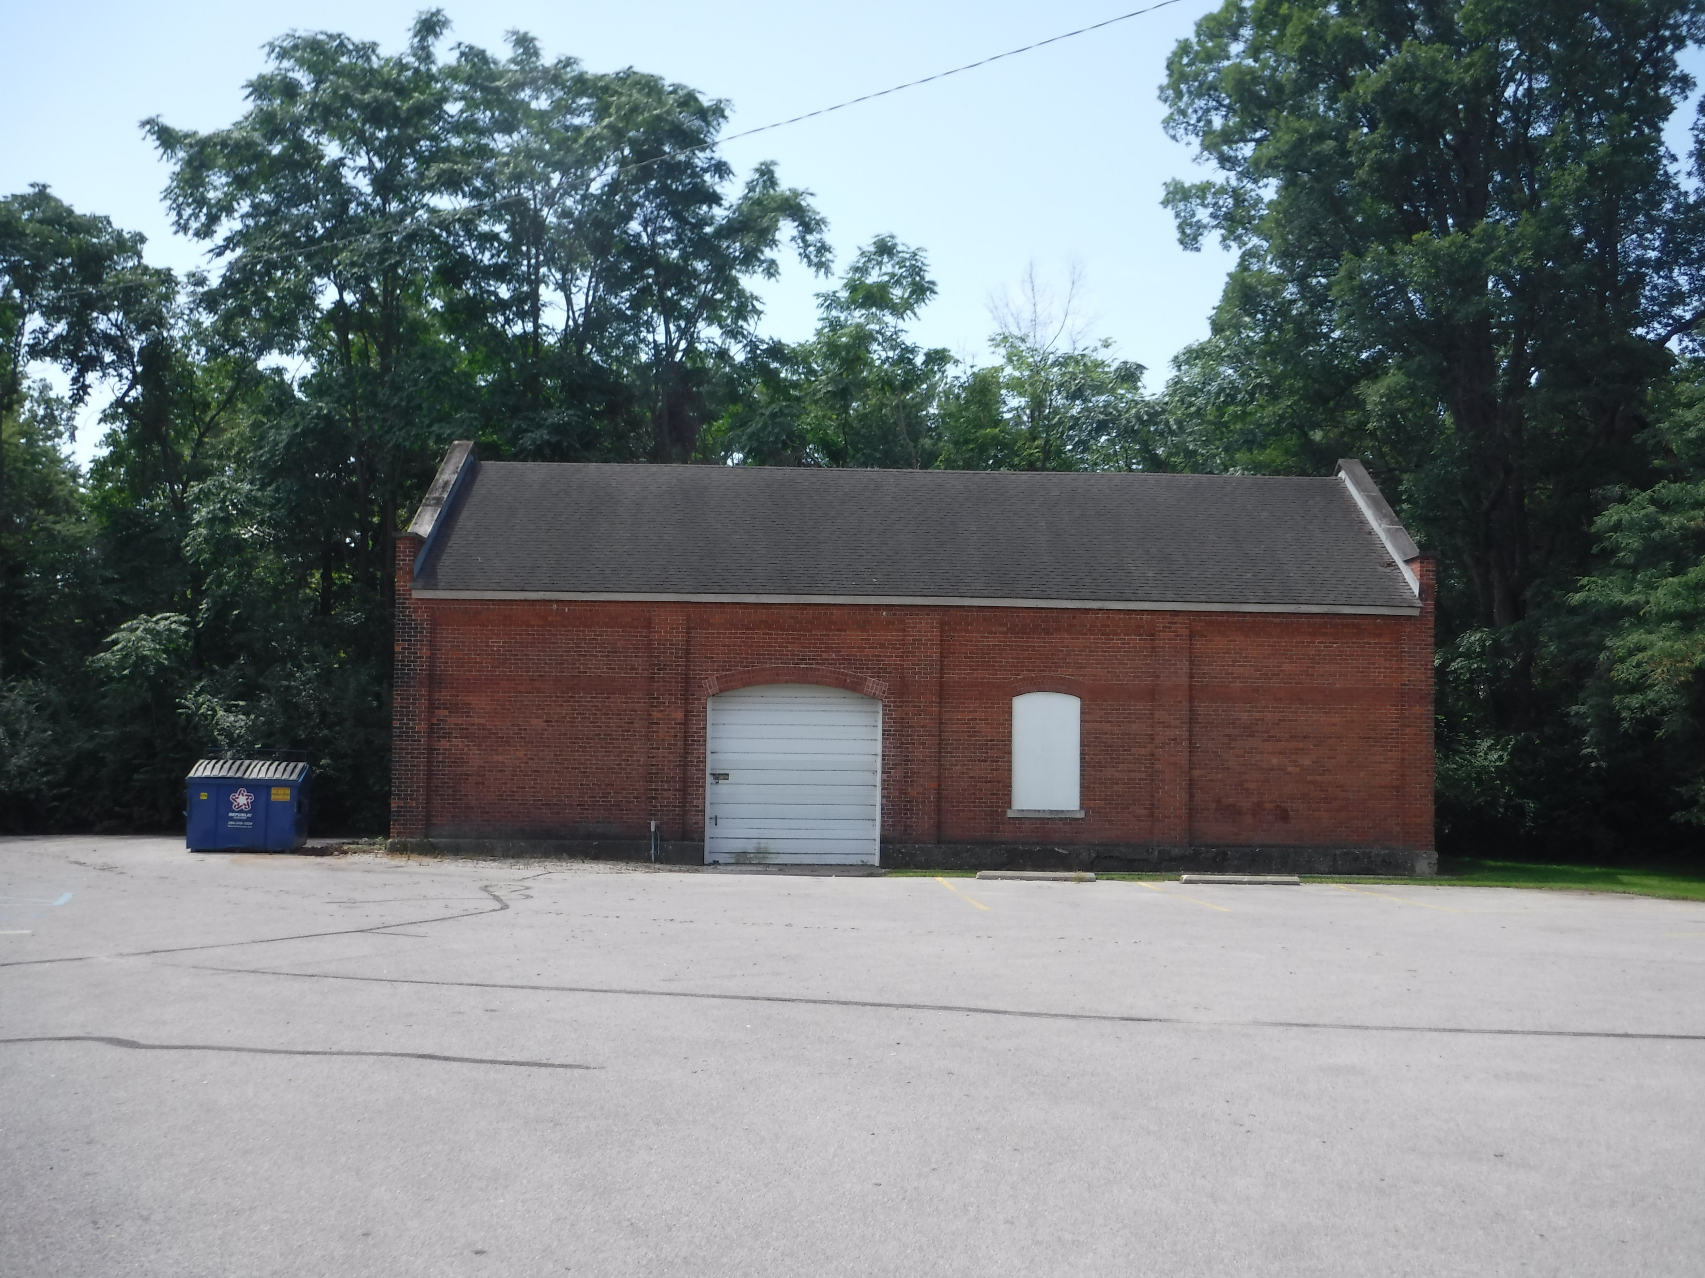
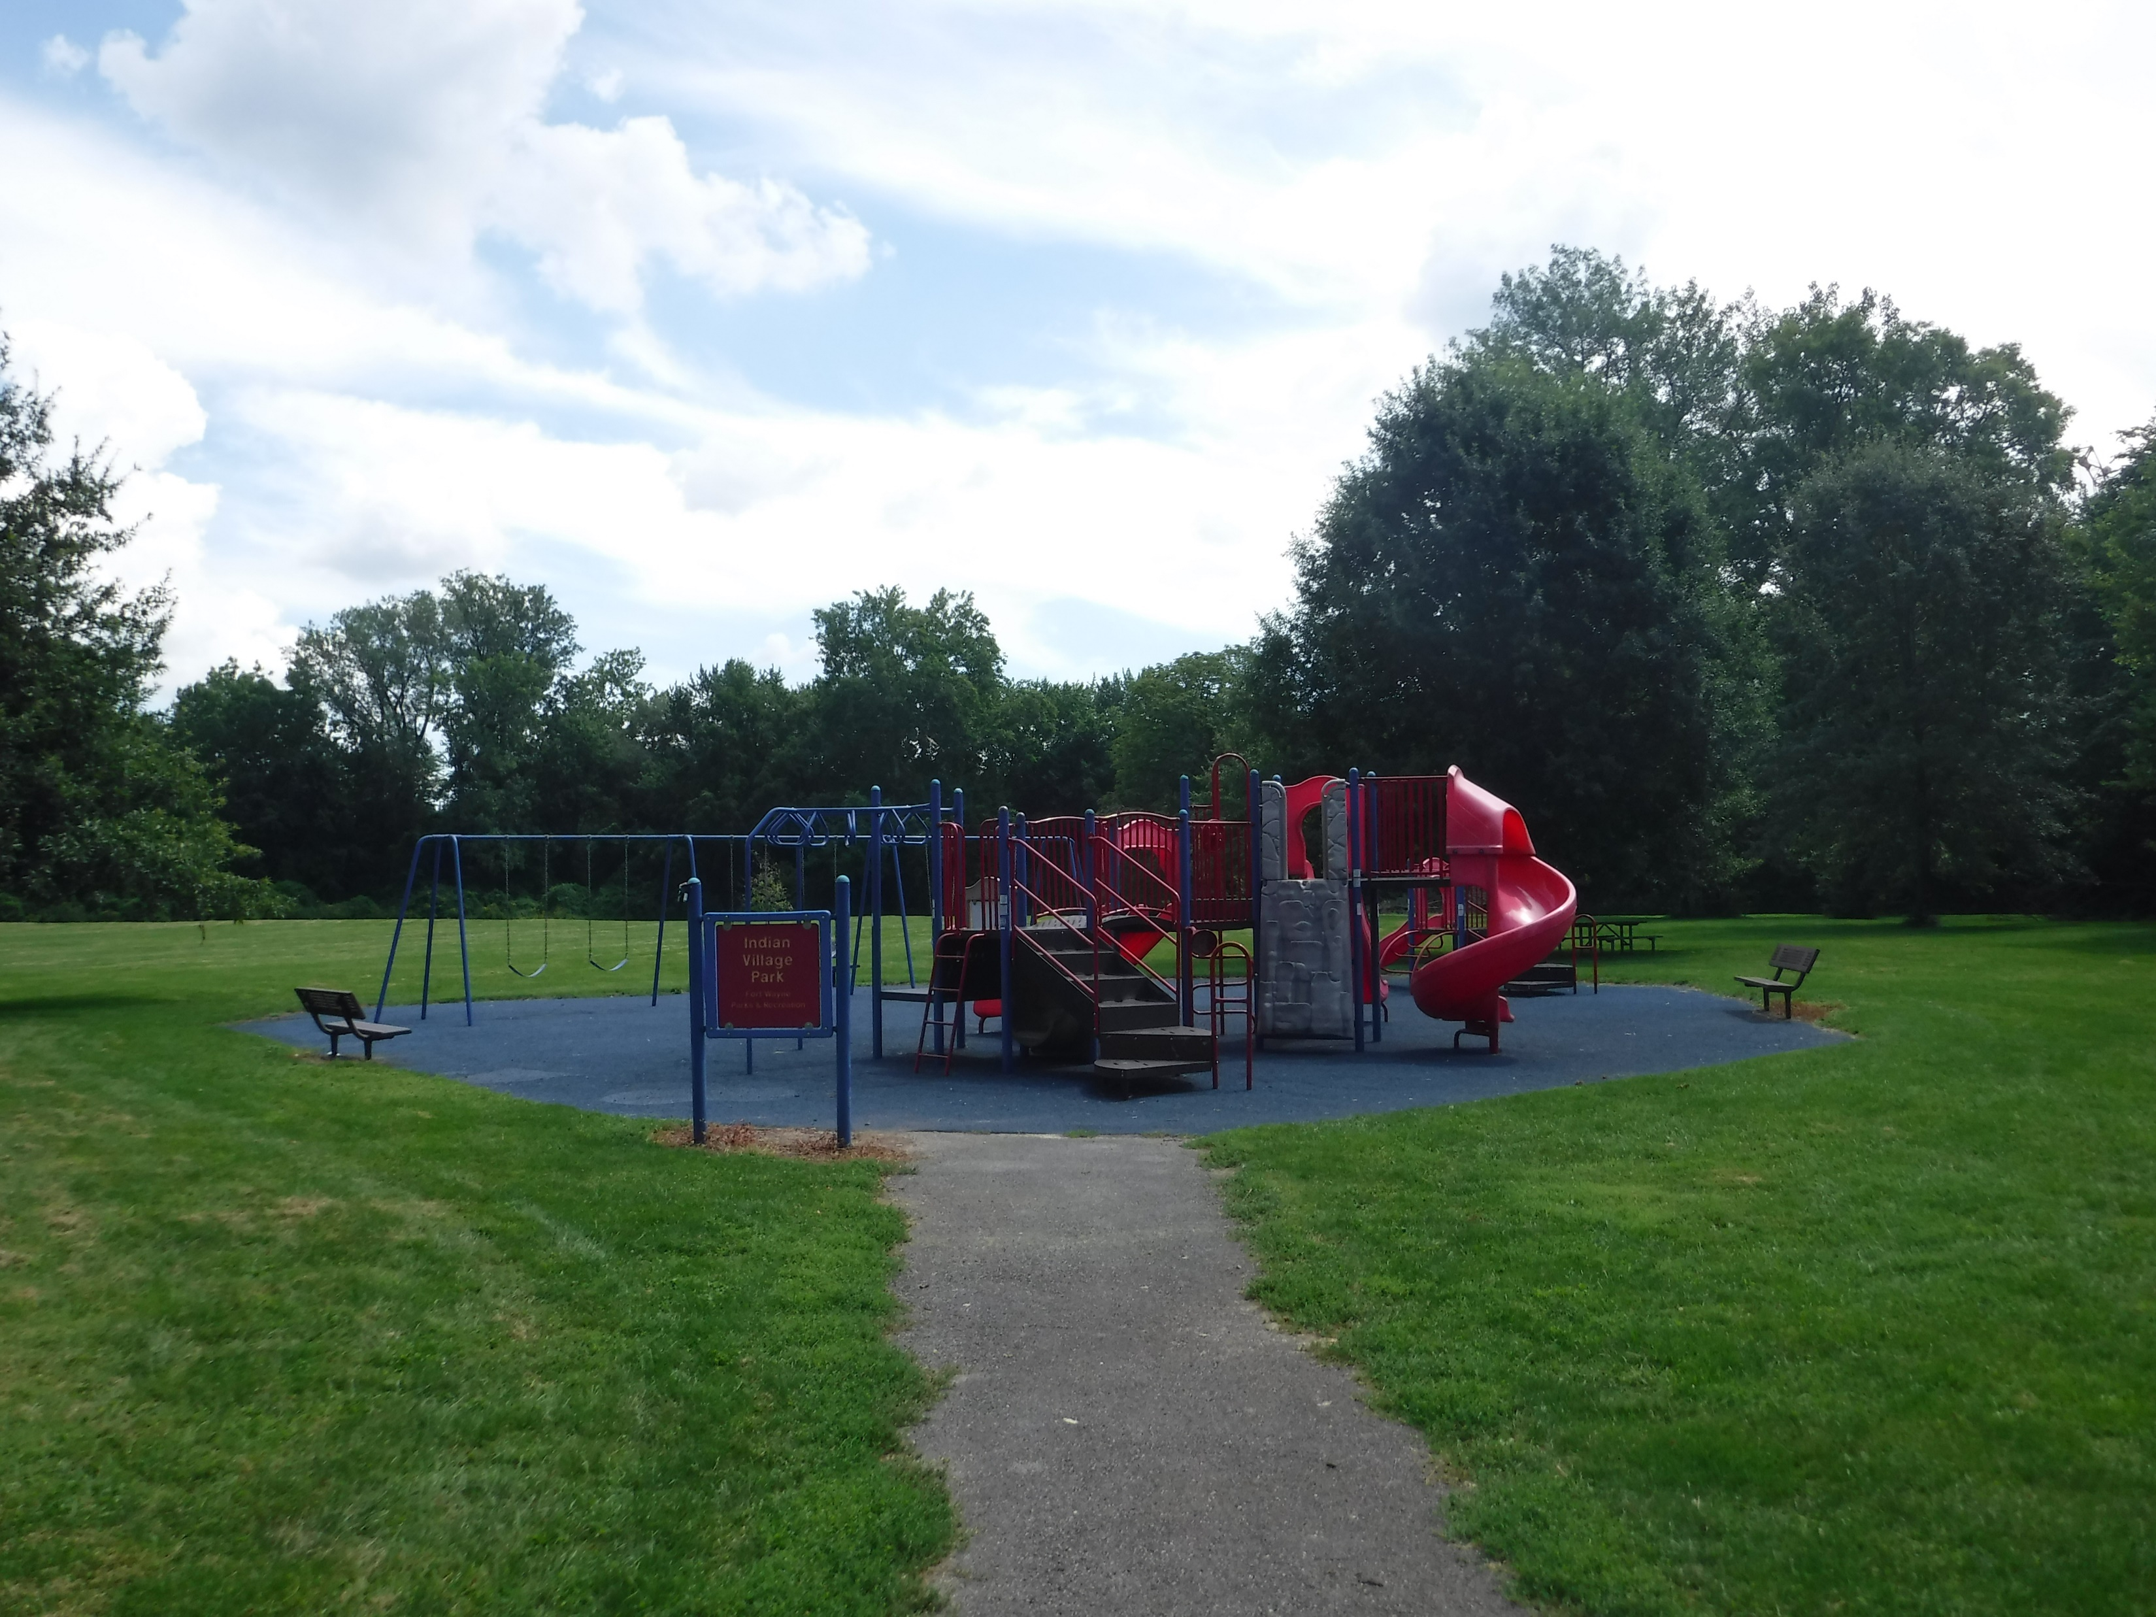
Indian village (sears) park
Since 1930
Size in Acres: 10.0
The riverbank and park strip tracts were transferred to the city in 1930. In 1929 the Board built a footbridge between Foster Park and land to be known as Indian Village Park. The site was once the home of the Allen County Orphan’s Home and one of the brick buildings may be associated with that endeavor. Sears Roebuck and Company offered to build the pavilion that is located in Indian Village Park for the city in the early 1940's with the understanding that the city would assume control and maintenance of the building after construction. Today that pavilion is known as Sears Pavilion. For a period of time, part of the pavilion was rented as an apartment. The park contains the pavilion, a playground, and a storage barn.

Slide 9
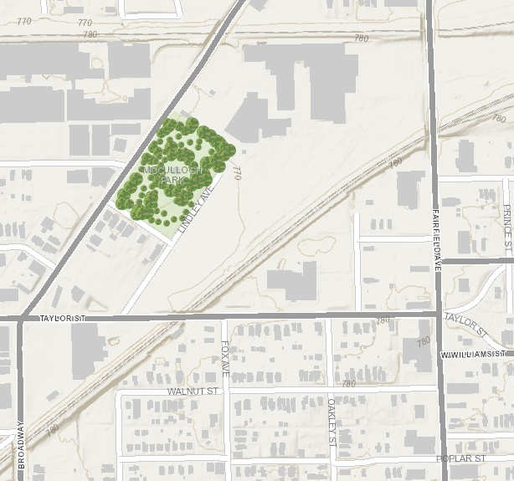
McULLOCH park
1700 Broadway St.

Slide 10
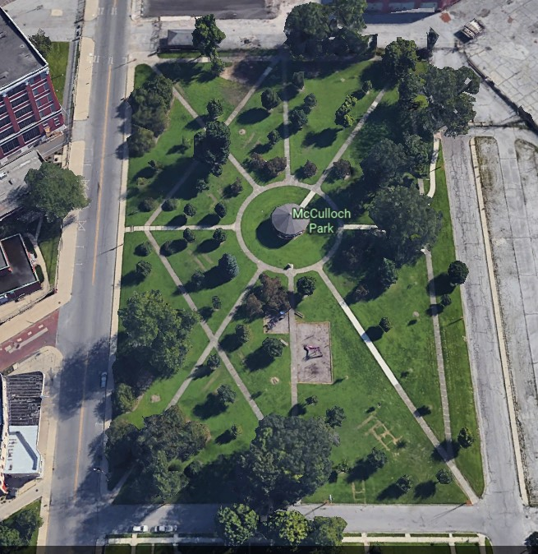
mcculloch park
Since 1864
Size in Acres: 4.1
Broadway St.
Lindley Ave.
Parkview Ave.

Slide 11
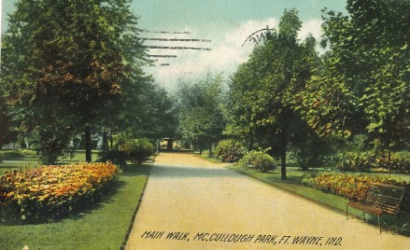
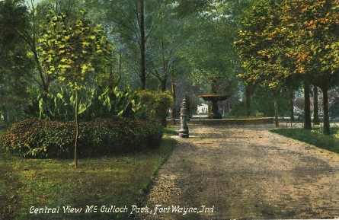
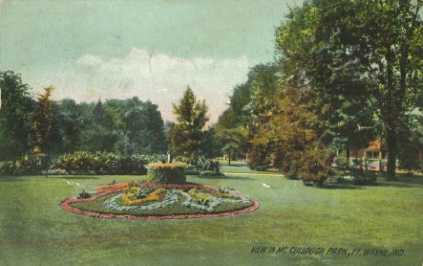
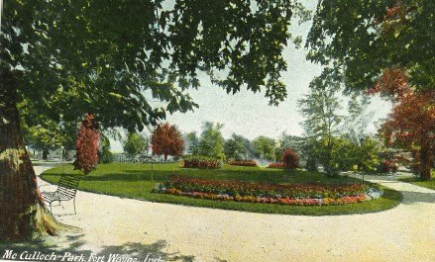
McCULLOCH PARK
History: McCulloch Park was acquired from Hugh McCulloch, a Fort Wayne resident and treasury secretary under Presidents Abraham Lincoln and Ulysses S. Grant. The donated land was used as a public cemetery until those buried there were relocated to Lindenwood Cemetery. The Park features a historic bandstand and the memorial grave site of Indiana's seventh governor, Samuel Bigger. Governor Bigger remains in his original resting place because he had no family to authorize a reburial.

Slide 12
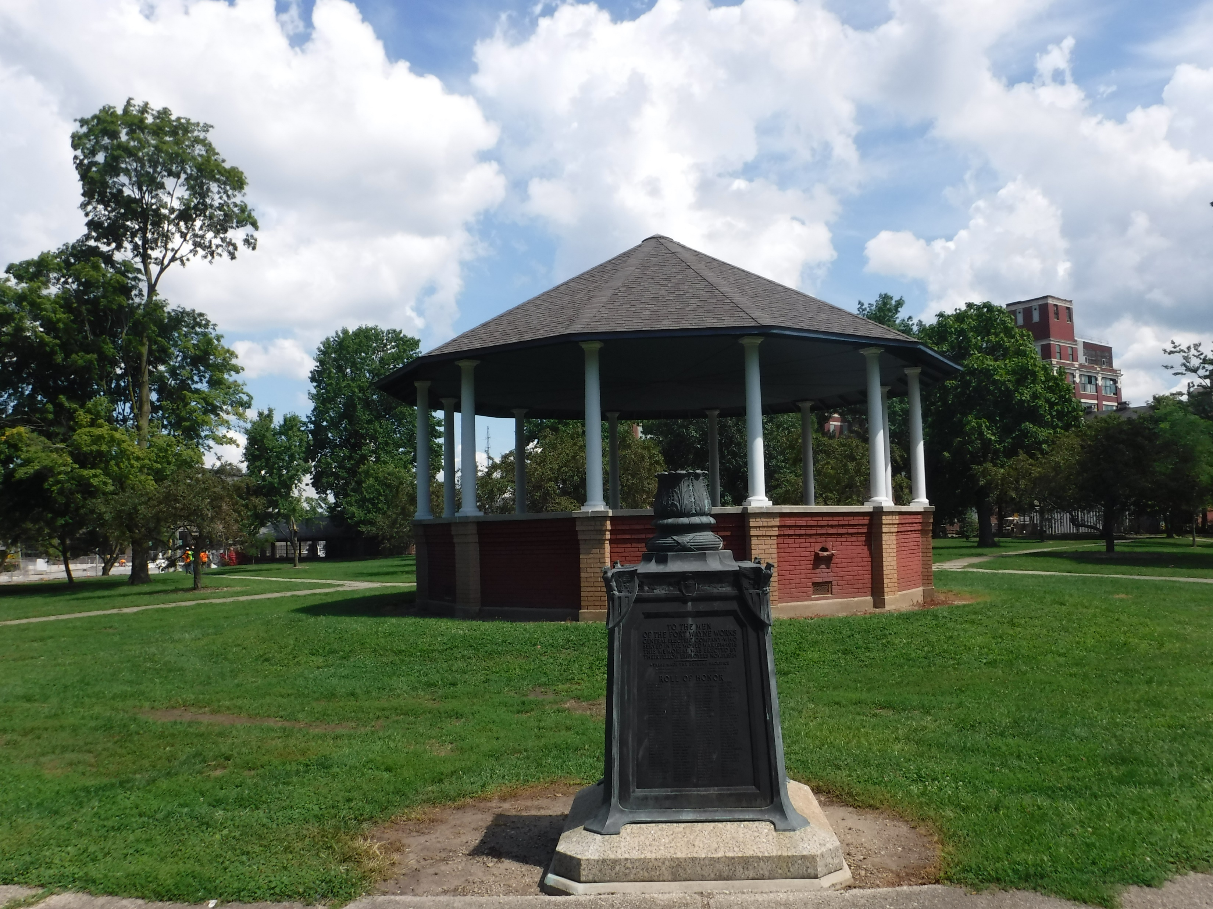
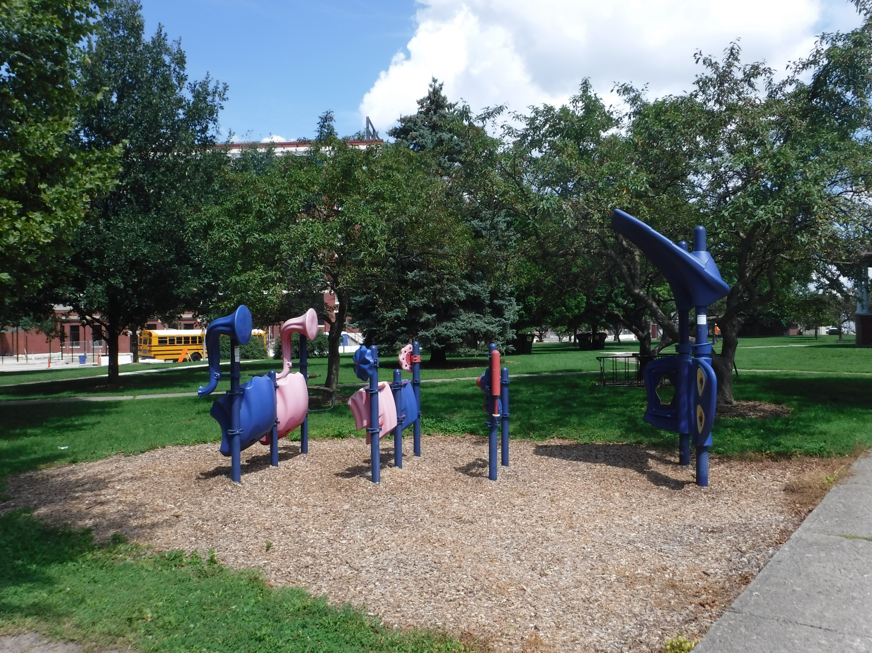
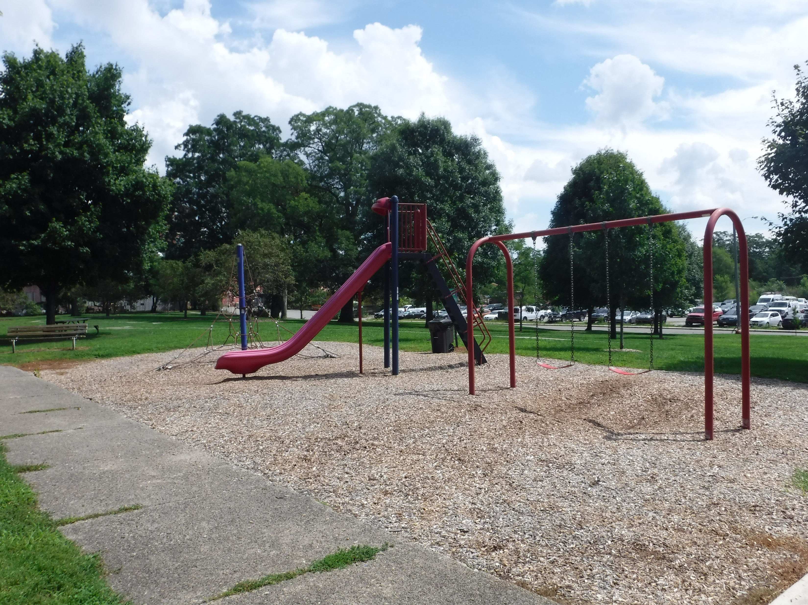
McCULLOCH PARK TODAY
The Park has a beautiful setting with many mature trees, multiple walking paths, a historic bandstand gazebo centrally located alongside a children’s play area which contains a climber, a slide, swings, and musical instruments.

Slide 13
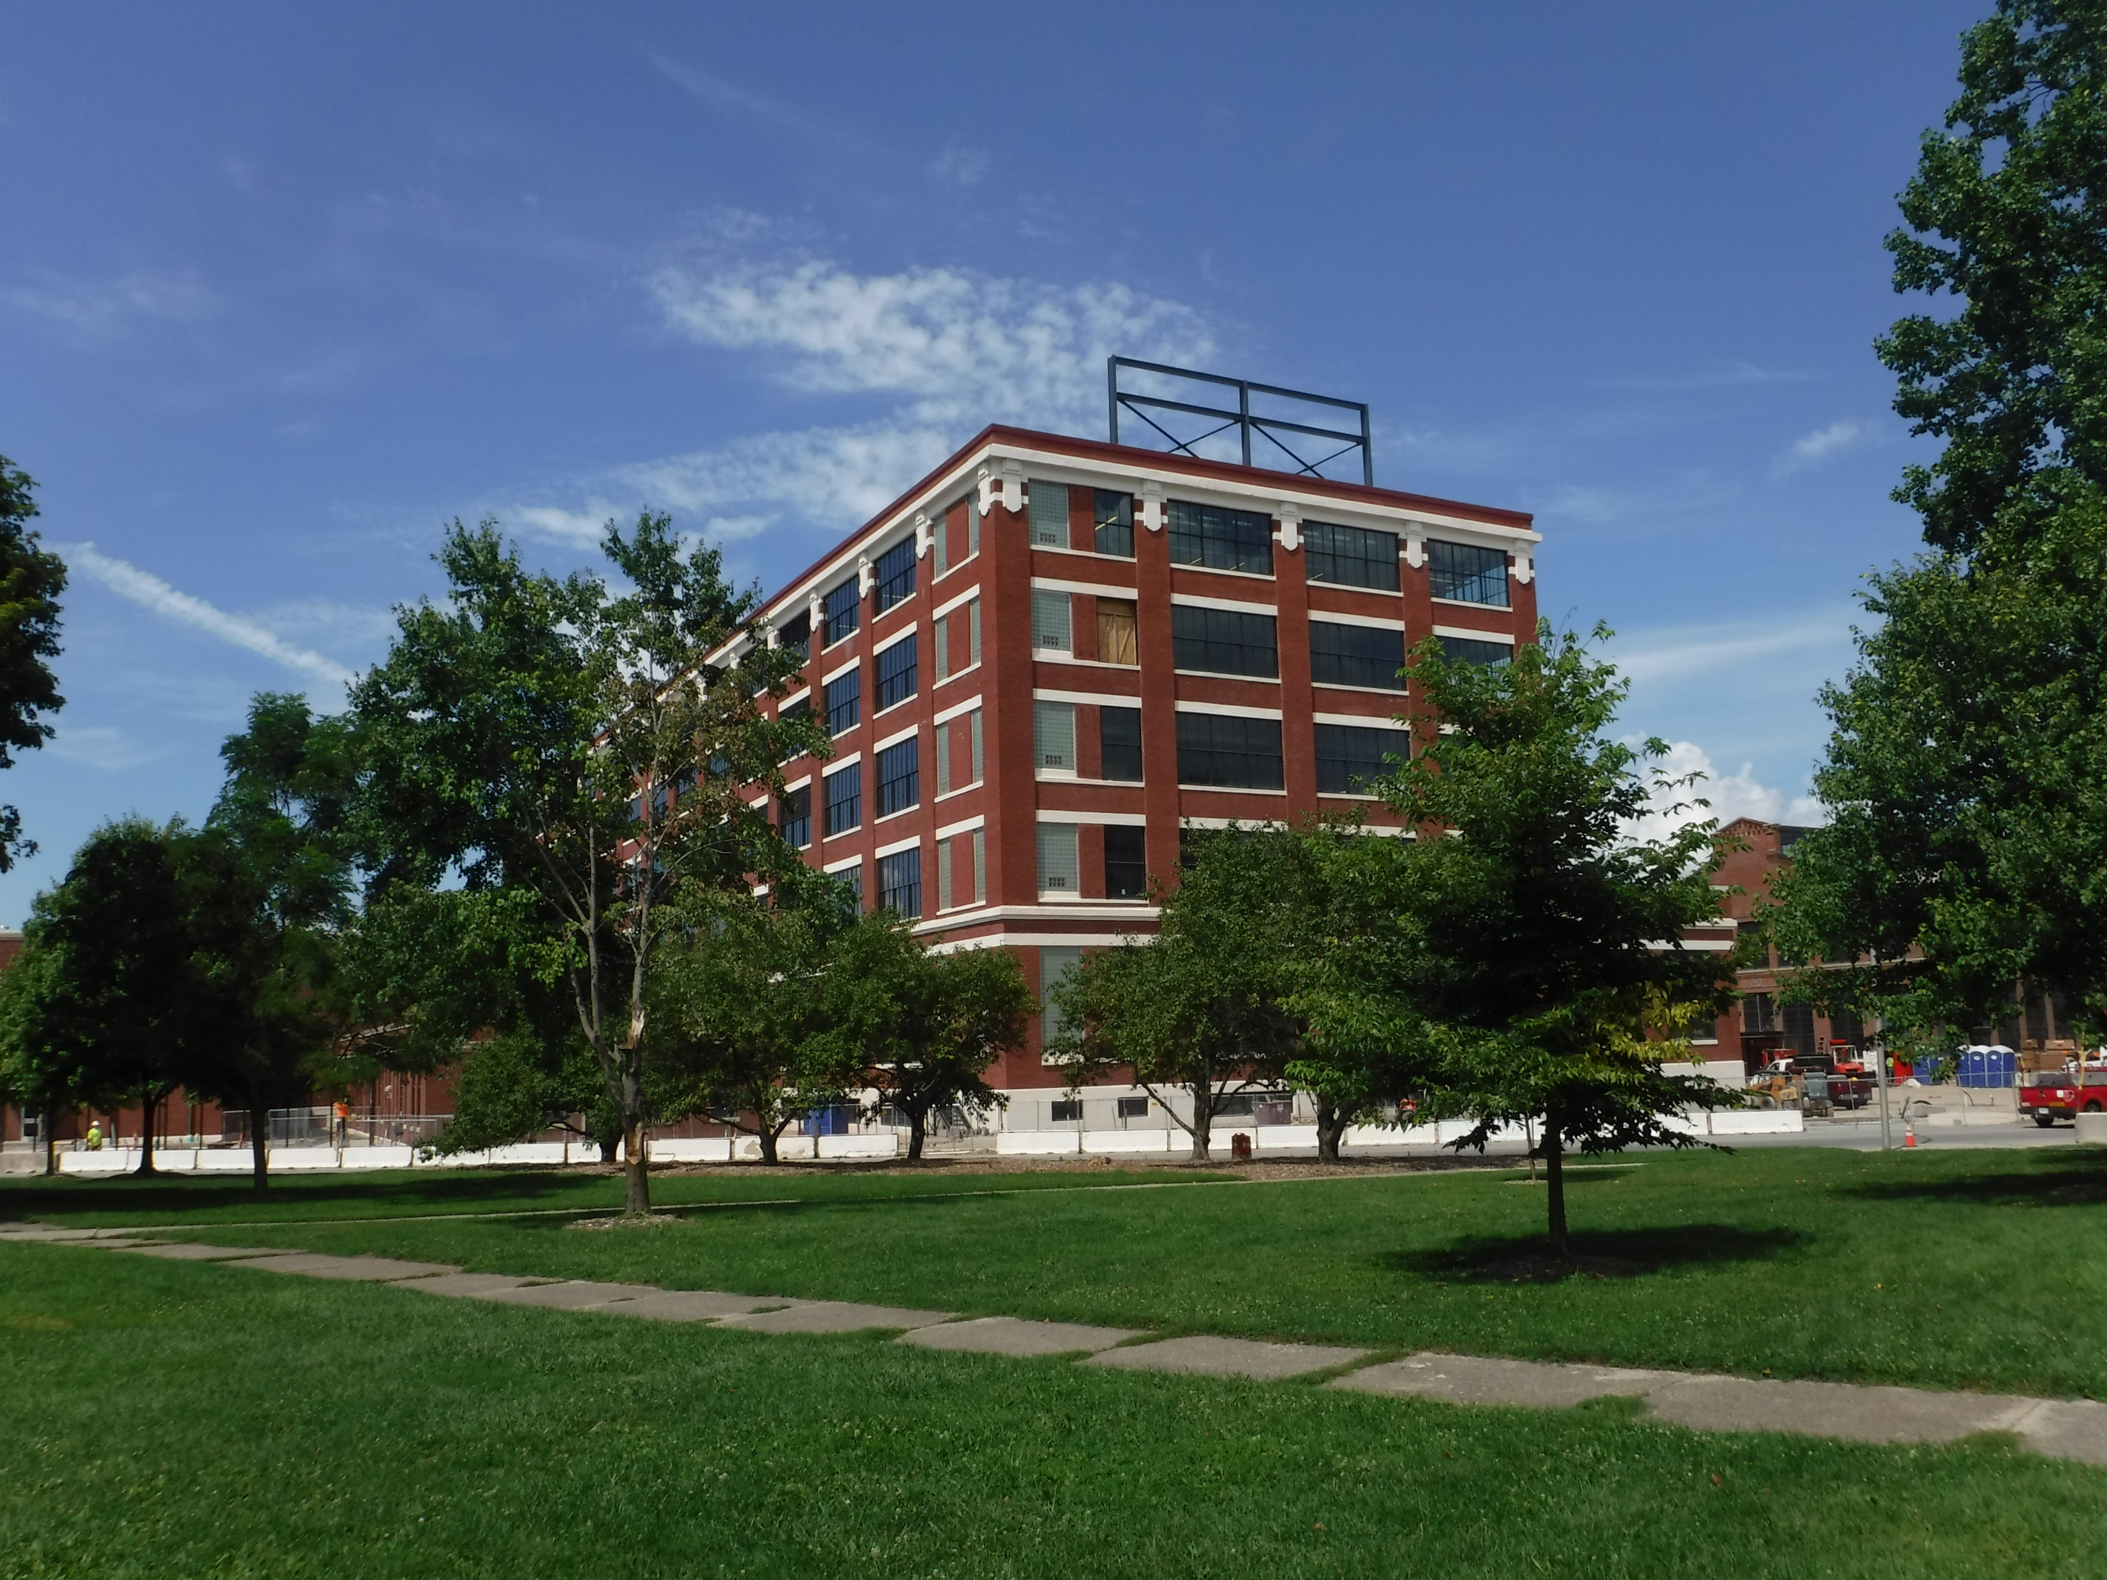
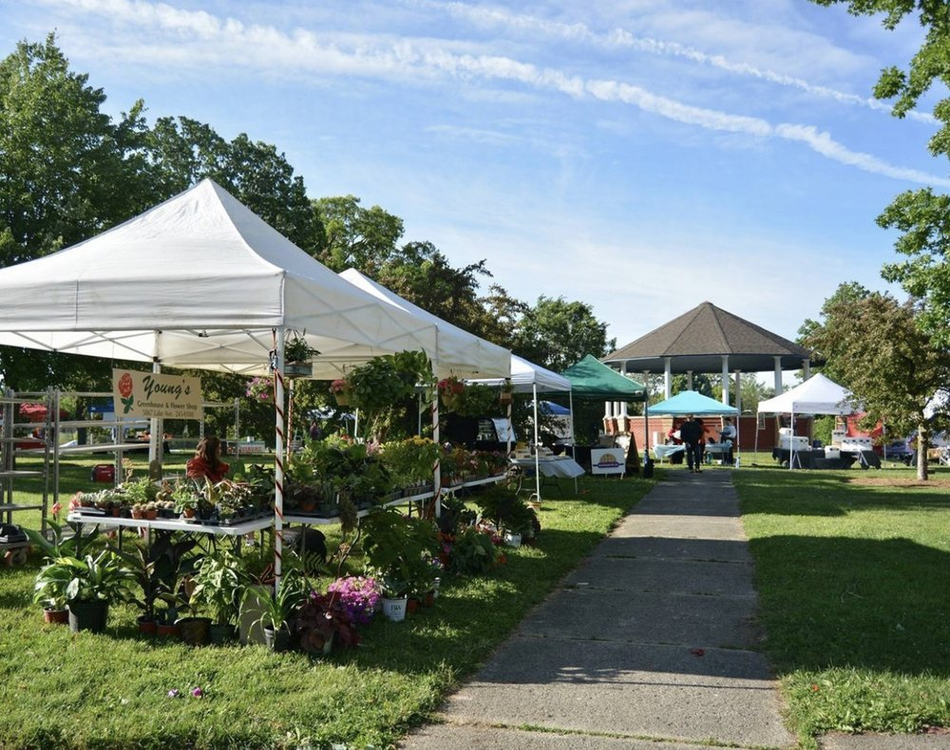
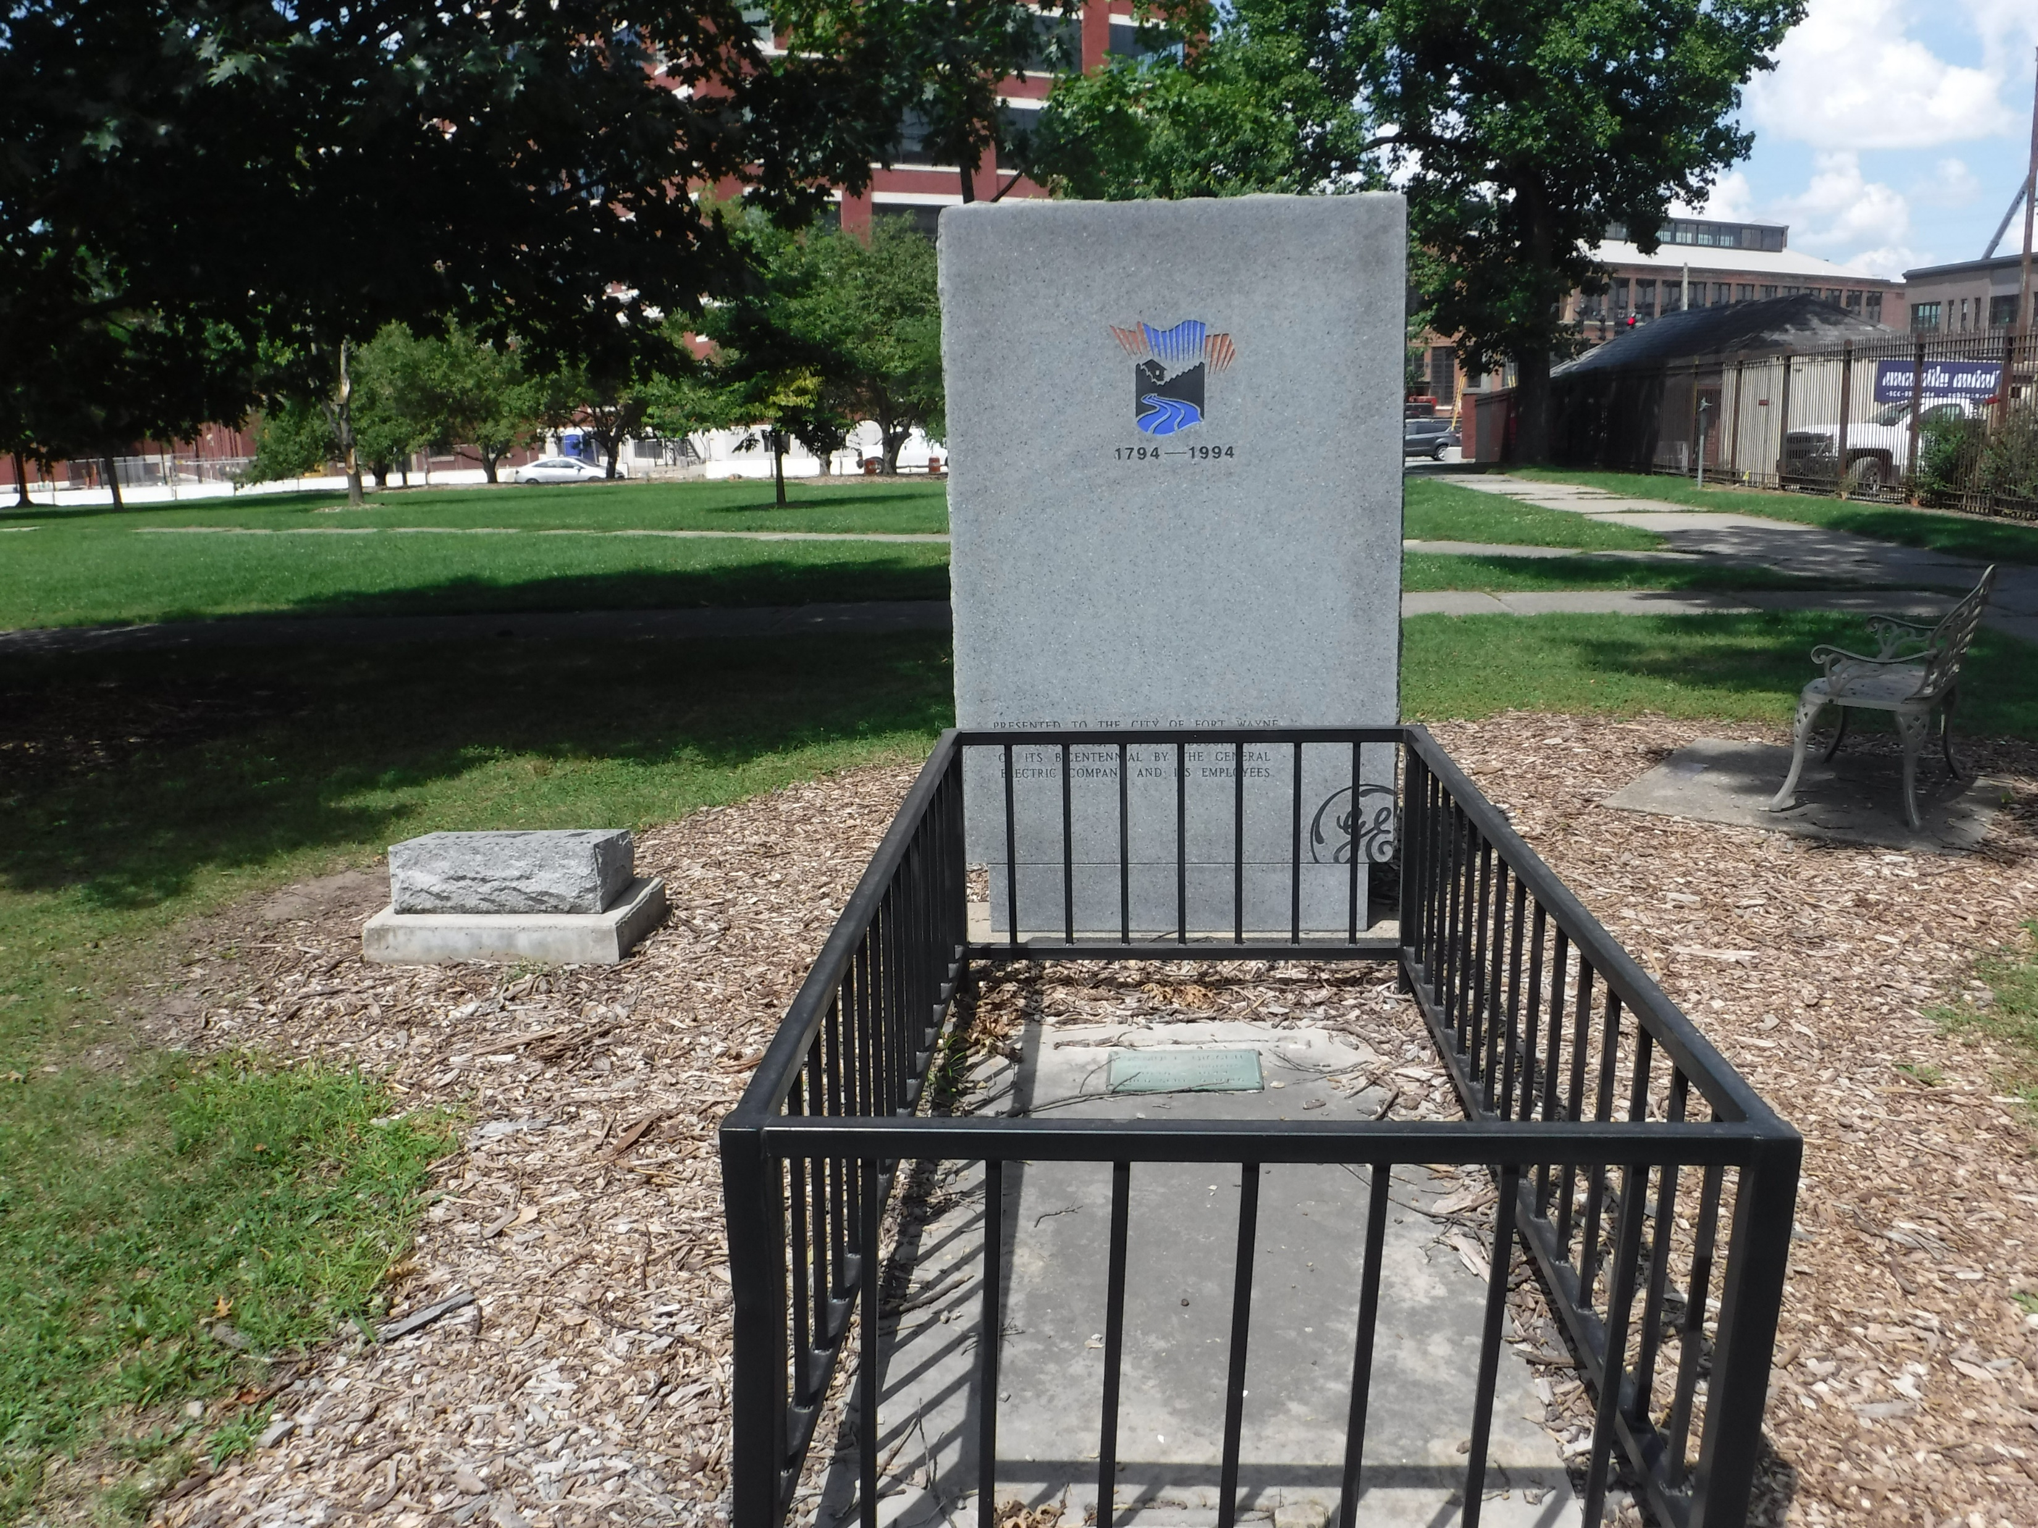
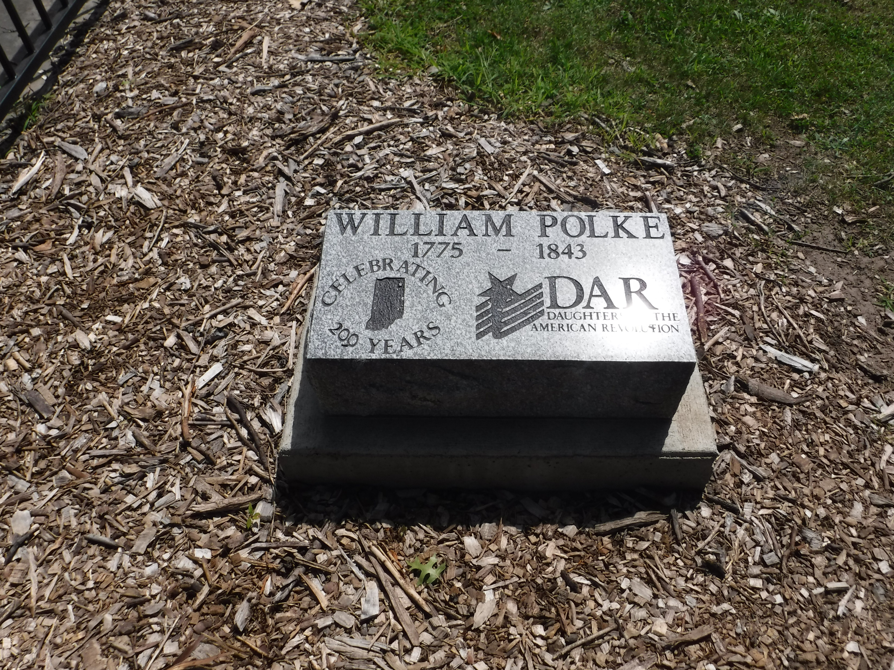
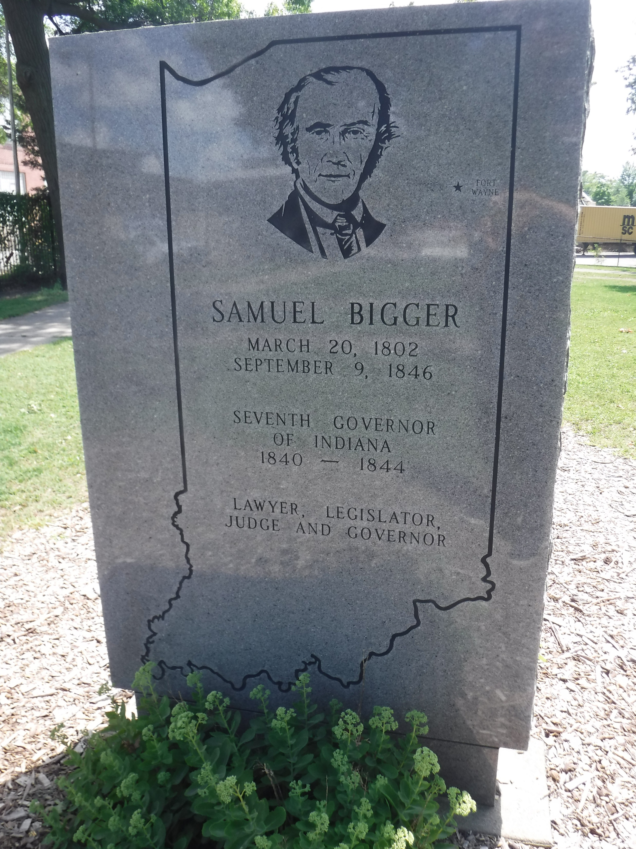
McCULLOCH PARK TODAY
Every Saturday morning during the summer, McCulloch Park gets used for a farmer’s market which lines the walks with tents filled by local vendors providing products from around the region. The park is also surrounded by the former General Electric Company campus which is currently the site of the adventurous Electric Works construction project. Former Indiana governer, Samuel Bigger’s grave and William Polke’s grave marker can be found, along with a monument commemorating former General Electric employees who served in WWI.

Slide 14
Much more to come…

