Slide 1
Building Bridges with youth and partner officers
Chantell Davis
Fort Wayne Parks and Recreation
Community Youth Centers

Slide 2
Determine the Need
Response to a cry for help from community
Homicides taking place right outside window
Prosecutor's Office frustrated – unable to prosecute
Police frustrated – no witnesses
Community terrified of police
Youth afraid of police
Parents afraid of police, fear of retaliation
How to build a relationship?
Increased wave of violence in our neighborhoods

Slide 3
Integrating into our existing core programs
Homework/Enrichment
Snack
Fitness
Open Recreation
Dinner – Kids Café
Core Programming
STEM
Character Development
Arts/Crafts
Cooking
Recreational Sports
Performing Arts
Community Unity Nights

Slide 4
Recruiting Officers
To provide youth and staff with a wealth of positive experiences with police officers
To form positive personal relationships with youth and staff
To form positive personal relationships with parents, grandparents, and other care providers
To encourage youth and their families to see police officers as friends and neighbors
To develop trust between officers, youth, and their families

Slide 5
Daily Youth Engagement
Assisting with homework help
Reading to or with the children
Playing games or sports with children
Helping children with craft projects
Participating in exercise programs with children
Sharing snacks and the evening meal with children (unfortunately the terms of our Kids Café program does not allow us to provide the meal to adults – you are welcome to pack a lunch if you would like)
Participating in occasional field trips with youth to local attractions
Participating in other youth activities taking place at the centers

Slide 6
Making our Case
Commitment to zero tax dollars
Finding the right fit
Pitch meetings
Thank you to:
Community Foundation of Greater Fort Wayne
Lincoln Financial Foundation
M.E. Raker Foundation
Three Rivers Credit Union
Report Out – Honesty is the best policy
Plan for sustainability
Our partners
Fort Wayne Police Department
Fort Wayne United
Ten Point Coalition
Media Sponsor– B96.9

Slide 7
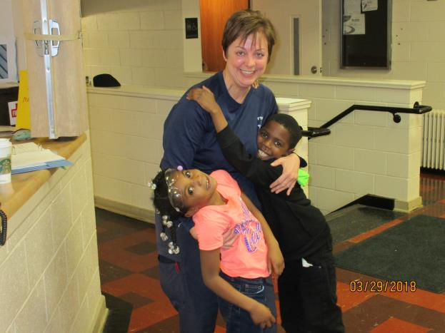
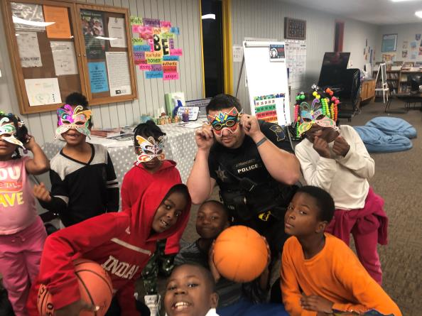
School Success Celebrations

Slide 8
Reflections from an Officer
First Impressions – “Can I do this?”
A Day in the life of a Partner Officer
School Success Celebrations

Slide 9
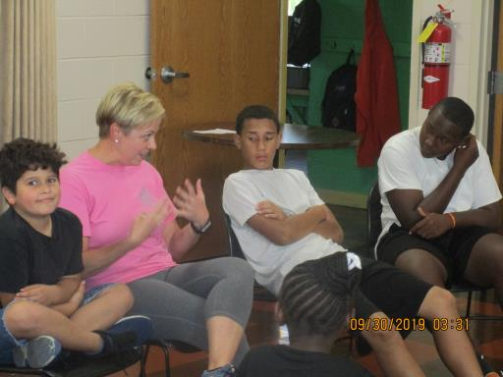
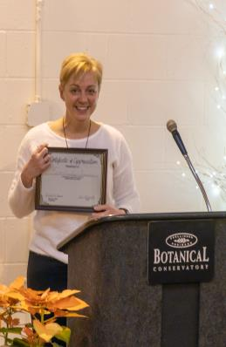
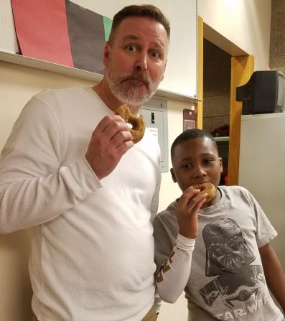
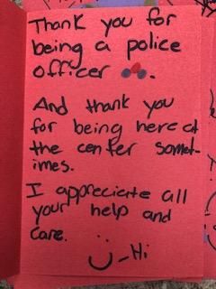
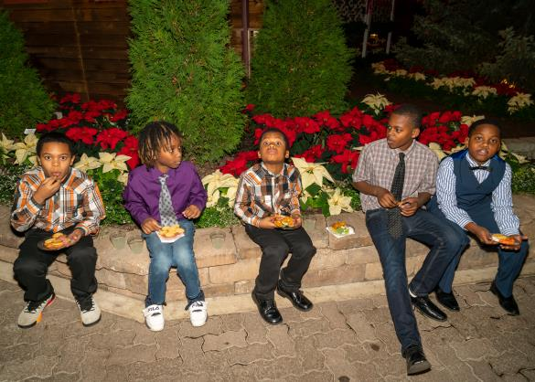
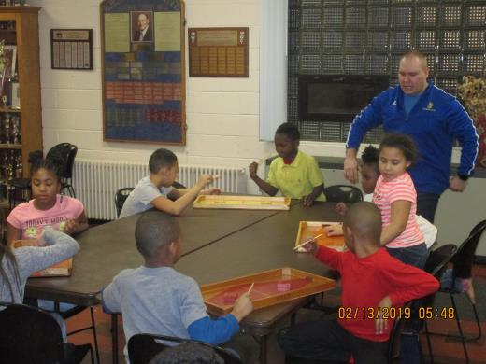
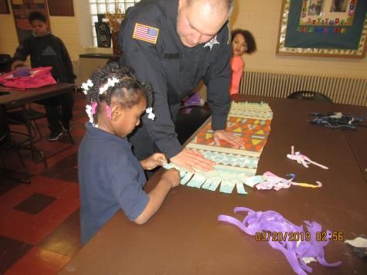
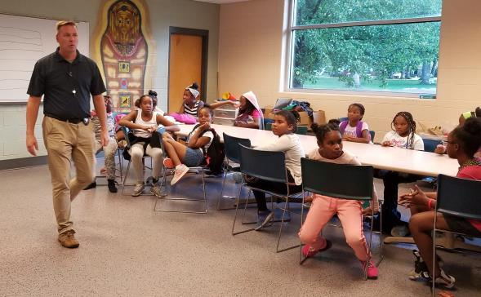

Slide 10
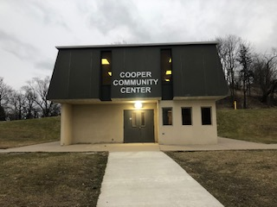
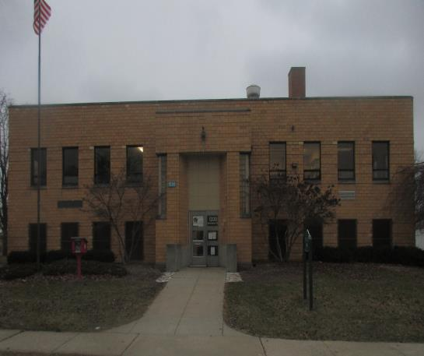
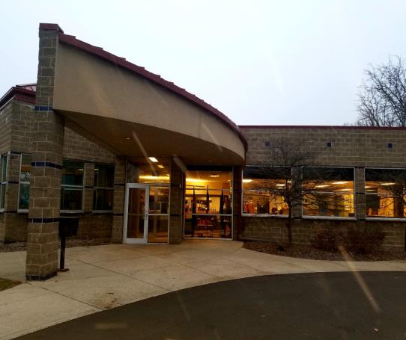
Questions, Answers and Contacts
Ms. Mitch Sheppard, Deputy Director – mitch.sheppard@cityoffortwayne.org
Ms. Chantell Davis, Manager – Chantell.davis@cityoffortwayne.org
Mr. Dmitri Gholston, Program Coordinator – dmitri.gholston@cityoffortwayne.org
Ms. MaKayla Gusching, Cooper Center Supervisor makayla.gusching@cityoffortwayne.org
Mr. Michael Ayers, Jennings Recreation Center Supervisor
michael.ayers@cityoffortwayne.org
Ms. Zynette Paige, Weisser Park Youth Center Supervisor zynette.paige@cityoffortwayne.org

